Slide 1

Exploring Environmental Science for AP®
1st Edition
Chapter 17
Water Pollution
Copyright © 2018 Cengage Learning. All Rights Reserved. May not be copied, scanned, or duplicated, in whole or in part, except for use as permitted in a license distributed with a certain product or service or otherwise on a password-protected website for classroom use.

Slide 2
Core Case Study: The Gulf of Mexico’s Annual Dead Zone (1 of 2)
Spring and summer bring huge inputs of nutrients from the Mississippi River basin
  Explosive growth of phytoplankton that eventually die and are consumed by bacteria
  Depletes oxygen in the Gulf’s bottom layer of water
  Resulting dead zone contains little marine life
  Winter storms redistribute oxygen

Slide 3
Core Case Study: The Gulf of Mexico’s Annual Dead Zone (2 of 2)
Notes:
Figure 20.1 Water containing sediments, dissolved nitrate fertilizers, and other pollutants drains from the Mississippi River basin (top) into the Mississippi River and from there into the northern Gulf of Mexico (bottom). This creates a dead zone with low levels of dissolved oxygen (1–3 ppm), indicated by the dark and light red shaded areas in the bottom figure for 2015.

Slide 4
17.1 What Are the Causes and Effects of Water Pollution?
The chief sources of water pollution are agriculture, industry, and untreated wastewater
Water pollution causes illness and death in humans and other species, and disrupts ecosystems

Slide 5
Water Pollution Comes from Point and Nonpoint Sources (1 of 5)
Water pollution
  Change in water quality that can harm living organisms or make water unfit for human use
Point sources
  Discharge pollutants at specific locations
  Examples: factories, animal feed lots, underground mines, oil wells, and oil tankers
Nonpoint sources
  Broad, diffuse areas
  Rainfall or snowmelt washes pollutants from land into surface water
  Examples: runoff of fertilizers and pesticides from croplands, logged forests, lawns, and golf courses

Slide 6
Water Pollution Comes from Point and Nonpoint Sources (2 of 5)
Leading causes of water pollution
  Agricultural activities
    Sediment eroded from the lands
    Fertilizers, pesticides, and bacteria from livestock and food-processing wastes
  Industrial facilities
  Mining
  Untreated human wastewater
  Plastic

Slide 7
Water Pollution Comes from Point and Nonpoint Sources (3 of 5)
Notes:
Figure 20.2 Point source of water pollution from an industrial plant

Slide 8
Water Pollution Comes from Point and Nonpoint Sources (4 of 5)
Notes:
Figure 20.3 Point source pollution: acid draining from an abandoned open-pit coal mine

Slide 9
Water Pollution Comes from Point and Nonpoint Sources (5 of 5)
Notes:
Figure 20.4 Nonpoint source pollution: sediments in farmland runoff flowing into a stream. By weight, sediment is the largest source of water pollution. Critical thinking: What do you think the owner of this farm could have done to prevent such sediment pollution?

Slide 10
Harmful Effects of Water Pollutants
Most serious threats to stream and lake water quality
  Mercury
  Pathogens from broken sewer pipes
  Sediment from land disturbance and erosion
  Metals
  Nutrients that cause oxygen depletion
Infectious disease organisms
  Contaminated drinking water
  An estimated 1.6 million people die every year

Slide 11
TABLE 17.1 Major Water Pollutants and Their Sources (1 of 2)
Type/Effects | Examples | Major Sources
Infectious agents (pathogens) Cause diseases | Bacteria, viruses, protozoa, parasites | Human and animal wastes
Oxygen-demanding wastes Deplete dissolved oxygen needed by aquatic species | Biodegradable animal wastes and plant debris | Sewage, animal feedlots, food-processing facilities, paper mills
Plant nutrients Cause excessive growth of algae and other species | Nitrates (NO3) and phosphates (PO431-) | Sewage, animal wastes, inorganic fertilizers
Organic chemicals Add toxins to aquatic systems | Oil, gasoline, plastics, pesticides, cleaning solvents | Industry, farms, households
Inorganic chemicals Add toxins to aquatic systems | Acids, bases, salts, metal compounds | Industry, households, surface runoff, mining sites
Notes:
Table 20.1 Major water pollutants and their sources

Slide 12
TABLE 17.1 Major Water Pollutants and Their Sources (2 of 2)
Sediments Disrupt photosynthesis, food webs, other processes | Soil, silt | Land erosion
Heavy metals Cause cancer, disrupt immune and endocrine systems | Lead, mercury, arsenic | Unlined landfills, household chemicals, mining refuse, industrial discharges
Thermal Make some species vulnerable to disease | Heat | Electric power and industrial plants
Notes:
Table 20.1 Major water pollutants and their sources

Slide 13
17.2 What Are the Major Pollution Problems in Streams and Lakes?
Many streams and rivers around the world are polluted
  Can cleanse themselves of biodegradable wastes if we do not overload them or reduce their flows
Adding excessive nutrients to lakes from human activities can disrupt ecosystems
Preventing pollution more effective and less costly than cleaning it up

Slide 14
Stream Pollution in More-Developed Countries
1970s: water pollution control laws
Successful water clean-up
  Ohio Cuyahoga River, U.S.
  Driven by bottom-up pressure from citizens
EPA estimate: mining wastes pollute 40 percent of headwaters of western watersheds
Ohio River: most polluted river in the United States

Slide 15
Stream Pollution in Less-Developed Countries (1 of 2)
Half of the world’s 500 major rivers are polluted
  Untreated sewage
  Industrial waste
Water often used for human activities
Nearly half of China’s rivers too toxic to touch or drink
  Liver and stomach cancer linked to water pollution among leading causes of death

Slide 16
Stream Pollution in Less-Developed Countries (2 of 2)
Notes:
Figure 20.7 Hindu people in India washing themselves in a river as a part of their daily holy ritual. They also use the river to wash their clothes, and it is polluted with animal and human wastes.

Slide 17
Critical Concept: Oxygen Sag Curves (1 of 2)
Flowing rivers or streams can dilute organic pollutants and heated water unless overloaded
Does not eliminate heavy metals or slowly degradable pollutants
Oxygen sag curve is created when degradable pollutants are emitted and bacteria act to decompose the waste

Slide 18
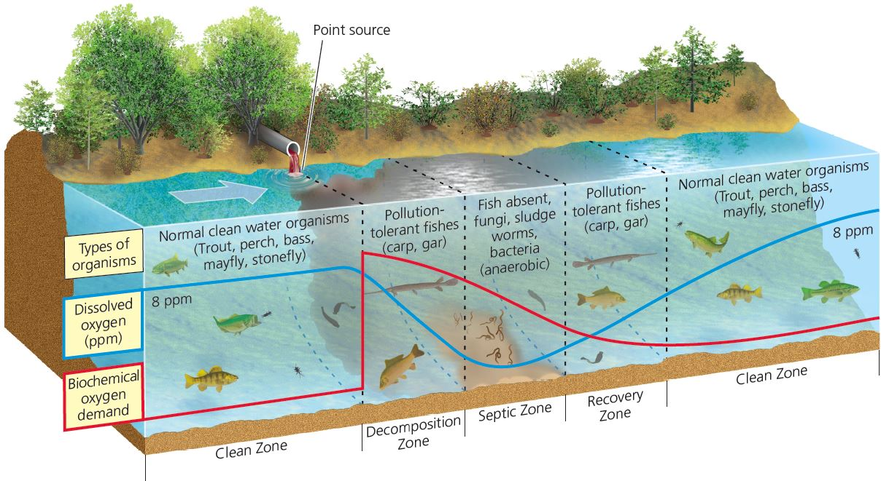
Critical Concept: Oxygen Sag Curves (2 of 2)
A stream can dilute and decay degradable, oxygen-demanding wastes and also dilute heated water. This figure shows the oxygen sag curve (blue) and the curve of oxygen demand (red).

Slide 19
Pollution of Lakes and Reservoirs
Lakes and reservoirs less effective at diluting pollutants than streams
  Stratified layers with little vertical mixing
  Little or no water flow
  Can take up to 100 years to flush and change the water in a lake
  Biological magnification of pollutants

Slide 20
Cultural Eutrophication: Too Much of a Good Thing (1 of 3)
Eutrophication
  Natural enrichment of a shallow lake, river mouth, or slow-moving stream
  Caused by runoff of plant nutrients such as nitrates and phosphates
Oligotrophic lake
  Low nutrients
  Clear water
Cultural eutrophication
  Nitrates and phosphates from human sources
    Farms, feedlots, streets, parking lots, lawns, mining sites, and sewage plants

Slide 21
Cultural Eutrophication: Too Much of a Good Thing (2 of 3)
During hot weather or drought
  Dense growths of algae and cyanobacteria
  Oxygen depleted by bacteria that decompose the algae
Prevent or reduce cultural eutrophication
  Remove nitrates and phosphates
  Recycle nutrients into the soil
Methods to clean up lakes
  Remove excess weeds
  Use herbicides and algaecides
  Pump in air
  Most lakes will recover if excessive input of nutrients is stopped

Slide 22
Cultural Eutrophication: Too Much of a Good Thing (3 of 3)
Notes:
Figure 20.8 Severe cultural eutrophication of Chao Lake in China.

Slide 23
Case Study: Pollution in the Great Lakes (1 of 4)
1960s: many areas with cultural eutrophication, fish kills, and contamination
1972: Great Lakes Water Quality Agreement
  New or upgraded sewage treatment plants
  Decreased algal blooms
  Increased dissolved oxygen levels
  Increased fishing catches

Slide 24
Case Study: Pollution in the Great Lakes (2 of 4)
Notes:
Figure 20.9 The five Great Lakes of North America make up the world’s largest freshwater system.

Slide 25
Case Study: Pollution in the Great Lakes (3 of 4)
Bans on phosphate-containing household cleaners
Many problems remain
  Increasing nonpoint runoff of pesticides and fertilizers greatest threat
  Atmospheric deposition of pesticides, mercury, and other chemicals
    From as far away as Mexico and Russia
  25% of fish had unsafe mercury content

Slide 26
Case Study: Pollution in the Great Lakes (4 of 4)
Great Lakes Restoration Initiative
  $1.3 billion provided between 2010 and 2015
  Focused on reducing toxic pollution, cultural eutrophication, loss of wildlife habitat, invasive species, and soil erosion into lakes
  Promotes wetlands restoration
Prevention approach
  Call for ban on toxic chlorine compounds used in pulp and paper industry

Slide 27
Gulf of Mexico Dead Zone: A Closer Look
Level of nitrates discharged from Mississippi River into Gulf of Mexico tripled since 1950s
  Causes severe depletion of dissolved oxygen
Food web disruption
  Many species cannot migrate away from area and die
    Causes deaths of seabird and marine mammal species that depend on dying fish and shellfish
Human factors
  Dredging and straightening increases flow of nutrients
  Removal of wetlands that act as filters for pollutants

Slide 28
17.3 What Are the Major Groundwater Pollution Problems?
Chemicals used in agriculture, industry, transportation, and homes spill and leak into groundwater
Protecting groundwater through pollution prevention
  Least expensive and most effective strategy

Slide 29
Groundwater Cannot Cleanse Itself Very Well (1 of 2)
Aquifers: drinking water source for about half the U.S. population
Common pollutants
  Fertilizers and pesticides
  Gasoline
  Organic solvents
  Fracking
Slower chemical reactions in groundwater due to:
  Slow flow–contaminants not diluted
  Less dissolved oxygen
  Fewer decomposing bacteria
  Cold temperatures

Slide 30
Groundwater Cannot Cleanse Itself Very Well (2 of 2)
Notes:
Figure 20.11 Natural capital degradation: Principal sources of groundwater contamination in the United States. Another source in coastal areas is saltwater intrusion from excessive groundwater withdrawal. (Figure is not drawn to scale.) Critical thinking: What are three contamination sources in the figure that might be affecting groundwater in your area?

Slide 31
Groundwater Pollution Is a Hidden Threat (1 of 2)
China: 90% of shallow groundwater is polluted
  About 37% so polluted it cannot be treated for use as drinking water
Liquid hazardous wastes are injected into ground in disposal wells in the United States
EPA cleaning up leaking underground storage tanks
Slowly degradable wastes
  Can take decades to thousands of years to clear
Non-biodegradable wastes
  Remain in the water permanently
Prevention is the most effective solution

Slide 32
Groundwater Pollution Is a Hidden Threat (2 of 2)
Notes:
Figure 20.13 We can clean up contaminated groundwater, but prevention is the only effective approach. Critical thinking: Which two of these preventive solutions do you think are the most important? Why?

Slide 33
Case Study: Arsenic in Drinking Water
Arsenic-rich rocks can contaminate wells
  Long-term exposure likely to cause skin, lung, and bladder cancer
  Levels especially high in Bangladesh, China, India’s state of West Bengal, and parts of northern Chile
Treatment approach: rust nanoparticles removed with magnet

Slide 34
Purifying Drinking Water
Reservoirs and purification plants
Process sewer water to drinking water
Expose clear plastic containers to intense sunlight (UV) to kill infectious microbes
The LifeStraw filters viruses and parasites

Slide 35
Case Study: Is Bottled Water a Good Option?
Bottled water can be useful but expensive
The United States has some of the world’s cleanest drinking water
Bottled water takes huge energy inputs and creates environmental problems
  67 million plastic water bottles discarded daily in the United States
  Most end up in landfills

Slide 36
Using Laws to Protect Drinking Water Quality
1975: U.S. Safe Drinking Water Act
  Sets maximum contaminant levels for any pollutants that affect human health
  Health scientists recommend strengthening the law
  Various industries have lobbied to weaken the law
Less-developed countries: laws do not exist or are not enforced

Slide 37
Case Study: Lead in Drinking Water
2014: residents of Flint, Michigan were exposed to dangerous levels of lead in tap water
  Officials began withdrawing water from Flint River instead of Lake Huron
  Failed to add chemicals to reduce leaching from lead pipes
  Public outcry resulted in water source switched back to Lake Huron

Slide 38
17.4 What Are the Major Ocean Pollution Problems?
Most ocean pollution originates on land
  Oil and other toxic chemicals
  Solid waste
  Threats to fish and wildlife
    Disrupt marine ecosystems
Key to protecting the oceans
  Reduce pollution flow from land and air and from streams emptying into ocean waters

Slide 39
Ocean Pollution Is a Growing Problem (1 of 2)
Municipal sewage from less-developed countries often dumped into oceans without treatment
  Overwhelms coastal waters’ ability to degrade wastes
Deeper ocean waters
  Dilution
  Dispersion
  Degradation
U.S. coastal waters
  Raw sewage–viruses
  Sewage and agricultural runoff: NO₃– and PO₄^{3–}
  Harmful algal blooms
  Oxygen-depleted zones

Slide 40
Ocean Pollution Is a Growing Problem (2 of 2)
Notes:
Figure 20.15 Natural capital degradation: Residential areas, factories, and farms all contribute to the pollution of coastal waters. Critical thinking: What do you think are the three worst pollution problems shown here? For each one, how does it affect two or more of the ecosystem and economic services listed in Figure 8.4?

Slide 41
Case Study: Ocean Garbage Patches: There Is No Away (1 of 2)
North Pacific Garbage Patch
  Two rotating gyres
    Particles float on or just beneath the water surface
  80% of this trash comes from the land
Tiny plastic pieces harmful to wildlife
  Hazardous chemicals move through the food chain
No practical way to clean up
  Best approach: prevent growth by reducing production of solid wastes

Slide 42
Case Study: Ocean Garbage Patches: There Is No Away (2 of 2)
Notes:
Figure 20.16 The North Pacific Garbage Patch is actually two vast, slowly swirling masses of small plastic particles floating just under the water. Five other huge garbage patches have been discovered in the world’s other major oceans.

Slide 43
Ocean Pollution from Oil (1 of 3)
Crude and refined petroleum
  From natural sources and human activities
Urban and industrial runoff from land
  Largest source of ocean oil pollution from human activities
Prominent pollution accidents
  1989: Exxon Valdez, oil tanker
  2010: BP Deepwater Horizon in the Gulf of Mexico
Volatile organic hydrocarbons
  Kill many aquatic organisms

Slide 44
Ocean Pollution from Oil (2 of 3)
Tar-like globs on the ocean’s surface
  Coat animals’ fur and feathers
    Animals drown or die from loss of body heat
Heavy oil components sink
  Smother bottom-dwelling organisms
Faster recovery in warm water with rapid currents
  In cold, calm waters recovery can take decades
Current cleanup methods
  Recover up to only 15% of oil from a major spill
Methods of preventing oil spills
  Double-hulled tankers

Slide 45
Ocean Pollution from Oil (3 of 3)
Notes:
Figure 20.17 The Deepwater Horizon drilling platform, located 64 kilometers (40 miles) off the coast of Louisiana, exploded, burned, and sank in the Gulf of Mexico on April 20, 2010.

Slide 46
Case Study: The BP Deepwater Horizon Oil-Rig Spill
Spill from deep-sea oil drilling
  Released 3.1 million barrels of crude oil before well was capped
  Contaminated vast areas of coastline
  Caused by equipment failure and poor decisions
Government developed new standards for offshore drilling procedures

Slide 47
17.5 How Can We Deal with Water Pollution?
Reducing water pollution
  Prevent it
  Work with nature to treat sewage
  Use natural resources more efficiently

Slide 48
Reducing Ocean Water Pollution (1 of 2)
Reduce flow of pollution from land
  Land-use
  Air pollution
  Linked to energy and climate policy

Slide 49
Reducing Ocean Water Pollution (2 of 2)
Notes:
Figure 20.19 Methods for preventing excessive pollution of coastal waters and methods for cleaning it up. Critical thinking: Which two of these solutions do you think are the most important? Why?

Slide 50
Reducing Water Pollution from Nonpoint Sources
Methods to reduce pollution
  Use soil conservation methods
  Use fertilizers that release nutrients slowly
    Do not use on steeply sloped land
  Reduce use and runoff of plant nutrients and pesticides
  Plant buffer zones of vegetation
  Set discharge standards for nitrate chemicals from sewage treatment and industrial plants

Slide 51
Case Study: Reducing Water Pollution in the United States
1972/1977: Clean Water Act
1972: Marine Protection, Research, and Sanctuaries Act
1975/1996: Clean Drinking Water Act
1976: Toxic substances Control Act
1980: Comprehensive Environmental Response Compensation and Liability Act (CERCLA)
1987: Water Quality Act
1990: Oil Pollution Act
Experimenting with a discharge trading policy that uses market forces
What are some achievements of the Clean Water Act?

Slide 52
Sewage Treatment Reduces Water Pollution (1 of 4)
Septic tanks used in rural areas
Wastewater or sewage treatment plants
  Primary sewage treatment
    Physical process
  Secondary sewage treatment
    Biological process using bacteria
  Tertiary or advance sewage treatment
    Special filtering processes
    Bleaching and disinfection

Slide 53
Sewage Treatment Reduces Water Pollution (2 of 4)
Many cities violate federal standards for sewage treatment plants
  Federal law requires primary and secondary treatment
    Exemptions from secondary treatment
Health risks result from swimming in water with blended sewage wastes

Slide 54
Sewage Treatment Reduces Water Pollution (3 of 4)
Notes:
Figure 20.21 Solutions: Septic tank systems are often used for disposal of domestic sewage and wastewater in rural and suburban areas.

Slide 55
Sewage Treatment Reduces Water Pollution (4 of 4)
Notes:
Figure 20.22 Solutions: Primary and secondary sewage treatment systems help to reduce water pollution. Critical thinking: What do you think should be done with the sludge produced by sewage treatment plants?

Slide 56
Improving Conventional Sewage Treatment
Remove toxic wastes before water goes to municipal sewage treatment plants
Reduce or eliminate use and waste of toxic chemicals
Use composting toilet systems
Wetland-based sewage treatment systems
  Work with nature

Slide 57
Sustainable Ways to Reduce and Prevent Water Pollution (1 of 3)
Developed countries
  Bottom-up political pressure to pass laws
Less-developed countries
  Little has been done to reduce water pollution
  China has plans for small sewage treatment plants
How can we avoid producing water pollutants in the first place?

Slide 58
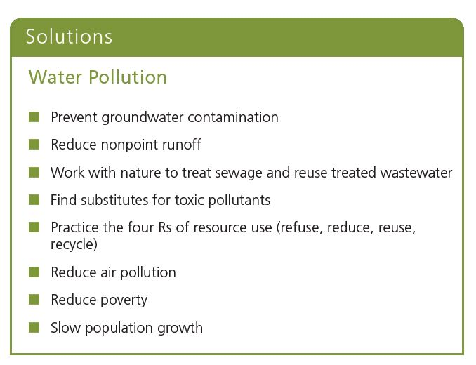
Sustainable Ways to Reduce and Prevent Water Pollution (2 of 3)

Slide 59
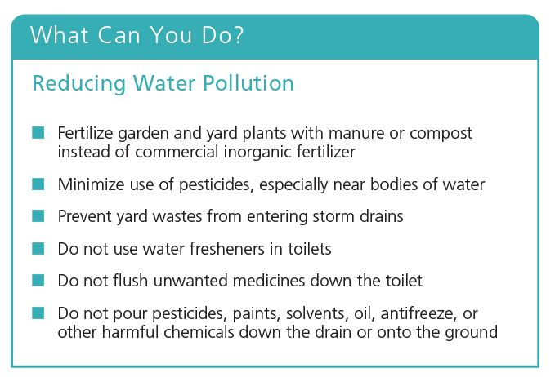
Sustainable Ways to Reduce and Prevent Water Pollution (3 of 3)

