Slide 1
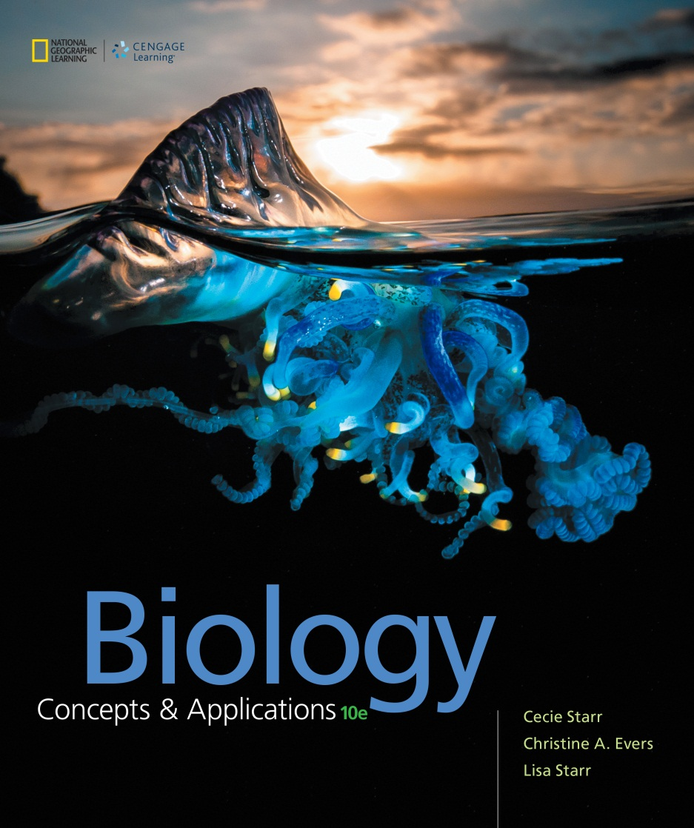
Biology Concepts & Applications
10 Edition
Chapter 16
Evidence of Evolution
Copyright © 2018 Cengage Learning. All Rights Reserved. May not be copied, scanned, or duplicated, in whole or in part, except for use as permitted in a license distributed with a certain product or service or otherwise on a password-protected website for classroom use.

Slide 2
16.1 Early Beliefs, Confusing Discoveries (1 of 5)
Expeditions by 19th century naturalists
  Yielded increasingly detailed observations of nature
  Collected thousands of plants and animals from around the world
  Catalogued and described newly discovered species

Slide 3
Early Beliefs, Confusing Discoveries (2 of 5)
19th century naturalists (cont’d.)
  Pioneered the field of biogeography
    The study of patterns in the geographic distribution of species
  Many of these patterns raised questions that could not be answered
    Extremely isolated species that looked similar to others around the world
    Species with some shared characteristics but others that differed greatly

Slide 4
Early Beliefs, Confusing Discoveries (3 of 5)
Comparative morphology
  Study of anatomical patterns
  The only way to distinguish differences in species at that time
  Problematic in classifying organisms that are outwardly very similar, but quite different internally

Slide 5
Early Beliefs, Confusing Discoveries (4 of 5)
Example: the American saguaro cactus and African milk barrel plant
  Live in similar environments
  Native to different continents
  Reproductive parts are very different, so they cannot be as closely related they appear

Slide 6
Early Beliefs, Confusing Discoveries (5 of 5)
Fossils
  Physical evidence of an organism that lived in ancient past
  Proved puzzling
    Deeper layers held fossils of simple marine life
    Layers above held similar but more complex fossils

Slide 7
Similar-looking, Related Species
Notes:
Figure 16.1 Similar-looking, related species native to distant geographic realms. These birds are unlike most others in several unusual features, including long, muscular legs and an inability to fly. All are native to open grassland regions about the same distance from the equator.
A Ostrich, native to Africa.
B Rhea, native to South America.
C Emu, native to Australia.

Slide 8
Comparative Morphology
Notes:
Figure 16.2 Similar-looking, unrelated species. On the left, saguaro cactus (Carnegiea gigantea), native to the Sonoran Desert of Arizona. On the right, an African milk barrel cactus (Euphorbia horrida), native to the Great Karoo desert of South Africa.

Slide 9
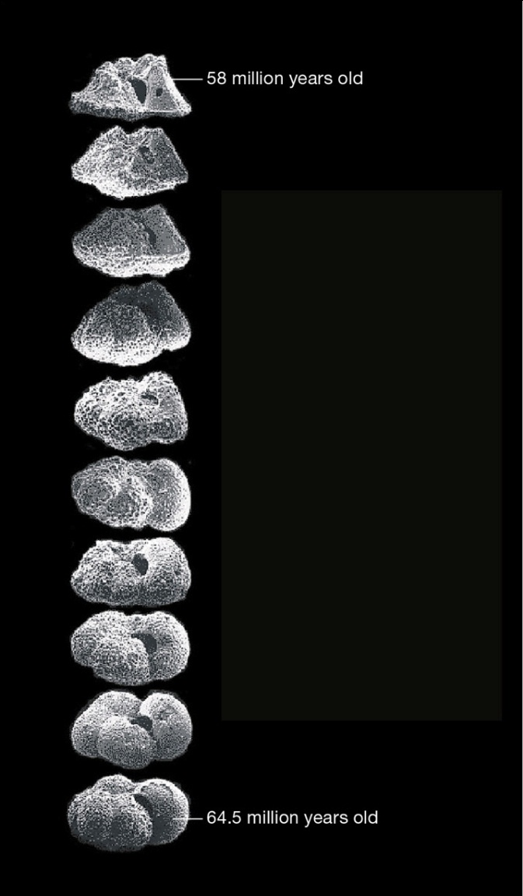
Fossil Evidence
Notes:
Figure 16.4 Sequence of ten fossil foraminifera

Slide 10
16.2 A Flurry of New Ideas
19th century naturalists tried to explain evidence that life on Earth had changed over time
George Cuvier
  Assumed Earth to be in the thousands, not billions, of years
  Proposed theory of catastrophism
    Catastrophic geological events caused extinctions

Slide 11
Jean-Baptiste Lamarck (1 of 2)
Believed that a species gradually improved over generations due to a drive toward perfection
Proposed that environmental pressures cause an internal need for change
  Resulting change is inherited by offspring
Thought about the processes that drive evolution

Slide 12
Jean-Baptiste Lamarck (2 of 2)
Evolution
  Lamarck was the first to think about lineage, a line of descent
  Involves the idea that a species gradually improves over generations

Slide 13
Charles Lyell
Principles of Geology supported theory of uniformity
  Over great spans of time, gradual, everyday geologic processes such as erosion could have sculpted Earth
Challenged idea that Earth was 6,000 years old
  Calculated that Earth is millions of years old
Provided Darwin with insights

Slide 14
Charles Darwin
Naturalist aboard the Beagle
Circumnavigated the globe over five years
Made detailed observations of geology, fossils, plants, and animals
  Collected specimens like fossil glyptodonts
    Noticed that Glyptodons and modern armadillos share traits, and therefore, that they possibly share an ancestor
    Helped Darwin develop a theory of evolution by natural selection

Slide 15
Ancient Relatives
Notes:
Figure 16.5 Ancient relatives: glyptodon and armadillo. Though widely separated in time, these animals share a restricted distribution and unusual traits, including a shell and helmet of keratin-covered bony plates—a material similar to crocodile and lizard skin. (The fossil in A is missing its helmet.) Their similarities were a clue that helped Darwin develop the theory of natural selection.
A Fossil of a glyptodon, an automobile-sized mammal that existed from 2 million to 15,000 years ago.
B A modern armadillo, about a foot long.

Slide 16
Thomas Malthus
Economist that correlated increases in the size of human populations with episodes of disease, famine and war
Proposed idea that humans can run out of resources
  Human reproduction can exceed capacity of environment to sustain them
Influenced Darwin’s ideas of natural selection

Slide 17
Darwin
Darwin applied Malthus’ ideas broadly
  Realized some individuals have traits that make them better suited to their environment than others
    Those traits might enhance the individual’s fitness or the ability to survive and reproduce
    Adaptations—a trait that imparts greater fitness to an individual would become more common in a population over generations, compared with less-competitive forms

Slide 18
Evolution by Natural Selection (1 of 3)
Darwin
  Called the process in which environmental pressures result in the differential survival and reproduction of individuals of a population natural selection
  Published On the Origin of Species
    Laid out the theory of evolution by natural selection

Slide 19
Evolution of Natural Selection (2 of 3)
TABLE 16.1
Evolution by Natural Selection
Observations About Populations
Natural populations have an inherent capacity to increase in size over time.
As a population expands, resources that are used by its members (such as food and living space) eventually become limited
When resources are limited, members of a population compete for them.
Observations About Genetics
Individuals of a species share certain traits.
Individuals of a natural population vary in the details of those shared traits.
Shared traits have a heritable basis, in genes. Slightly different forms of those genes (alleles) give rise to variation in shared traits.
Notes:
Table 16.1 Evolution by Natural Selection

Slide 20
Evolution of Natural Selection (3 of 3)
TABLE 16.1
Evolution by Natural Selection
Inferences
A certain form of a shared trait may make its bearer better able to survive.
Individuals of a population that are better able to survive tend to leave more offspring
Thus, an allele associated with an adaptive trait tends to become more common in a population over time.
Notes:
Table 16.1 Evolution by Natural Selection

Slide 21
Alfred Wallace
Studied wildlife in the Amazon basin and Malay Archipelago
Wrote to Darwin and Lyell about patterns in the geographic distribution of species
  Had come up with the same hypothesis as Darwin: evolution occurs by natural selection
  Darwin and Wallace are both credited with presenting the hypothesis of evolution in 1858, one year before On the Origin of Species was published

Slide 22
16.3 Ancient Evidence (1 of 3)
Most fossils are mineralized
  Bones
  Teeth
  Shells
  Seeds
  Spores

Slide 23
Ancient Evidence (2 of 3)
Trace fossils can be:
  Footprints and other impressions
  Nests
  Burrows
  Trails
  Eggshells
  Feces

Slide 24
Ancient Evidence (3 of 3)
Notes:
Figure 16.6 Examples of fossils.
A Fossil skeleton of an ichthyosaur that lived about 200 million years ago. These marine reptiles were about the same size as modern porpoises, breathed air like them, and probably swam as fast, but the two groups are not closely related.
B Extinct wasp encased in amber, which is ancient tree sap. This 9-mm-long insect lived about 20 million years ago.
C Fossilized imprint of a leaf from a 260-millionyear- old Glossopteris, a type of plant called a seed fern.
D Fossilized footprint of a theropod, a name that means “beast foot.” This group of carnivorous dinosaurs, which includes the familiar Tyrannosaurus rex, arose about 250 million years ago.
E Coprolite (fossilized feces). Fossilized food remains and parasitic worms inside coprolites offer clues about the diet and health of extinct species. A foxlike animal excreted this one.

Slide 25
Evidence in Rock Formations
Fossilization
  Begins when an organism or its traces become covered by sediments/volcanic ash
  After a very long time, pressure and mineralization transform the remains into rock
  Fossils are found in stacked layers of sedimentary rock
  Younger fossils occur in more recent layers, on top of older fossils in older layers

Slide 26
The Fossil Record
We have fossils for more that 250,000 species
Fossils are relatively rare, so the fossil record will always be incomplete
  Most ancient species had no hard parts to fossilize
  Burial site had to escape destructive geologic events

Slide 27
16.4 Filling in Pieces of the Puzzle
Radiometric dating
  The time it takes for half of the atoms in a sample of radioisotope to decay is called half-life
  Can determine the age of rocks and fossils

Slide 28
Radiometric Dating Applied
Carbon dating
  Recent fossils that still contain carbon can be dated (carbon 14)
    The half-life of ¹⁴C is 5,370 years
    Most ¹⁴C in a fossil will have decayed after about 60,000 years
    ¹⁴C in CO₂ enters food chains through photosynthesis
    Ratio of ¹⁴C to ¹²C is used to calculate how many half-lives passed since the organism died

Slide 29
Missing Links
Fossil records holds clues to evolution:
  Ancestors of whales probably walked on land
  The skull and lower jaw have characteristics similar to those of ancient carnivorous land animals
  With their artiodactyl-like ankle bones, Rodhocetus and Dorudon were probably offshoots of the artiodactyl-to-modern-whale lineage

Slide 30
Cetacean Skeletons
Notes:
Figure 16.9 Comparison of cetacean skeletons.
The ancestor of whales was an artiodactyl that walked on land. Over millions of years, the lineage transitioned from life on land to life in water, and as it did, bones of the hindlimb (highlighted in blue) became smaller.

Slide 31
16.5 Drifting Continents, Changing Seas
Theory of Plate Tectonics
  Continents were one big supercontinent called Pangea
    Formed about 237 mya (Triassic); broke up about 152 mya ago (Jurassic)
  Continents drift over time
    Continental plates move no more than 10 cm/year
    New crust spreads outward from oceanic ridges, forcing tectonic plates away from the ridge and into trenches

Slide 32
Plate Tectonics
Notes:
Figure 16.10 Plate tectonics. Slowing moving pieces of Earth’s outer layer of rock convey continents around the globe.
1 At oceanic ridges, plumes of molten rock welling up from Earth’s interior drive the movement of tectonic plates. New crust spreads outward as it forms on the surface, forcing adjacent tectonic plates away from the ridge and into trenches elsewhere.
2 At trenches, the advancing edge of one plate plows under an adjacent plate and buckles it.
3 Faults are ruptures in Earth’s crust where plates meet. The diagram shows a rift fault, in which plates move apart. The photo above shows a strikeslip fault, in which two abutting plates slip against one another in opposite directions.
4 Plumes of molten rock rupture a tectonic plate at what are called “hot spots.” The Hawaiian Islands have been forming from molten rock that continues to erupt from a hot spot under the Pacific Plate. This and other tectonic plates are shown in Appendix V.

Slide 33
Drifting Continents, Changing Seas
Gondwana
  Supercontinent that existed before Pangea, more than 500 mya
    Identical layers of rock around the Southern Hemisphere hold matching fossils of organisms that were extinct millions of years before Pangea formed
  Included most land masses that are now in the Southern Hemisphere, India and Arabia

Slide 34
Ancient Earth
Notes:
Figure 16.11 Reconstructions of ancient Earth. mya: million years ago.

Slide 35
16.6 Putting Time Into Perspective
Geologic time scale
  Chronology of Earth’s history
  Each layer offers clues about conditions on Earth at the time layer was deposited
  Fossils in each layer are a record of life during that period of time
  Correlates geologic and evolutionary events

Slide 36
16.7 Evidence in Form (1 of 3)
Clues about the history of a lineage may be found in:
  Fossils
  Body form of modern organisms
  Body function of modern organisms

Slide 37
Evidence in Form (2 of 3)
Morphological divergence
  Change from the body form of a common ancestor
Homologous structures
  Body parts that appear different in different lineages, but are similar in some aspect
    Become modified to a different size, shape, or function in different lineages
  Are evidence of a common ancestor

Slide 38
Evidence in Form (3 of 3)
Morphological convergence
  Independent evolution of similar body parts in different lineages
Analogous structures
  Body parts that look alike in different lineages but did not evolve in a common ancestor

Slide 39
Morphological Convergence
Notes:
Figure 16.14 Examples of morphological convergence.
A The flight surfaces of an insect wing, a bat wing, and a bird wing are analogous structures. The diagram shows how the evolution of wings (red dots) occurred independently in the three separate lineages. You will read more about diagrams that show evolutionary relationships in Section 17.11.

Slide 40
16.8 Evidence in Function
There are generally fewer differences between the DNA of more closely related lineages
Similar genes give rise to similar proteins
Fewer differences occur among the proteins of more closely related lineages

Slide 41
Comparing Proteins
Notes:
Figure 16.15 Comparing proteins. Below, part of the amino acid sequence of mitochondrial cytochrome b from 19 species is aligned. This protein is a crucial component of mitochondrial electron transfer chains. The honeycreeper sequence is identical in ten species of honeycreeper; amino acids that differ in the other species are shown in red. Dashes reflect insertion or deletion mutations.

Slide 42
Evidence in Function
Similar patterns of embryonic development reflect shared ancestry
  Master genes that control embryonic development patterns have changed very little or not at all over evolutionary time
  Master genes with similar sequence and function in different lineages are strong evidence that those lineages are related

Slide 43
Comparing Vertebrate Embryos
Notes:
Figure 16.16 Comparing vertebrate embryos. Below, all vertebrates go through an embryonic stage in which they have four limb buds, a tail, and divisions called somites along their back. From left to right: human, mouse, lizard, bat, alligator, chicken.

Slide 44
Patterns in Animal Development
Homeotic genes
  Master genes
  Guide formation of specific body parts during development
  Example: Hox genes
  Similar genes give rise to similar proteins
  Proteins are also commonly compared
    The amino acid sequence of a protein is compared between several species

Slide 45
Master Gene Expression
Notes:
Figure 16.17 Comparing master gene expression. Expression of the Hoxc6 gene is indicated by purple stain in two vertebrate embryos, chicken (left) and garter snake (right). Expression of this gene causes a vertebra to develop ribs as part of the back. Chickens have 7 vertebrae in their back and 14 to 17 vertebrae in their neck; snakes have upwards of 450 back vertebrae and essentially no neck.

Slide 46
Application: Evolution
An asteroid impact may have caused a mass extinction 65.5 million years ago
  Resulted in a simultaneous loss of many lineages from Earth

Slide 47
Reflections of a Distant Past (1 of 2)
K-Pg boundary sequence (formerly known as K-T boundary)
  A unique rock layer
  Formed worldwide 65.5 million years ago
  Marks an abrupt transition in the fossil record
  Implies a mass extinction

Slide 48
Reflections of a Distant Past (2 of 2)
Notes:
Figure 16.18 The K–Pg boundary sequence, an unusual, worldwide sedimentary rock formation that formed 66 million years ago. This rock formation marks an abrupt transition in the fossil record that implies a mass extinction of the dinosaurs. It also contains materials consistent with a meteorite impact. The red pocketknife gives an idea of scale.

Slide 49
Discuss
How did the widespread discoveries of fossils in the 19th century help to support Darwin’s views on evolution?
Can you think of any ideas commonly expressed today that are similar to Lamarck’s understanding of evolution?
How did Darwin’s observation of variation among species help him to develop his principle of evolution?

