Slide 1
Exploring Environmental Science for AP®
1st Edition
Chapter 15
Energy Efficiency and Renewable Energy
Copyright © 2018 Cengage Learning. All Rights Reserved. May not be copied, scanned, or duplicated, in whole or in part, except for use as permitted in a license distributed with a certain product or service or otherwise on a password-protected website for classroom use.

Slide 2
Core Case Study: Saving Energy and Money and Reducing our Environmental Impact
About 43% of money Americans spend on energy is unnecessarily wasted
Sources of waste
Inefficient use of gasoline in car engines
Air leaks cause heat loss from buildings
Easy and cost-effective solutions
Caulking home windows and doors
Adding insulation

Slide 3
15.1 Why Do We Need a New Energy Transition?
World is in early stages of a transition
Move from fossil fuels to energy efficiency and renewable energy

Slide 4
Establishing New Energy Priorities
New energy transition is needed
Improve energy efficiency and reduce energy waste
Decrease dependence on nonrenewable fossil fuels
Rely more on a mix of renewable energy sources
Benefits
Save money, create jobs, reduce air pollution, keep climate change from accelerating
Shift due to
increasing availability of cheaper solar and wind and advances in renewable technology

Slide 5
Case Study: Germany Is a Renewable Energy Superpower
Germany’s 2050 goals
Obtain 60% of energy from renewable resources
Increase electricity efficiency by 50%
Reduce CO₂ emissions by 80–95%
Sharply reduce use of coal
Feed-in-tariff
Utilities must buy electricity from homeowners with solar cells and feed into electrical grid

Slide 6
15.2 Why Is Improving Energy Efficiency and Reducing Energy Waste an Important Energy Resource?
Improvements in energy efficiency and reductions in energy waste
Could save at least one-third of the energy used in the world
Up to 43% of energy used in the United States
Many technologies exist for increasing energy efficiency of industry, vehicles, appliances, and buildings

Slide 7
We Waste a Lot of Energy and Money (1 of 4)
Energy efficiency
How much useful work we get from each unit energy
Energy conservation
Reducing or eliminating unnecessary energy waste

Slide 8
We Waste a Lot of Energy and Money (2 of 4)
Some sources of waste
Poorly insulated buildings
Reliance on cars for getting around
Huge data centers filled with electronic servers
Use only 10% of energy they consume
Motor vehicles with internal combustion engines
Nuclear, coal, and natural gas power plants

Slide 9
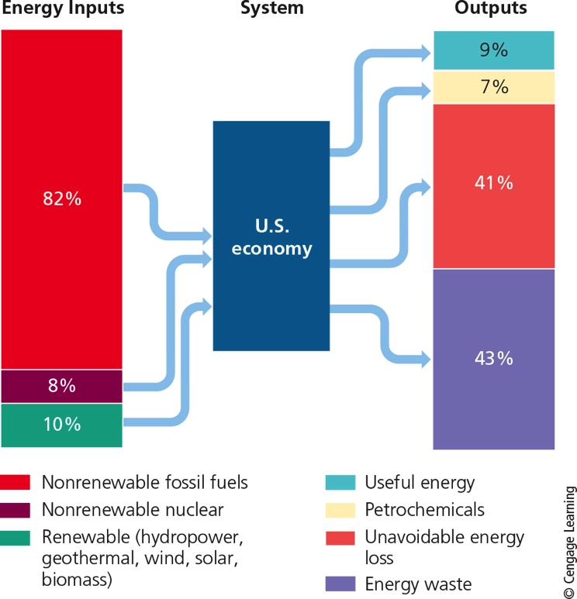
We Waste a Lot of Energy and Money (3 of 4)
Notes:
Figure 16.2 Flow of commercial energy through the U.S. economy. Only 16% of the country’s high-quality energy ends up performing useful tasks. Critical thinking: What are two examples of unnecessary energy waste?

Slide 10
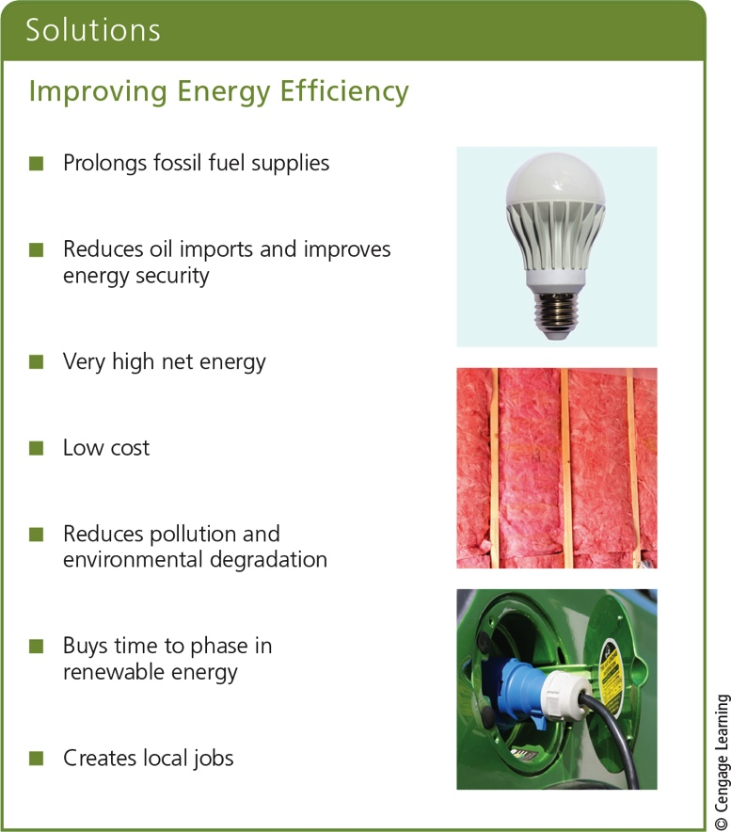
We Waste a Lot of Energy and Money (4 of 4)
Notes:
Figure 16.3 Improving energy efficiency and conserving energy has several benefits. Critical thinking: Which two of these benefits do you think are the most important? Why?

Slide 11
Improving Energy Efficiency in Industries and Utilities
Cogeneration
Combined heat and power
Two forms of energy from same fuel source
Replace energy-wasting electric motors
Recycle materials
Use energy-efficient LED lighting
Meter energy use
Shut down unused computers and lights

Slide 12
Building an Interactive and More Energy-Efficient Electrical Grid
Current electrical grid system–outdated and wasteful
Interactive grid
Ultra-high-voltage
Super-efficient transmission lines
Digitally controlled
Responds to local changes in demand and supply
Easier to buy renewable energy
Will save $2 trillion over next 20 years

Slide 13
Making Transportation More Energy-Efficient
Hidden costs in gasoline
Corporate Average Fuel Economy (CAFÉ)
Government subsidies and tax breaks for oil companies
All hidden costs add up to $12 per gallon
Build or expand mass transit and high speed rail
Carry more freight by rail instead of trucks
Encourage biking by building bike lanes

Slide 14
Switching to Energy-Efficient Vehicles (1 of 2)
Gasoline-electric hybrid car
Plug-in hybrid electric vehicle
Electric vehicle with a hydrogen fuel cell
Car bodies made of light, composite materials

Slide 15
Switching to Energy-Efficient Vehicles (2 of 2)
Notes:
Figure 16.4 Solutions: A conventional gasoline–electric hybrid vehicle (left) is powered mostly by a small internal combustion engine with an assist from a strong battery. A plug-in hybrid electric vehicle (right) has a smaller internal combustion engine with a second and more powerful battery that can be plugged into a 110-volt or 220-volt outlet and recharged (see photo). An all-electric vehicle (not shown) runs completely on a rechargeable battery. Question: Would you buy one of these vehicles? Explain.

Slide 16
Designing Buildings That Save Energy and Money (1 of 2)
Green architecture
Living or green roofs
Specially formulated soil and vegetation
Superinsulation
No need for heating system
U.S. Green Building Council’s Leadership in Energy and Environmental Design (LEED)
Standards

Slide 17
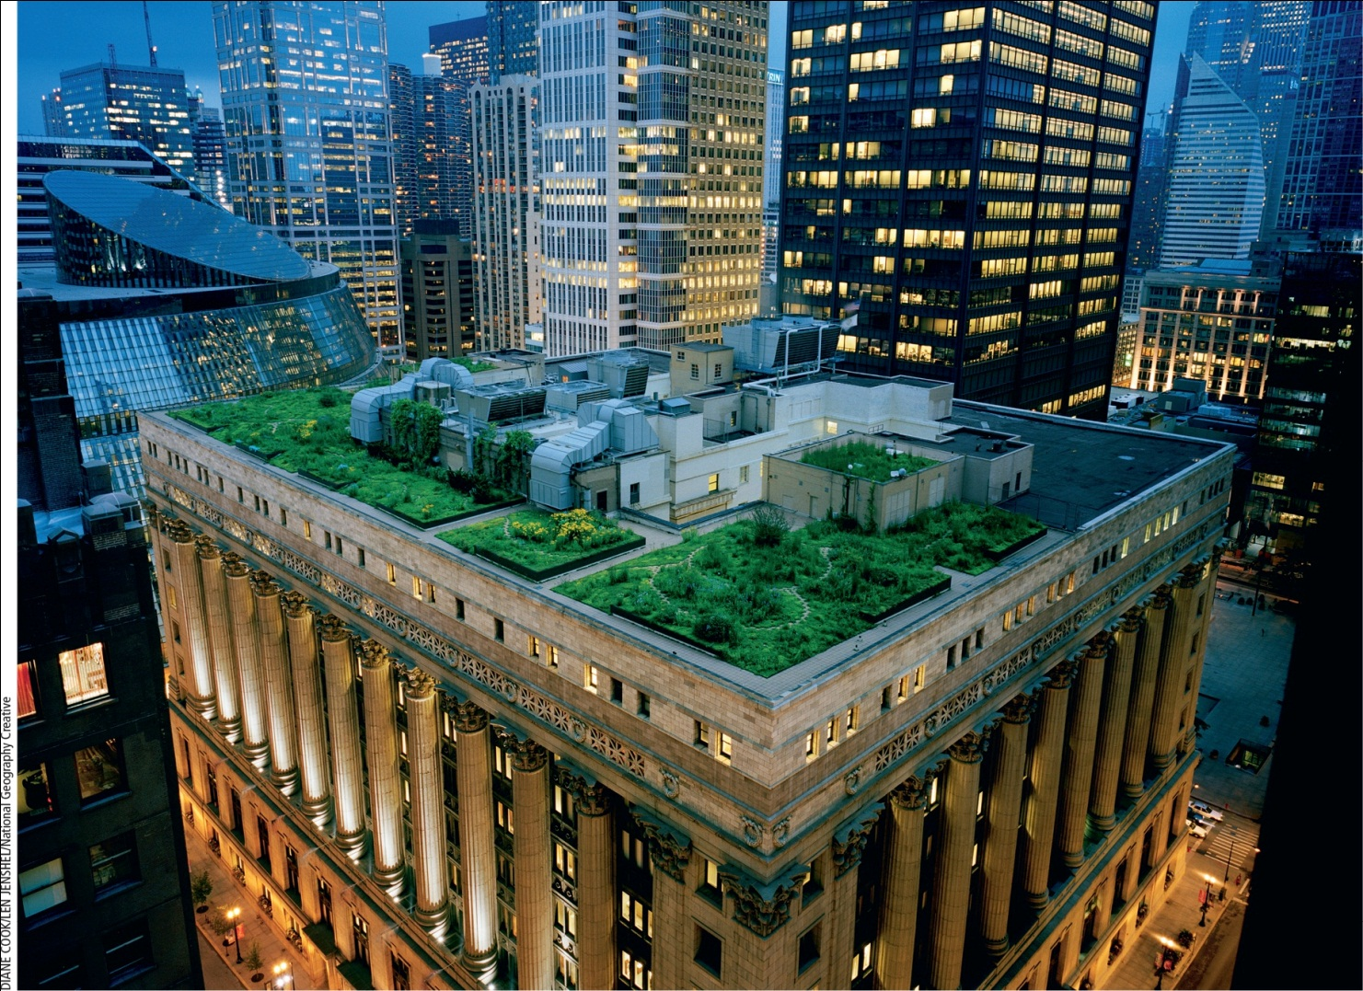
Designing Buildings That Save Energy and Money (2 of 2)
Notes:
Figure 16.5 Green roof on Chicago’s City Hall.

Slide 18
Saving Energy and Money in Existing Buildings (1 of 2)
Ways to reduce energy use
Get a home energy audit
Insulate the building and plug leaks
Use energy-efficient windows
Stop other heating and cooling losses
Heat interior spaces more efficiently
Heat water more efficiently
Use energy-efficient appliances, computers, and lighting

Slide 19
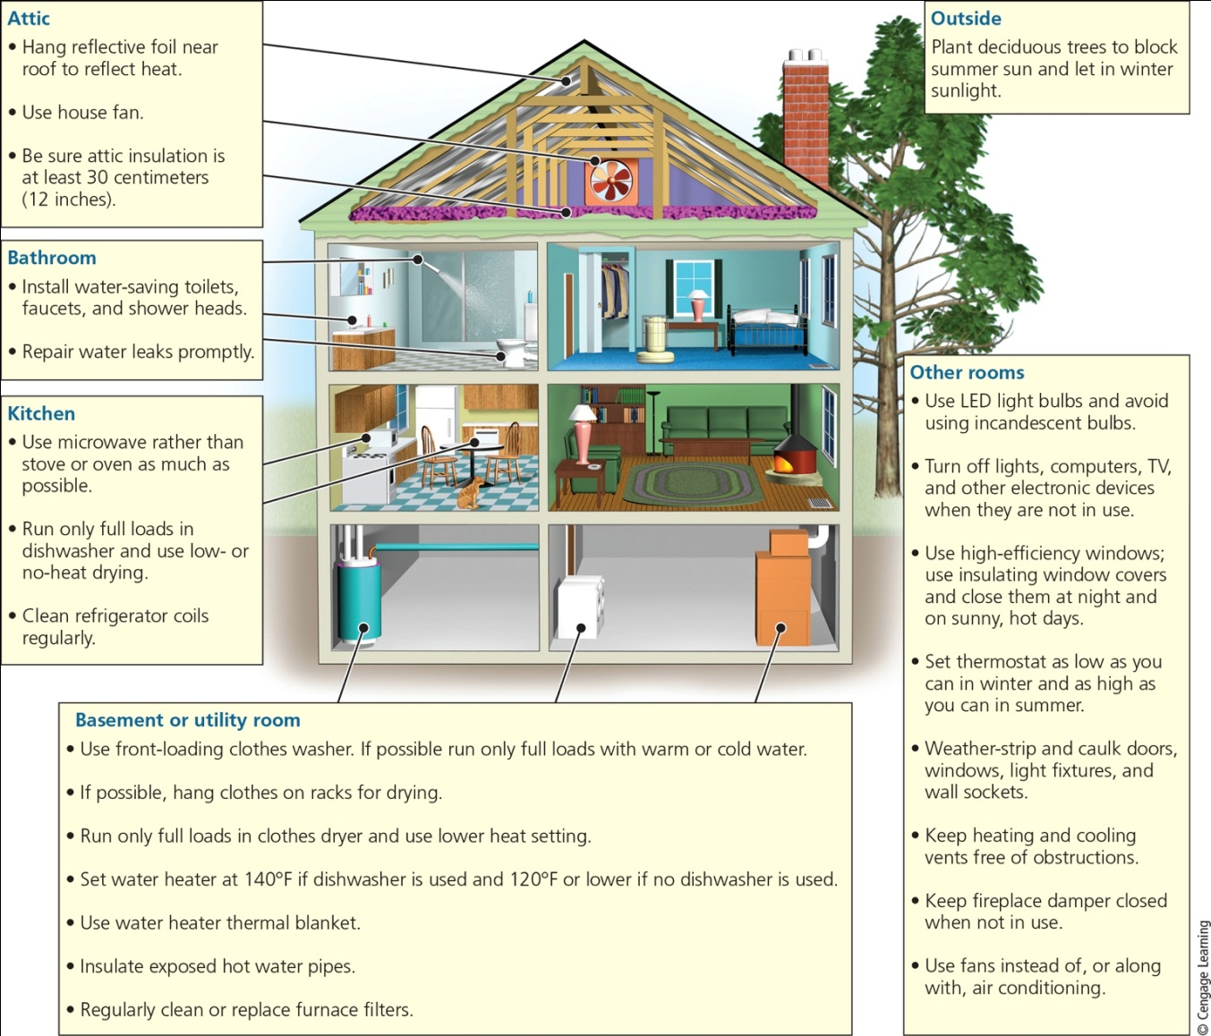
Saving Energy and Money in Existing Buildings (2 of 2)
Stepped Art
Notes:
Figure 16.7 Individuals matter: You can save energy and money where you live and reduce your harmful environmental impact. Critical thinking: Which of these things do you already do? Which additional ones might you do?

Slide 20
Why Are We Wasting So Much Energy and Money?
Energy remains artificially cheap
Government subsidies
Tax breaks
Prices don’t include true cost
Few large and long-lasting incentives for improving energy efficiency and reducing waste
Rebound effect

Slide 21
Relying More on Renewable Energy
Reasons renewable energy use is not more prevalent
Inaccurate perceptions that solar and wind energy are unreliable and intermittent
Government subsidies and tax breaks lower for renewable energy than for fossil fuels
Prices for nonrenewable energy do not include harmful environmental impacts
Energy shift takes many decades

Slide 22
15.3 What Are the Advantages and Disadvantages of Using Solar Energy?
Passive and active solar heating systems can heat water and buildings effectively
Cost of using sunlight to produce electricity is falling rapidly

Slide 23
Heating Buildings and Water with Solar Energy (1 of 3)
Passive solar heating system
Absorbs and stores heat from the sun directly within a well-insulated structure
Active solar heating system
Captures energy from the sun in a heat-absorbing fluid

Slide 24
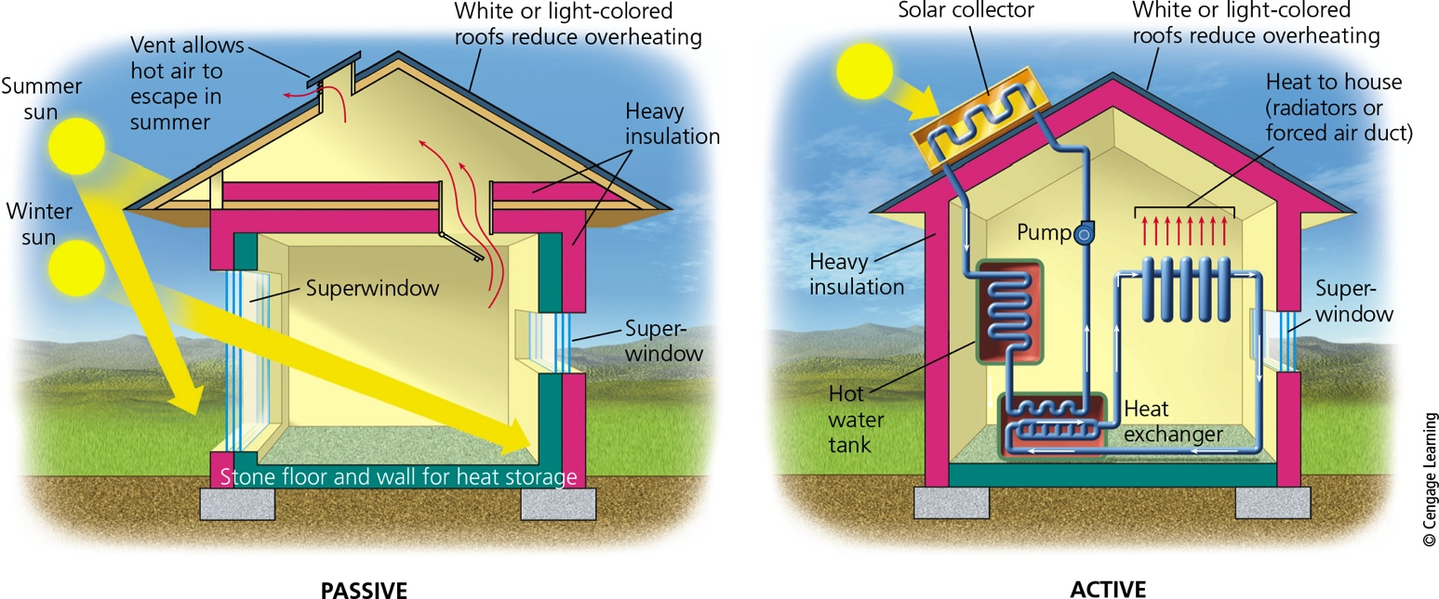
Heating Buildings and Water with Solar Energy (2 of 3)
Notes:
Figure 16.8 Solutions: Passive (left) and active (right) solar home heating systems.

Slide 25
Heating Buildings and Water with Solar Energy (3 of 3)
Notes:
Figure 16.10 Heating a house with passive or active solar energy system has advantages and disadvantages (Concept 16.3). Critical thinking: Which single advantage and which single disadvantage do you think are the most important? Why? Do you think that the advantages of using these technologies outweigh their disadvantages?

Slide 26
Cooling Buildings Naturally
Methods to keep a building cool
Open windows when cooler outside
Use fans
Superinsulation and high-efficiency windows
Shade trees, overhangs, or window awnings
Light-colored roof
Geothermal heat pumps bring cool air from underground

Slide 27
Concentrating Sunlight to Produce High-Temperature Heat and Electricity (1 of 4)
Solar thermal systems
Collect sunlight to boil water and produce steam to generate electricity
Used in deserts and open areas with ample sunlight
Require large volumes of cooling water for condensing steam and cleaning mirrors
Low net energy yields

Slide 28
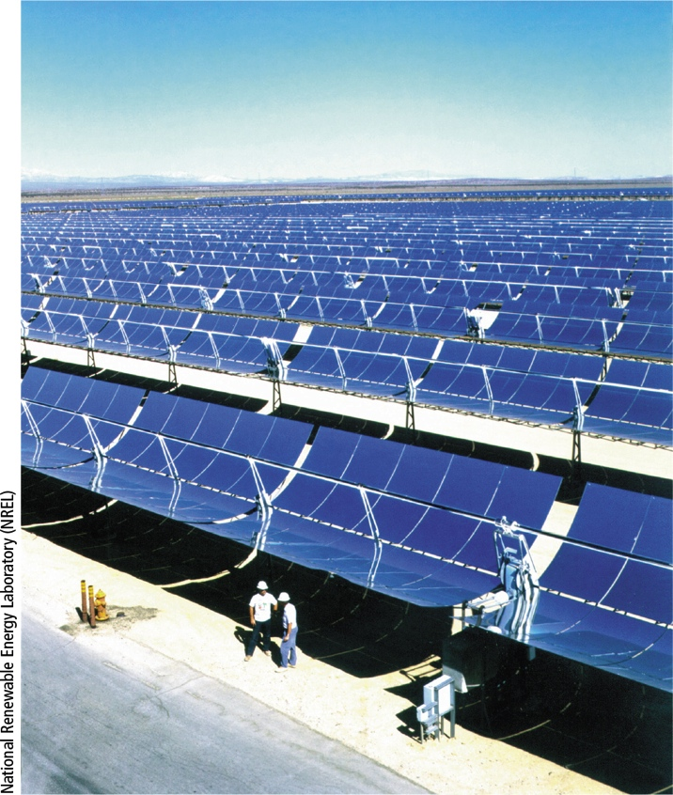
Concentrating Sunlight to Produce High-Temperature Heat and Electricity (2 of 4)
Notes:
Figure 16.11 Solar thermal power: This solar power plant in California’s Mojave Desert uses curved (parabolic) solar collectors to concentrate solar energy to provide enough heat to boil water and produce steam for generating electricity.

Slide 29
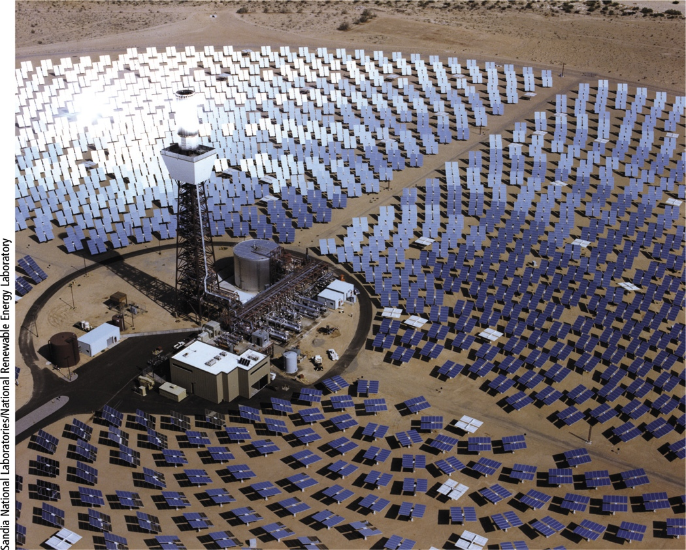
Concentrating Sunlight to Produce High-Temperature Heat and Electricity (3 of 4)
Notes:
Figure 16.12 Solar thermal power: In this system in California an array of mirrors tracks the sun and focuses reflected sunlight on a central receiver to boil the water for producing electricity.

Slide 30
Concentrating Sunlight to Produce High-Temperature Heat and Electricity (4 of 4)
Notes:
Figure 16.13 Using solar energy to generate high-temperature heat and electricity has advantages and disadvantages (Concept 16.3). Critical thinking: Which single advantage and which single disadvantage do you think are the most important? Why? Do you think that the advantages of using these technologies outweigh their disadvantages?

Slide 31
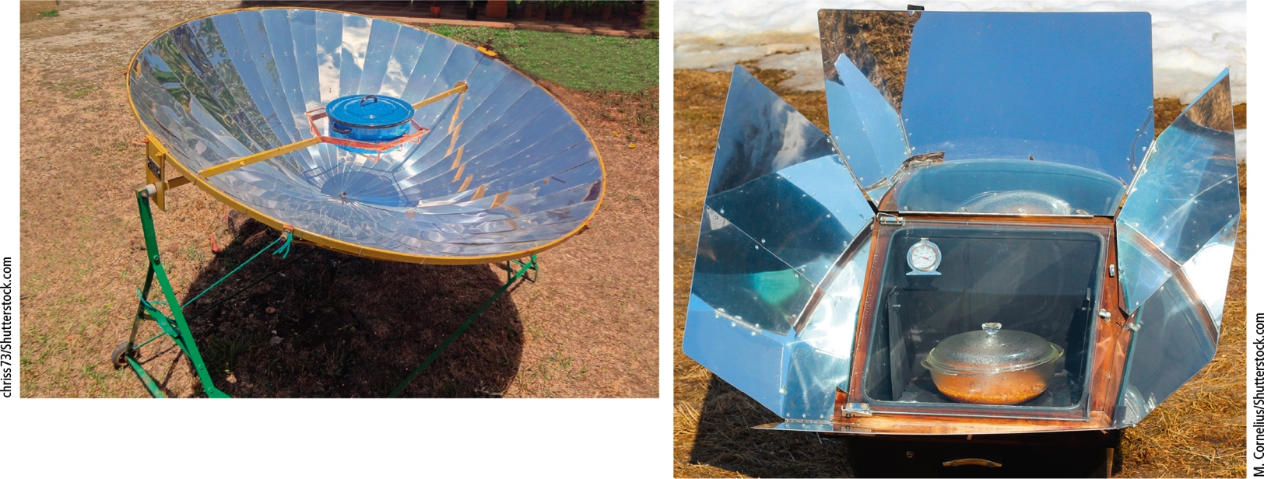
Solar Cookers
Solar cookers can replace wood and charcoal fires
Notes:
Figure 16.14 Solutions: Solar cooker (left) in Costa Rica and simple solar oven (right).

Slide 32
Using Solar Cells to Produce Electricity (1 of 5)
Photovoltaic (PV) cells
Convert solar energy to electric energy
Design of solar cells
Sunlight hits cells and produces flow of electrons
Systems can be connected to existing electrical grids or to batteries

Slide 33
Using Solar Cells to Produce Electricity (2 of 5)
Solar cells made of paper-thin, rigid, or flexible sheets
Enabled by nanotechnology and other emerging technologies
Rural use of solar
Rooftop solar panels power LED lamps
Solar powered microgrids

Slide 34
Using Solar Cells to Produce Electricity (3 of 5)
Problem with current solar cells
Low energy efficiency
Scientists and engineers are developing more efficient cells
Solar cells have become world’s fastest growing way to produce electricity

Slide 35
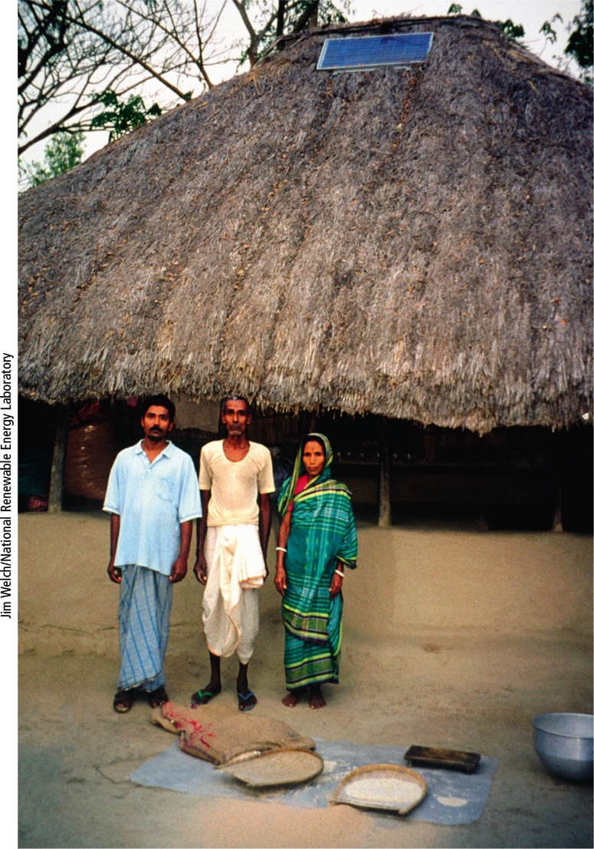
Using Solar Cells to Produce Electricity (4 of 5)
Notes:
Figure 16.16 Solutions: A solar-cell panel provides electricity for lighting this hut in rural West Bengal, India. Critical thinking: Do you think your government should provide aid to poor countries for obtaining solar-cell systems? Explain.

Slide 36
Using Solar Cells to Produce Electricity (5 of 5)
Notes:
Figure 16.18 Using solar cells to produce electricity has advantages and disadvantages (Concept 16.3). Critical thinking: Which single advantage and which single disadvantage do you think are the most important? Why? Do you think that the advantages of using this technology outweigh its disadvantages? Why?

Slide 37
15.4 What Are the Advantages and Disadvantages of Using Wind Power? (1 of 2)
Wind is one of the fastest growing, least expensive, and cleanest ways to produce electricity
Wind is an indirect form of solar energy
Uneven heating and earth’s rotation cause winds to blow
Kinetic energy captured by wind turbines
Turbines grouped together in wind farms
On land and at sea

Slide 38
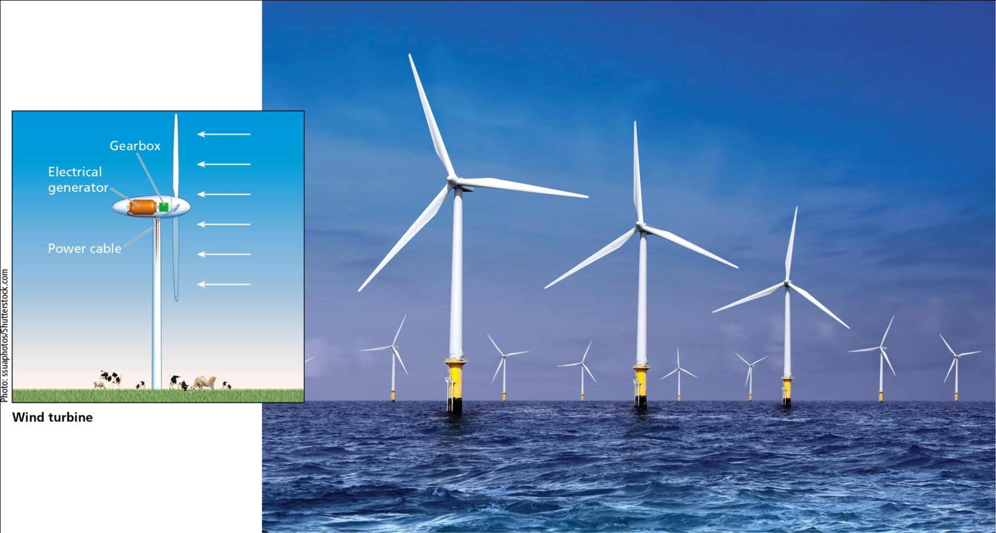
15.4 What Are the Advantages and Disadvantages of Using Wind Power? (2 of 2)
Notes:
Figure 16.20 Wind turbines convert the kinetic energy in wind to electricity, another form of kinetic energy (moving electrons). Wind power is an indirect form of solar energy.

Slide 39
Using Wind to Produce Electricity (1 of 3)
Tall, long-blade turbines can extract more energy from the wind
Rapidly growing power source
The United States, China, and Germany
Future is offshore wind farms
Wind power has potential to produce 40 times the world’s current electricity used

Slide 40
Using Wind to Produce Electricity (2 of 3)
Wind is abundant, widely distributed, and inexhaustible
Mostly carbon-free and pollution-free
High net energy yield
Largest potential areas are usually rural
Smart grid needed to connect
Backup power source may be needed
Alternative: large number of wind farms in different areas connected to smart grid

Slide 41
Using Wind to Produce Electricity (3 of 3)
Notes:
Figure 16.22 Using wind to produce electricity has advantages and disadvantages (Concept 16.4). Critical thinking: Which single advantage and which single disadvantage do you think are the most important? Why? Do you think the advantages outweigh the disadvantages? Why?

Slide 42
15.5 What Are the Advantages and Disadvantages of Geothermal Energy?
Geothermal energy can supply many areas with heat and electricity
Generally low environmental impact
Limited number of sites where it can be produced economically

Slide 43
Tapping into the Earth’s Internal Heat (1 of 5)
Geothermal energy
Heat stored in soil, underground rocks, and fluids in the earth’s mantle
Geothermal heat pump system
Uses temperature difference between the earth’s surface and underground
Fluid carried through a closed loop
Can heat a building in winter and cool it in summer

Slide 44
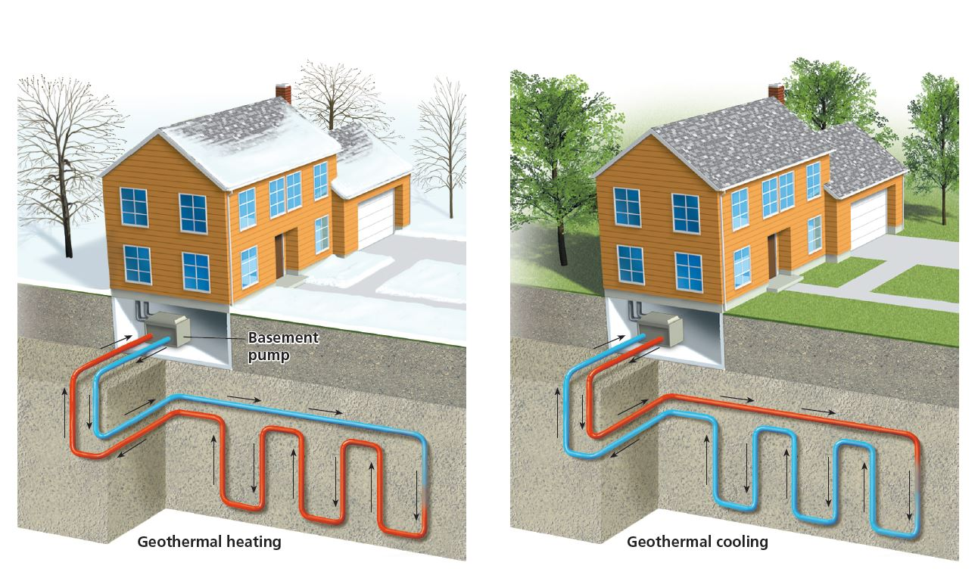
Tapping into the Earth’s Internal Heat (2 of 5)

Slide 45
Tapping into the Earth’s Internal Heat (3 of 5)
Hydrothermal reservoirs
Drill wells and extract dry steam, wet steam, or hot water
The United States is the world’s largest producer
Drilling geothermal wells is expensive
Geothermal is used exclusively in Iceland, and in 23 other countries

Slide 46
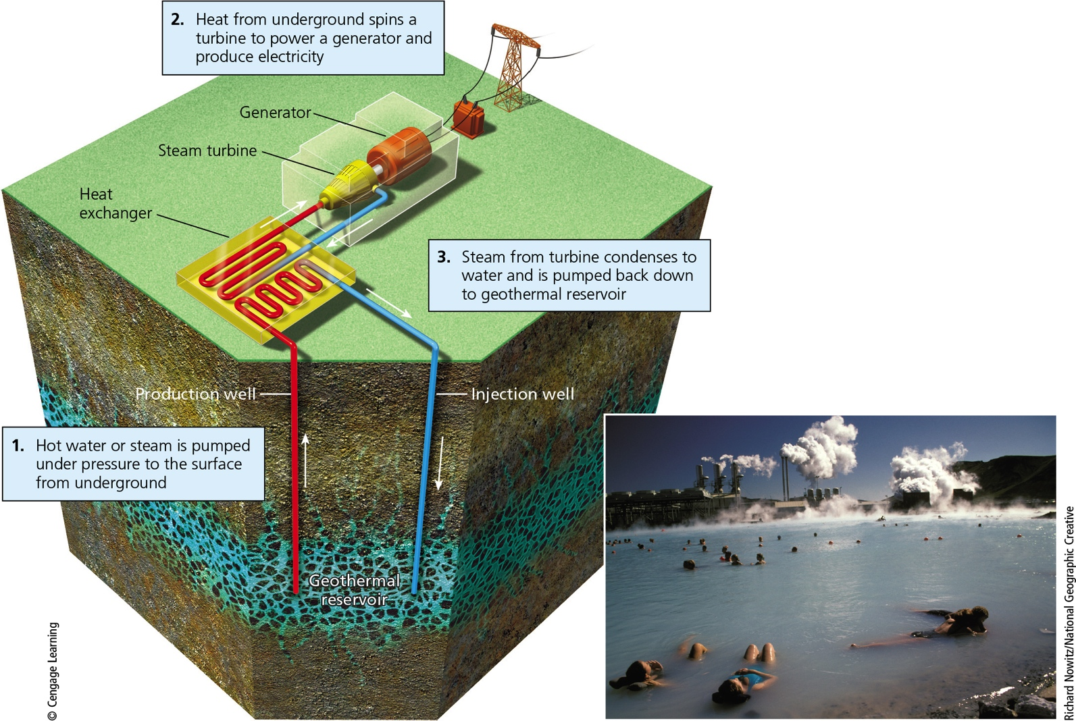
Tapping into the Earth’s Internal Heat (4 of 5)
Notes:
Figure 16.24 Power plants can produce electricity from heat extracted from underground geothermal reservoirs. The photo shows a geothermal power plant in Iceland that produces electricity and heats a nearby spa called the Blue Lagoon.

Slide 47
Tapping into the Earth’s Internal Heat (5 of 5)
Notes:
Figure 16.26 Using geothermal energy for space heating and for producing electricity or high-temperature heat for industrial processes has advantages and disadvantages. (Concept 16.5). Critical thinking: Which single advantage and which single disadvantage do you think are the most important? Why? Do you think the advantages of this energy resource outweigh its disadvantages? Why?

Slide 48
15.6 What Are the Advantages and Disadvantages of Using Biomass as an Energy Source?
Solid biomass
Potentially renewable resource
Requires large areas of land
Exceeding replenishment rate produces a net gain in emissions of greenhouse gases
Liquid biofuels
Can lessen dependence on oil
Biofuel crops can degrade soil and biodiversity and increase emissions

Slide 49
Producing Energy by Burning Solid Biomass (1 of 2)
Biomass
Plant materials and agricultural waste that can be burned for fuel
Biomass plantations
Fast growing trees and shrubs for repeated harvest
Wood pellet production degrades forests
Burning wood and other forms of biomass produces CO₂ and pollutants

Slide 50
Producing Energy by Burning Solid Biomass (2 of 2)
Notes:
Figure 16.27 Burning solid biomass as a fuel has advantages and disadvantages (Concept 16.6A). Critical thinking: Which single advantage and which single disadvantage do you think are the most important? Why? Do you think the advantages outweigh the disadvantages? Why?

Slide 51
Using Liquid Biofuels to Power Vehicles (1 of 4)
Ethanol
Ethyl alcohol produced from plants
Biodiesel
Produced from vegetable oils
Advantages
Crops can be grown throughout the world
No net increase in CO₂ emissions under certain circumstances
Easy to store and transport

Slide 52
Using Liquid Biofuels to Power Vehicles (2 of 4)
Brazil makes ethanol from sugarcane residue
Medium net energy
2014: 43% of the corn produced in the United States was used to make ethanol
Corn-based ethanol has a low net energy
Producing and burning corn-based ethanol adds 20% more greenhouse gases than burning gasoline

Slide 53
Using Liquid Biofuels to Power Vehicles (3 of 4)
Growing corn requires much water
Ethanol distilleries produce large volumes of wastewater
Cellulosic ethanol
Alternative made of inedible cellulose
Can be made from grasses that do not require fertilizer or replanting (perennials)
Algae can produce biofuel

Slide 54
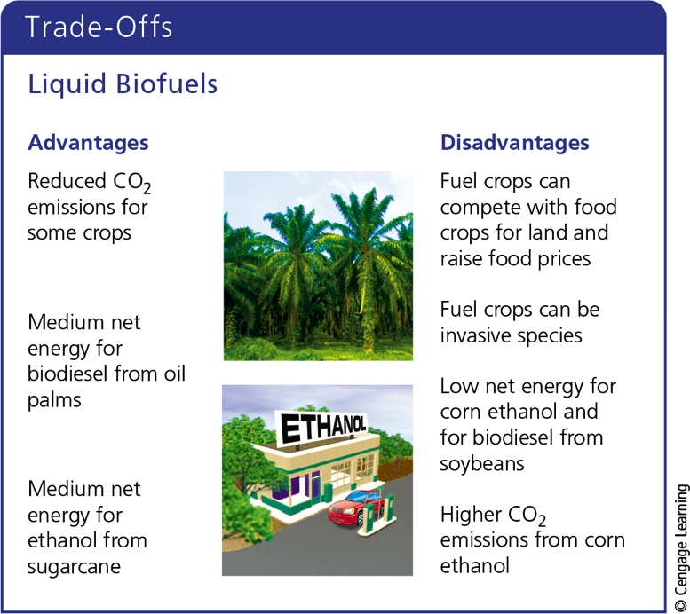
Using Liquid Biofuels to Power Vehicles (4 of 4)
Notes:
Figure 16.28 Ethanol and biodiesel biofuels have advantages and disadvantages (Concept 16.6B). Critical thinking: Which single advantage and which single disadvantage do you think are the most important? Why?

Slide 55
15.7 What Are the Advantages and Disadvantages of Using Hydropower?
Sources of hydropower
Water flowing over dams
Tidal flows
Ocean waves
Downsides
Environmental concerns
Limited availability of suitable sites

Slide 56
Producing Electricity from Falling and Flowing Water (1 of 2)
Hydropower
Uses kinetic energy of moving water
Indirect form of solar energy
World’s leading renewable energy source
Top three producers
China, Brazil, and the United States
Hydropower supplies half the electricity used on the West Coast

Slide 57
Producing Electricity from Falling and Flowing Water (2 of 2)
Notes:
Figure 16.30 Using large dams and reservoirs to produce electricity has advantages and disadvantages (Concept 16.7). Critical thinking: Which single advantage and which single disadvantage do you think are the most important? Why? Do you think that the advantages of this technology outweigh its disadvantages? Why?

Slide 58
Using Tides and Waves to Produce Electricity
Produce electricity from flowing water
Coastal bays and estuaries
Tidal energy dams
France, Nova Scotia, and South Korea
Challenges
Few suitable sites
High costs
Equipment damage from storms and saltwater corrosion

Slide 59
15.8 What are the Advantages and Disadvantages of Using Hydrogen as an Energy Source?
Hydrogen
Simplest and most abundant chemical element
Clean energy source
Provided it is not produced with the use of fossil fuels
Has a negative net energy
Fuel cells combine hydrogen and oxygen to produce electricity and water vapor

Slide 60
Will Hydrogen Save Us? (1 of 4)
Advantages of hydrogen as a fuel
Eliminates most outdoor air pollution from burning fossil fuels
Would greatly slow climate change and ocean acidification

Slide 61
Will Hydrogen Save Us? (2 of 4)
Some challenges
Hydrogen chemically locked in water and organic compounds
Negative net energy
Serious limitation
Fuel cells are costly
CO₂ emissions depend on method of hydrogen production

Slide 62
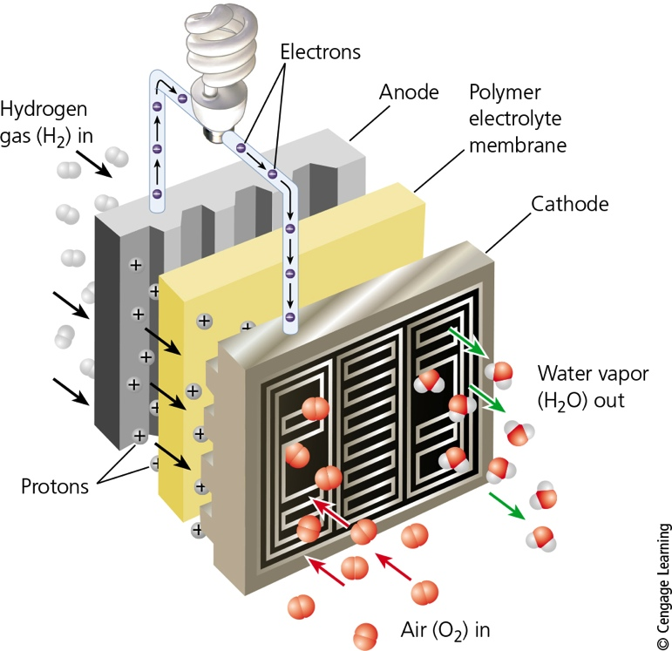
Will Hydrogen Save Us? (3 of 4)
Notes:
Figure 16.31 A fuel cell takes in hydrogen gas and separates the hydrogen atoms’ electrons from their protons. The electrons flow through wires to provide electricity, while the protons pass through a membrane and combine with oxygen gas to form water vapor. Note that this process is the reverse of electrolysis, the process of passing electricity through water to produce hydrogen fuel.

Slide 63
Will Hydrogen Save Us? (4 of 4)
Notes:
Figure 16.32 Using hydrogen as a fuel for vehicles and for providing heat and electricity has advantages and disadvantages. (Concept 16.8). Critical thinking: Which single advantage and which single disadvantage do you think are the most important? Why? Do you think that the advantages of hydrogen fuel outweigh its disadvantages? Why?

Slide 64
15.9 How Can We Make the Transition to a More Sustainable Energy Future?
We can make the transition to a more sustainable energy future by:
Reducing waste
Improving energy efficiency
Using a mix of renewable energy resources
Including the environmental and health costs of energy resources in their market prices

Slide 65
Shifting to a New Energy Economy (1 of 2)
China and the United States
Key players in making the shift to a new set of energy resources
Each country uses about 20% of the world’s energy
Important actions to enable energy shift
Use full-cost pricing
Tax carbon emissions

Slide 66
Shifting to a New Energy Economy (2 of 2)
Important actions (cont’d.)
Decrease and eliminate government subsidies for fossil fuel industries
Establish a national feed-in-tariff system
Mandate that a certain percentage of electricity generated by utility companies be from renewable resources
Increase government fuel efficiency standards

Slide 67
Critical Concept: Environmental Change and Leadership
Environmental Leadership
Lead by example
Work within existing economic and political systems to bring about environmental improvement
Buy sustainable products
Run for local office

Slide 68
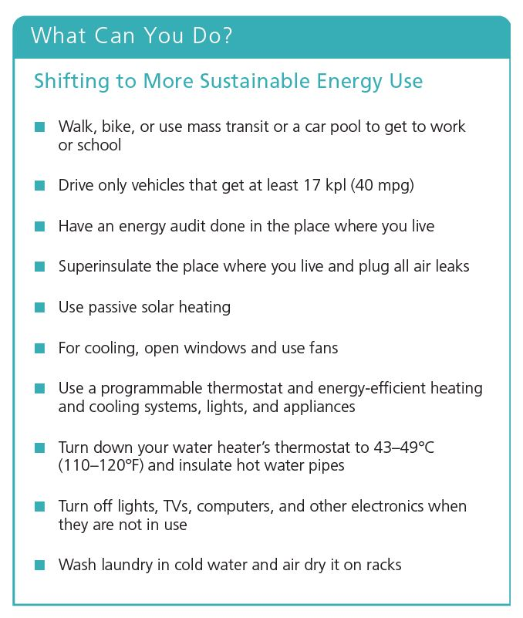
What Can You Do?
Notes:
Figure 16.33 Individuals matter: You can make a shift in your own life toward using energy more sustainably. Critical thinking: Which three of these measures do you think are the most important ones to take? Why? Which of these steps have you already taken and which do you plan to take?

