Slide 1
Exploring Environmental Science for AP®
1st Edition
Chapter 14
Nonrenewable Energy
Copyright © 2018 Cengage Learning. All Rights Reserved. May not be copied, scanned, or duplicated, in whole or in part, except for use as permitted in a license distributed with a certain product or service or otherwise on a password-protected website for classroom use.

Slide 2
Core Case Study: Using Hydrofracking to Produce Oil and Natural Gas (1 of 2)
Oil and natural gas trapped between compressed layers of shale rock formations
New technologies allowed access
Horizontal drilling
Hydraulic fracturing (hydrofracking)
Pump water, sand, and chemicals into cracks
Produces hazardous waste slurry

Slide 3
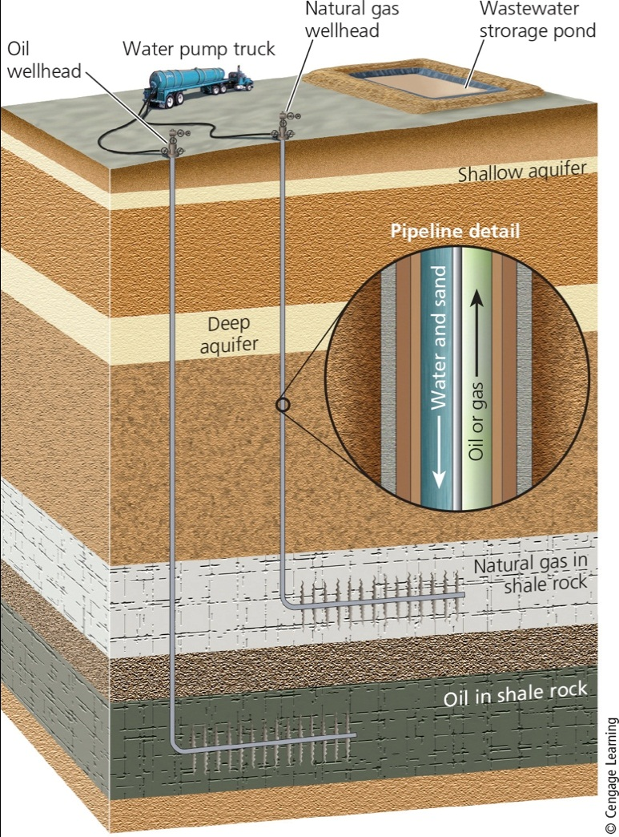
Core Case Study: Using Hydrofracking to Produce Oil and Natural Gas (2 of 2)
Notes:
Figure 15.1 Fracking: Horizontal drilling and hydraulic fracturing are used to release large amounts of oil and natural gas that are tightly held in underground shale rock formations.

Slide 4
14.1 What Types of Energy Resources Do We Use?
90% of the commercial energy used in the world comes from nonrenewable resources
Oil, natural gas, and coal
Energy resources vary greatly in their net energy
Amount of energy available from a resource minus the amount of energy needed to make it available

Slide 5
Where Does the Energy We Use Come From? (1 of 2)
Energy that heats the earth comes from the sun
Commercial energy is sold in the marketplace
Nonrenewable
Oil, coal, natural gas, and nuclear energy
Renewable
Solar, hydropower, biomass, geothermal, and wind

Slide 6
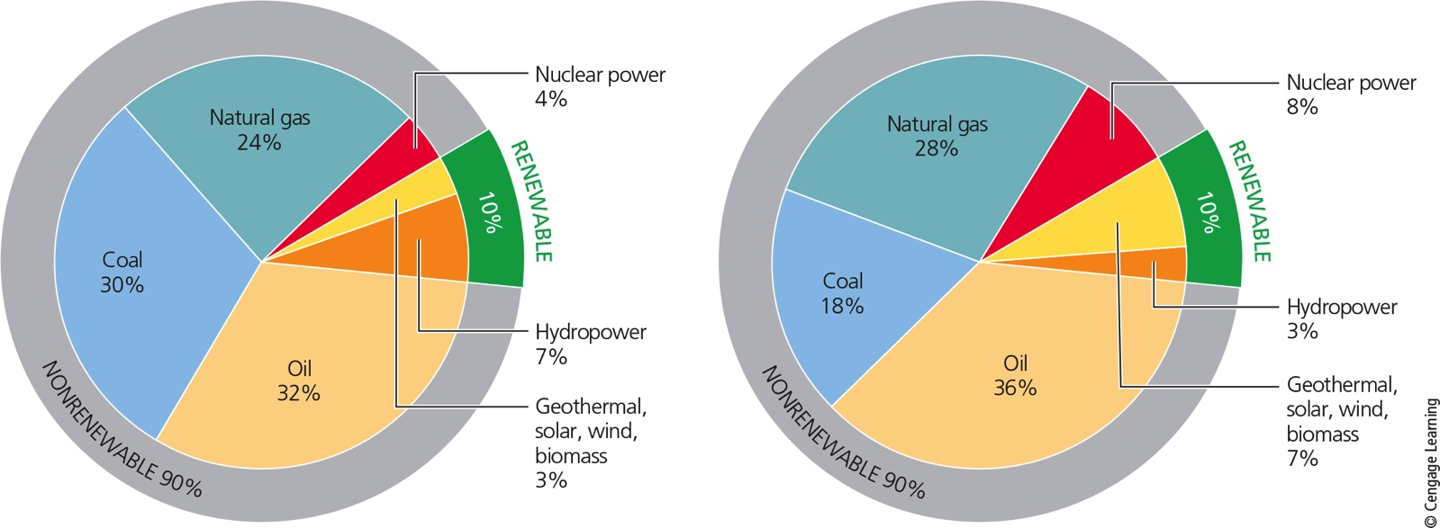
Where Does the Energy We Use Come From? (2 of 2)
Notes:
Figure 15.2 Energy use by source throughout the world (left) and in the United States (right) in 2014.

Slide 7
Net Energy: It Takes Energy to Get Energy (1 of 3)
Each step in making energy available uses high-quality energy
Example: oil must be found, pumped, transferred to a refinery, converted to gasoline, and delivered to consumers
Net energy yield
Amount of high-quality energy available from a resource minus the high-quality energy needed to make the energy available

Slide 8
Net Energy: It Takes Energy to Get Energy (2 of 3)
Net energy ratio
Also called energy returned on investment
Energy obtained per unit energy used to obtain it
Energy efficiency
Getting more useful work using less energy; heating buildings, producing electricity, driving more efficient cars

Slide 9
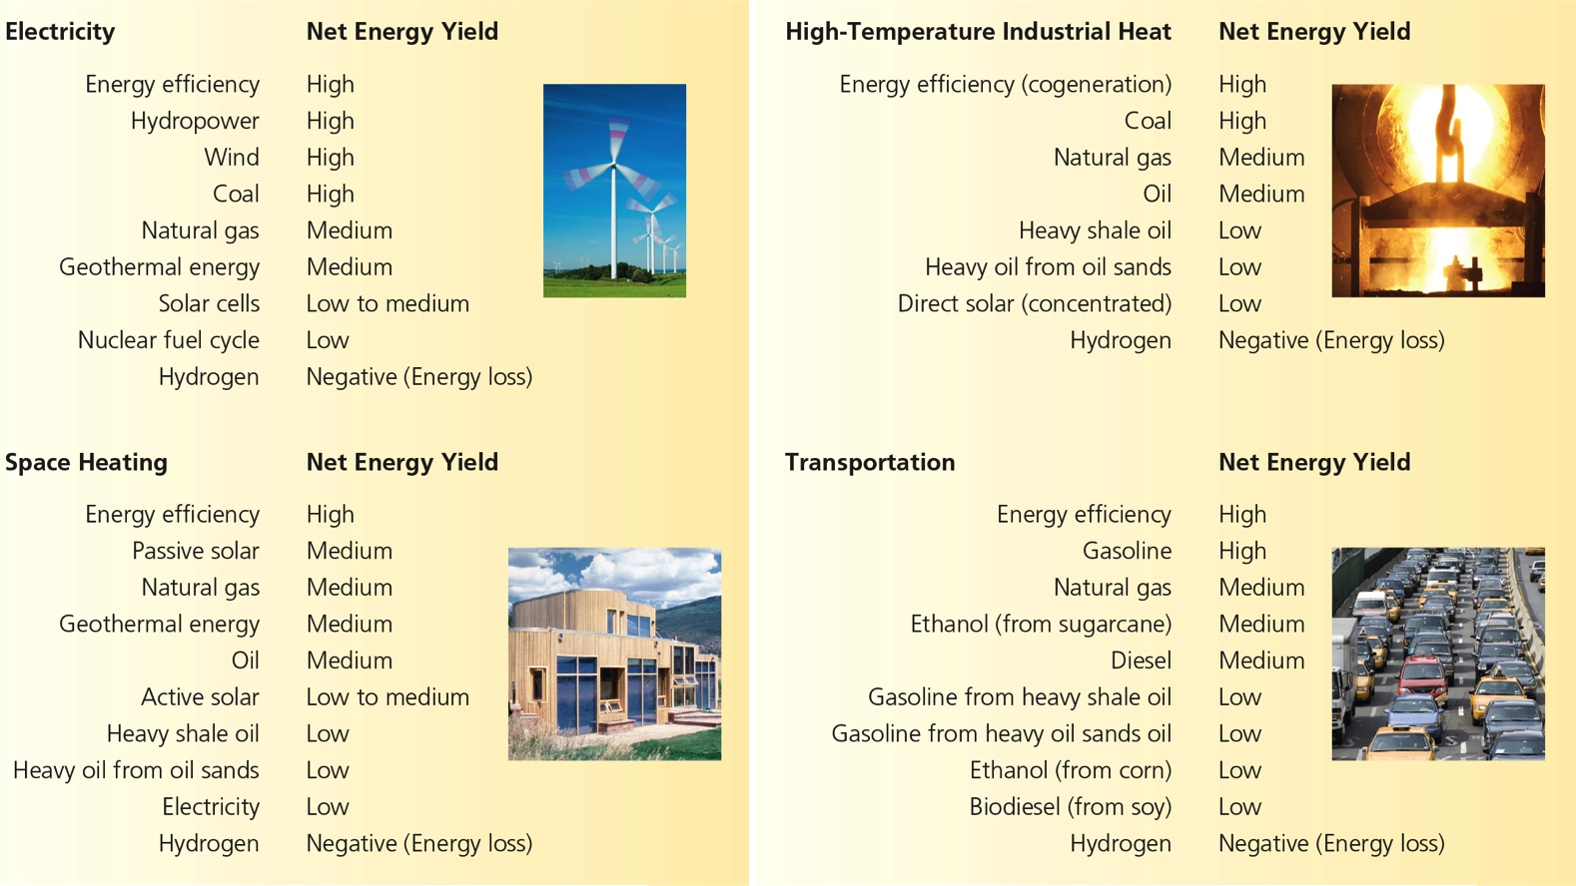
Net Energy: It Takes Energy to Get Energy (3 of 3)
Notes:
Figure 15.3 Generalized net energies for various energy resources and systems (Concept 15.1). Critical thinking: Based only on these data, which two resources in each category should we be using?

Slide 10
14.2 What Are the Advantages and Disadvantages of Using Oil?
Conventional crude oil is abundant
Medium net energy yield
Causes air and water pollution
Releases CO₂ into the atmosphere
Unconventional heavy oil from oil shale rock and oil sands
Potentially large supplies
Low net energy yield
Higher environmental impact

Slide 11
We Depend Heavily on Oil (1 of 3)
Crude oil (petroleum)
Contains combustible hydrocarbons
Peak production
Time after which production from a well declines
Crude oil cannot be used as it comes out of the ground
Must be refined using high-quality energy
Petrochemicals–byproducts

Slide 12
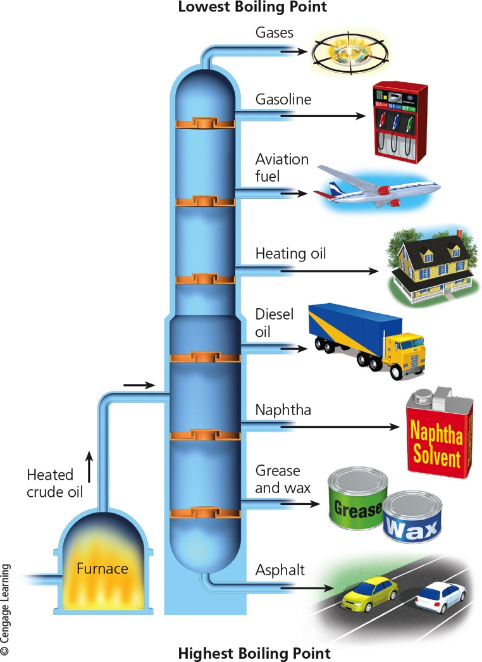
We Depend Heavily on Oil (2 of 3)
Notes:
Figure 15.4a When crude oil is refined, many of its components are removed at various levels of a distillation column, depending on their boiling points. The most volatile components with the lowest boiling points are removed at the top of the column, which can be as tall as a nine-story building.

Slide 13
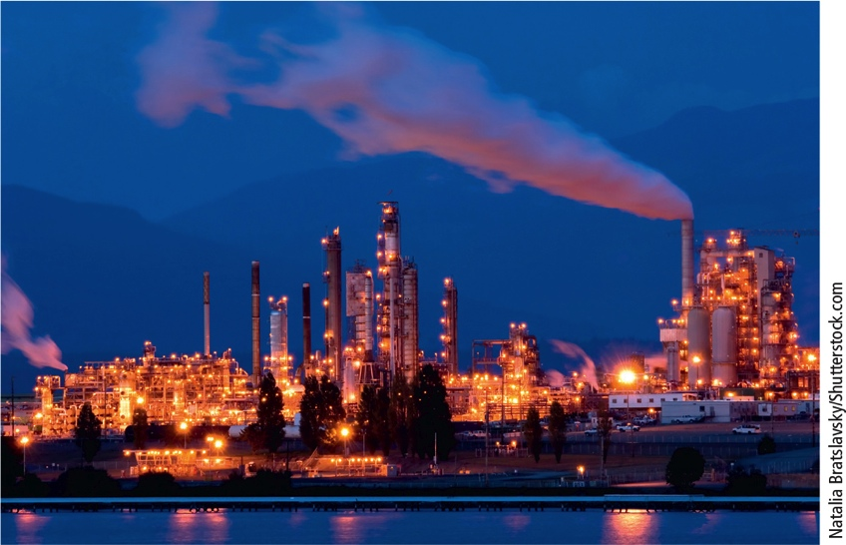
We Depend Heavily on Oil (3 of 3)
Notes:
Figure 15.4b The photo shows an oil refinery in Texas.

Slide 14
Is the World Running Out of Crude Oil? States (1 of 2)
Proven oil reserves–available deposits
12 OPEC countries have 81% of the world’s proven crude oil reserves
These countries play a role in regulating global prices by agreeing to increase or decrease the amount produced
Increasing shortage of cheap oil
Easy-to-reach deposits are quickly being depleted

Slide 15
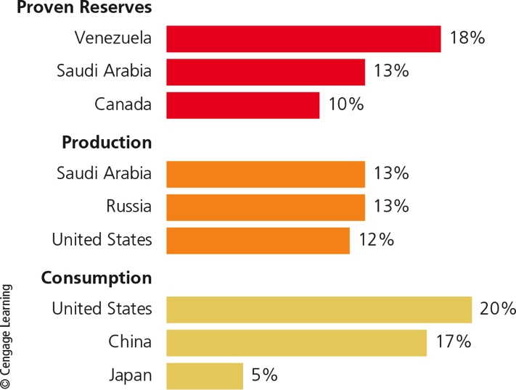
Case Study: Oil Production and Consumption in the United States (1 of 3)
Notes:
Figure 15.5 Countries with the largest proven crude oil reserves, oil production, and oil consumption in 2014

Slide 16
Case Study: Oil Production and Consumption in the United States States (2 of 3)
U.S. commercial energy sources
82% from fossil fuels
Largest portion comes from crude oil
U.S. oil consumption exceeds domestic production
Must import oil
Recent rise in domestic production of tight oil from shale rock
Likely to peak around 2020 and then decline

Slide 17
Case Study: Oil Production and Consumption in the United States (3 of 3)
Notes:
Figure 15.6 Using conventional light oil as an energy resource has advantages and disadvantages. Critical thinking: Which single advantage and which single disadvantage do you think are the most important? Why? Do the advantages of relying on conventional light oil outweigh its disadvantages? Explain.

Slide 18
Use of Heavy Oil Has a High Environmental Impact (1 of 5)
Shale oil
Oil that is integrated within bodies of shale rock
As opposed to being trapped between layers of rock
Production involves mining, crushing, and heating the rock
Extracts kerogen that can be distilled

Slide 19
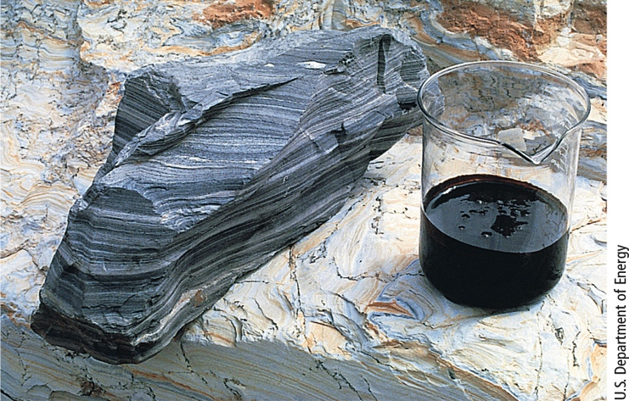
Use of Heavy Oil Has a High Environmental Impact (2 of 5)
Notes:
Figure 15.7 Heavy shale oil (right) can be extracted from oil shale rock (left).

Slide 20
Use of Heavy Oil Has a High Environmental Impact (3 of 5)
Oil sands (tar sands) another source of heavy oil
Contains bitumen
Extensive deposits in Canada
Extraction
Clear-cutting forests and strip-mining the land
Low net energy yield
Requires much water
Emits pollutants

Slide 21
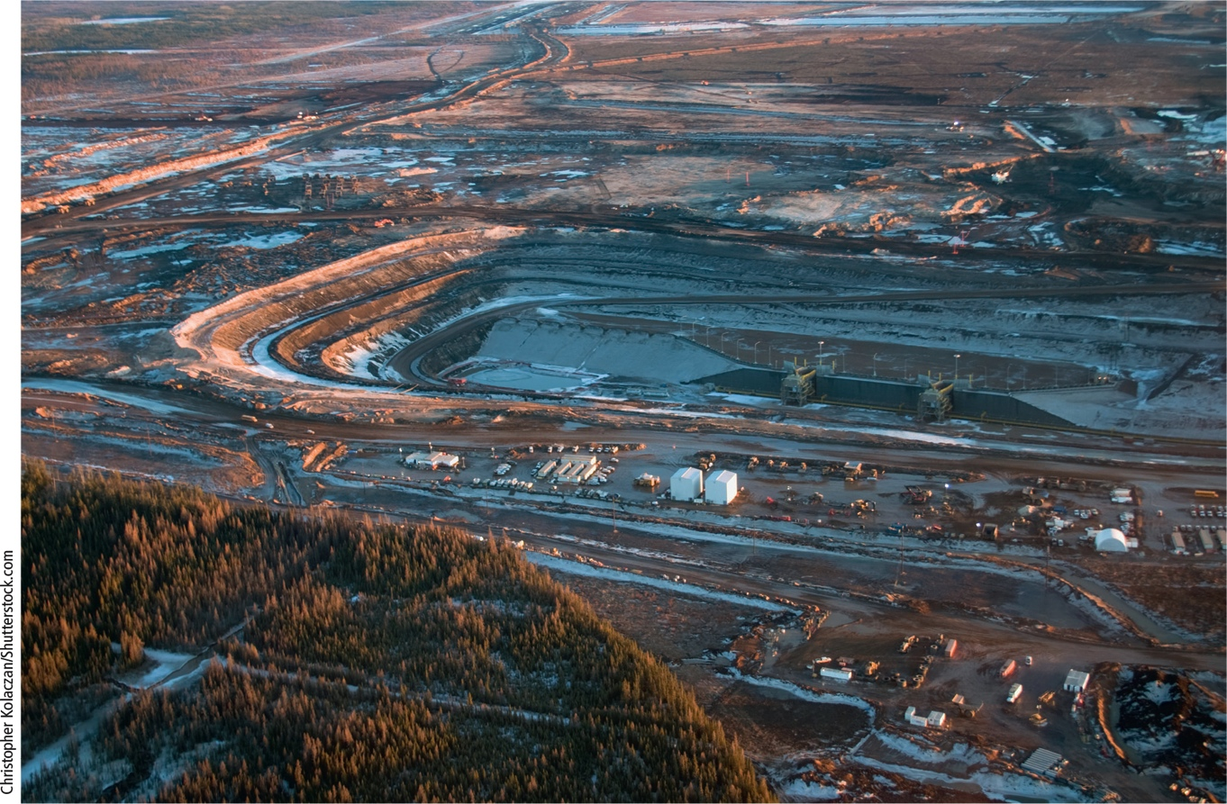
Use of Heavy Oil Has a High Environmental Impact (4 of 5)
Notes:
Figure 15.8 Oil sands surface mining operation in Alberta, Canada, involves clearing boreal forest and strip-mining the land to remove the oil sands.

Slide 22
Use of Heavy Oil Has a High Environmental Impact (5 of 5)
Notes:
Figure 15.9 Using heavy oil from oil sands as an energy resource has advantages and disadvantages (Concept 15.2). Critical thinking: Which single advantage and which single disadvantage do you think are the most important? Why? Do the advantages of relying on heavy oil from oil sands outweigh its disadvantages? Explain.

Slide 23
14.3 What Are the Advantages and Disadvantages of Using Natural Gas?
Natural gas
Mostly methane
Propane, butane, and hydrogen sulfide in smaller amounts
Has a medium net energy yield and a fairly low production cost
Burns cleaner than oil and coal
Extracted through horizontal drilling and fracking

Slide 24
Natural Gas Is a Versatile and Widely Used Fuel (1 of 2 )
Liquefied petroleum gas (LPG)
Stored in pressurized tanks for use in rural areas
Liquefied natural gas (LNG)
Can be transported across oceans
Low net energy yield
The United States currently exports to other nations

Slide 25
Natural Gas Is a Versatile and Widely Used Fuel (2 of 2 )
Notes:
Figure 15.11 Using conventional natural gas as an energy resource has advantages and disadvantages. Critical thinking: Which single advantage and which single disadvantage do you think are the most important? Why? Do you think that the advantages of using conventional natural gas outweigh its disadvantages? Explain.

Slide 26
Science Focus 14.1: Environmental Effects of Natural Gas Production and Fracking in the U.S. (1 of 2)
Fracking has several harmful environmental effects
Requires enormous volumes of water
Produces hazardous wastewater
Earthquakes could release into groundwater
Failure of well-casing cement causes contaminated ground water
Natural gas fracking excluded from EPA regulations in 2005

Slide 27
Science Focus 14.1: Environmental Effects of Natural Gas Production and Fracking in the U.S. (2 of 2)
Notes:
Figure 15.A Natural gas fizzing from this faucet in a Pennsylvania home can be lit like a natural gas stove burner. This began happening after an energy company drilled a fracking well in the area, but the company denies responsibility. The homeowners have to keep their windows open year-round to keep the lethal and explosive gas from building up in the house.

Slide 28
Can Natural Gas Help to Slow Climate Change?
Emits less CO₂ per unit of energy than coal
Low price could slow shift to other renewable energy resources
Methane a much more potent greenhouse gas than CO₂
Drilling, production, and distribution of natural gas releases large quantities of methane

Slide 29
14.4 What Are the Advantages and Disadvantages of Coal? (1 of 2)
Conventional coal is plentiful
High net energy yield
Low cost
Using it has a high environmental impact
We can produce gaseous and liquid fuels from coal
Lower net energy yields
Higher environmental impacts than conventional coal

Slide 30
14.4 What Are the Advantages and Disadvantages of Coal? (2 of 2)
Notes:
Figure 15.18 Using coal as an energy resource has advantages and disadvantages. Critical thinking: Which single advantage and which single disadvantage do you think are the most important? Why? Do you think that the advantages of using coal as an energy resource outweigh its disadvantages? Explain.

Slide 31
Coal Is a Plentiful but Dirty Fuel (1 of 4)
Coal
Solid fossil fuel formed from remains of land plants
Burned in power plants
Generated 40% of the world’s electricity in 2015
Largest consumers of coal
China, the United States, and India

Slide 32
Coal Is a Plentiful but Dirty Fuel (2 of 4)
Environmental costs of burning coal
Mining coal severely degrades land
Water and air pollution
Soot and CO₂
Trace amounts of mercury and radioactive materials
Scrubbers remove some pollutants before they leave smokestacks
Produces coal ash that must be safely stored

Slide 33
Coal Is a Plentiful but Dirty Fuel (3 of 4)
Notes:
Figure 15.12 Over millions of years, several different types of coal have formed. Peat is a soil material made of moist, partially decomposed organic matter, similar to coal; it is not classified as a coal, although it is used as a fuel. These different major types of coal vary in the amounts of heat, carbon dioxide, and sulfur dioxide released per unit of mass when they are burned.

Slide 34
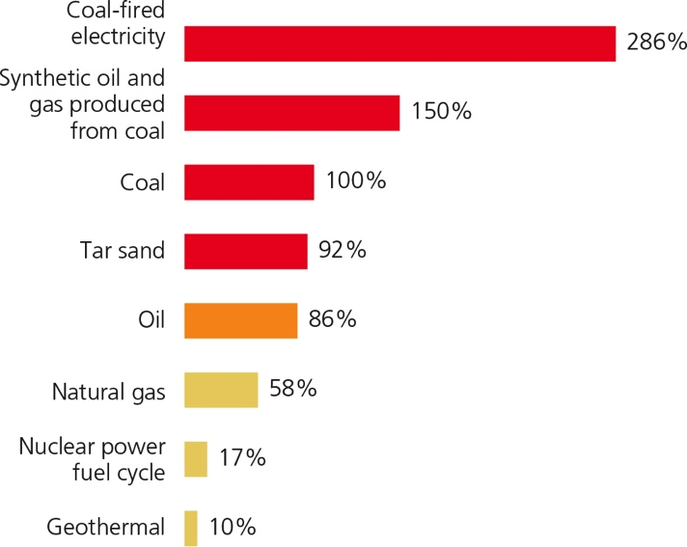
Coal Is a Plentiful but Dirty Fuel (4 of 4)
Notes:
Figure 15.17 CO₂ emissions, expressed as percentages of emissions released by burning coal directly, vary with different energy resources. Data analysis: Which of these produces more CO₂ emissions per kilogram: burning coal to heat a house, or heating with electricity generated by coal?

Slide 35
We Are Not Paying the Full Cost of Using Coal
Harmful environmental and health costs
Not included in market price of coal-generated electricity
Ways to implement full-cost pricing
Phase out subsidies and tax breaks
Require stricter air pollution controls
Tax CO₂ emissions
Regulate coal ash as a hazardous waste

Slide 36
The Future of Coal
U.S. coal use dropped 18% between 2007 and 2013
Increased competition from natural gas, wind, and solar power
Grassroots political opposition
Natural gas should overtake coal as largest electricity source by the 2030s
U.S. coal producers are exporting coal
Use is expanding in India, Africa, and Asia

Slide 37
We Can Convert Coal into Gaseous and Liquid Fuels (1 of 2)
Conversion of solid coal to synfuels
Synthetic natural gas (SNG) by coal gasification
Methanol or synthetic gasoline by coal liquefaction
Producing synfuels requires mining of 50% more coal
Lower net energy and cost more to produce than coal

Slide 38
We Can Convert Coal into Gaseous and Liquid Fuels (2 of 2)
Notes:
Figure 15.19 The use of synthetic natural gas (SNG) and liquid synfuels produced from coal as energy resources has advantages and disadvantages (Concept 15.2). Critical thinking: Which single advantage and which single disadvantage do you think are the most important? Why? Do you think that the advantages of using synfuels produced from coal as an energy source outweigh its disadvantages? Explain.

Slide 39
14.5 What Are the Advantages and Disadvantages of Using Nuclear Power?
Nuclear power has a low environmental impact and a very low accident risk
Drawbacks
Low net energy yield
High costs
Fear of accidents
Long-lived radioactive wastes
Role in spread of nuclear weapons technology

Slide 40
How Does a Nuclear Fission Reactor Work? (1 of 4)
Controlled nuclear fission reaction in a reactor
Light-water reactors
Boil water to produce steam to spin a turbine
Fueled by uranium ore mined from the earth’s crust
Enriched uranium packed as pellets in fuel rods and fuel assemblies
Control rods absorb neutrons

Slide 41
How Does a Nuclear Fission Reactor Work? (2 of 4)
Water is the usual coolant
Containment shell around the core for protection
Emergency core cooling system
Typical cost to construct
$9–11 billion
United States, France, and Russia
Leading producers of nuclear power in 2014
Notes:
41

Slide 42
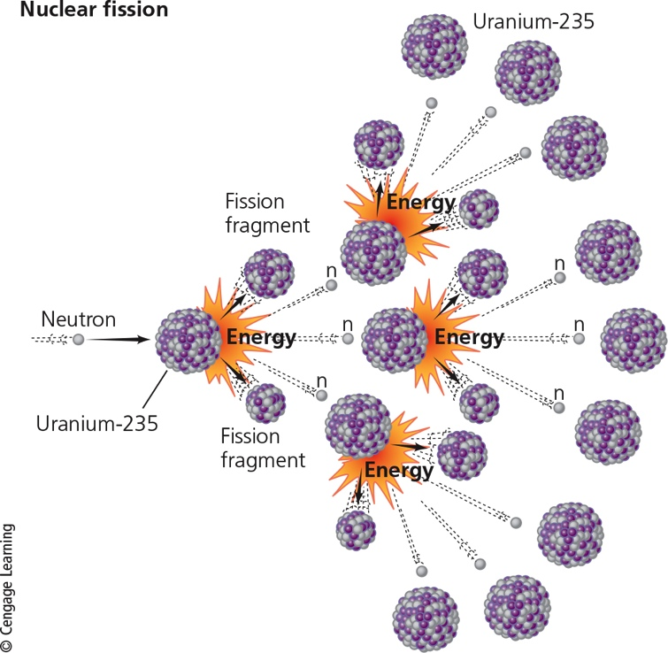
How Does a Nuclear Fission Reactor Work? (3 of 4)
Notes:
Figure 15.20 Nuclear fission is the source of energy for producing electricity in a nuclear power plant.

Slide 43
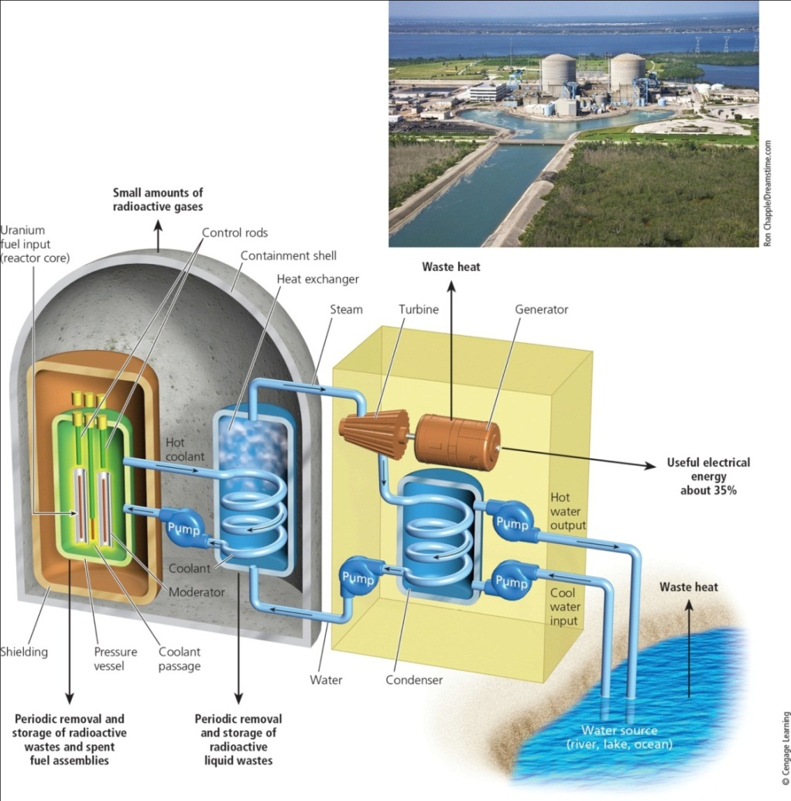
How Does a Nuclear Fission Reactor Work? (4 of 4)
Notes:
Figure 15.21 Nuclear power plant. Intense heat from the nuclear fission of uranium-235 in a chain reaction (Figure 15.20) in the core of this pressurized water-cooled nuclear power plant is transferred to two heat exchangers and converted to steam, which spins a turbine that generates electricity. About 65% of the energy released by the nuclear fission of the plant’s uranium fuel is wasted. It ends up as heat that flows into the atmosphere through gigantic cooling towers (shown in the photo) or into water from a nearby source that is used to cool the plant. Critical thinking: How does this plant differ from the coal-burning plant in Figure 15.13?

Slide 44
What Is the Nuclear Fuel Cycle? (1 of 3)
Mining the uranium
Processing and enriching the uranium to make fuel
Using it in a reactor
Safely storing the radioactive waste
Retiring the worn-out plant
Storing its high- and moderate-level radioactive parts safely

Slide 45
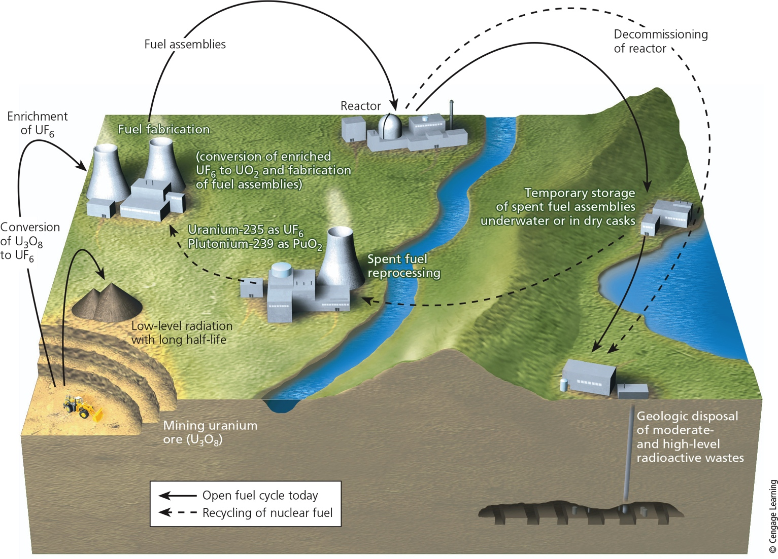
What Is the Nuclear Fuel Cycle? (2 of 3)
Notes:
Figure 15.22 Using nuclear power to produce electricity involves a sequence of steps and technologies that together are called the nuclear fuel cycle. Critical thinking: Do you think the market price of nuclear-generated electricity should include all the costs of the nuclear fuel cycle, in keeping with the full-cost pricing principle of sustainability? Explain

Slide 46
What Is the Nuclear Fuel Cycle? (3 of 3)
Notes:
Figure 15.23 Using the nuclear power fuel cycle (Figure 15.22) to produce electricity has advantages and disadvantages. Critical thinking: Which single advantage and which single disadvantage do you think are the most important? Why? Do you think that the advantages of using nuclear power outweigh its disadvantages? Explain.

Slide 47
Dealing with Radioactive Nuclear Wastes (1 of 2)
Rods must be replaced every three to four years
Stored in water-filled pools for several years to cool
Transferred to dry casks
Can be processed to remove plutonium
Reprocessing reduces storage time from 240,000 years to about 10,000 years
Costly and produces weapons material

Slide 48
Dealing with Radioactive Nuclear Wastes (2 of 2)
No permanent, secure repository exists today
Nevada Yucca Mountain site plan abandoned
Retiring nuclear plants
Enormous costs

Slide 49
Can Nuclear Power Slow Climate Change?
Nuclear power plants–no CO₂ emission
Nuclear fuel cycle–emits CO₂
Cutting global CO₂ emissions in half between 2015 and 2040 and meeting energy needs would require building 12,000 nuclear power reactors
According to Mark Lynas, climate change author

Slide 50
Controversy about the Future of Nuclear Power (1 of 3)
Nuclear reactors produced 19% of U.S. energy in 2014
67 new nuclear reactors under construction worldwide in 2015
U.S. government provides subsidies, tax breaks, and insurance for the nuclear industry
Accidents have dampened public confidence in nuclear power

Slide 51
Controversy about the Future of Nuclear Power (2 of 3)
New technologies
Advanced light-water reactors
Built-in safety features
Smaller, modular light water reactors
Not yet built and evaluated
Thorium-based reactors
Less costly and safer

Slide 52
Controversy about the Future of Nuclear Power (3 of 3)
Solutions
Reactors must be built so that a runaway chain reaction is impossible.
The reactor fuel and methods of fuel enrichment and fuel reprocessing must be such that they cannot be used to make nuclear weapons.
Spent fuel and dismantled plants must be easy to dispose of without burdening future generations with harmful radioactive waste.
Taking its entire fuel cycle into account, nuclear power must generate a net energy high enough so that it does not need government subsidies, tax breaks, or loan guarantees to compete in the open marketplace.
Its entire fuel cycle must generate fewer greenhouse gas emissions than other energy alternatives.

Slide 53
Case Study: The Fukushima Daiichi Nuclear Power Plant Accident in Japan
March 11, 2011 accident
Triggered by major offshore earthquake and resulting tsunami
Important effects
Increased fear about nuclear power
Revealed single accident can cost $500 billion
Some countries announced phasing out nuclear power
Spurred Japan to reduce energy use

Slide 54
Is Nuclear Fusion the Answer?
Fusion
Two isotopes fused together to form a heavier nucleus
Releases energy
Technology used by the sun to release energy
Technology is very difficult to develop
No approach has produced more energy than it has used

Slide 55
Big Ideas (1 of 2)
Net energy
Key factor in evaluating the long-term usefulness of any energy resource
Conventional oil, natural gas, and coal
Plentiful with moderate to high net energy yields
Use has a high environmental impact

Slide 56
Big Ideas (2 of 2)
Nuclear power fuel cycle
Low environmental impact
Very low accident risk
Downsides
High costs
Low net energy
Long-lived radioactive wastes
Role in spreading nuclear weapons technology

Slide 57
Tying It All Together: Fracking, Nonrenewable Energy, and Sustainability
Horizontal drilling and fracking have greatly increased oil and natural gas production in the United States
Long-term usefulness of an energy resource depends on net energy
Challenge: find ways to reduce harmful environmental impacts of fossil fuels and nuclear energy
Option: shift to renewable energy resources

