Slide 1
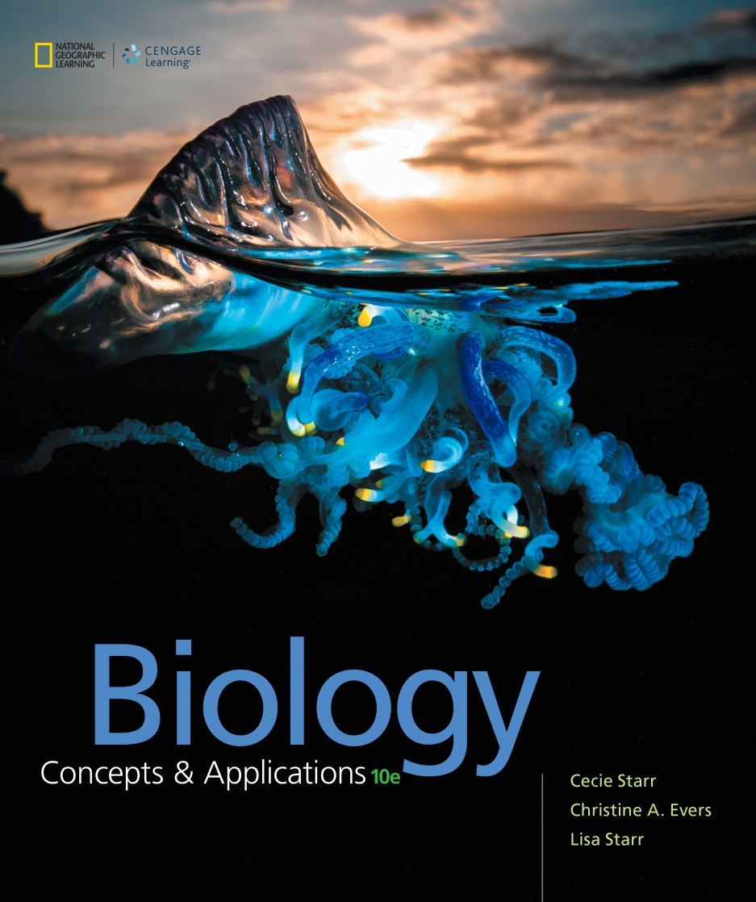
Biology Concepts & Applications
10 Edition
Chapter 14
Human Inheritance
Copyright © 2018 Cengage Learning. All Rights Reserved. May not be copied, scanned, or duplicated, in whole or in part, except for use as permitted in a license distributed with a certain product or service or otherwise on a password-protected website for classroom use.

Slide 2
14.1 Human Chromosomes
Pea plants and fruit flies are perfect for genetic studies because:
They have few chromosomes
They reproduce quickly
They can survive in lab conditions
There are few ethical problems with their use

Slide 3
Human Traits are Complex (1 of 2)
Humans involve more issues
Relatively few traits follow a Mendelian inheritance pattern
Cannot ethically perform test crosses
Live in variable conditions and places
Select own mates
Reproduce if and when chose
Sampling errors due to small family sizes

Slide 4
Human Traits are Complex (2 of 2)
Single gene disorders affect about 1 in 100 people
Most human traits are polygenic
Influenced by multiple genes
Traits can be influenced by environmental factors
Alleles that give rise to severe genetic disorders are rare

Slide 5
Some Single Gene Disorders
TABLE 14.1
Some Autosomal Abnormalities and Disorders
Disorder/Abnormality Main Symptoms
Autosomal dominant inheritance pattern
Achondroplasia | One form of dwarfism
Aniridia | Defects of the eyes
Huntington's disease | Degeneration of the nervous system
Marfan syndrome | Abnormal or missing connective tissue
Progeria | Drastic premature aging
Autosomal recessive inheritance pattern
Albinism | Absence of pigmentation
Cystic fibrosis | Difficulty breathing; lung infections
Ellis—van Creveld syndrome | Dwarfism, heart defects, polydactyly
Phenylketonuria (PKU) | Mental impairment
Tay—Sachs disease | Deterioration of mental and physical abilities; early death
pedigree Chart of family connections that shows the appearance of a phenotype through generations.
Notes:
Table 14.1 Some Autosomal Abnormalities and Disorders

Slide 6
Pedigrees
Geneticists often use historical records to study human traits
Make charts (pedigrees of genetic connections)
Determine the probability that a trait will recur in future generations
Predict probability that a disorder will reappear

Slide 7
Pedigree Analysis
Notes:
Figure 14.1 Pedigrees.
A Standard symbols used in pedigrees.
B Above, a pedigree for polydactyly, a genetic abnormality characterized by extra fingers (right), toes, or both. The number of fingers on each hand is indicated in black; toes on each foot, in red. Polydactyly on its own is often inherited in an autosomal dominant pattern. When part of a syndrome (such as Ellis–van Creveld syndrome), it can be inherited in an autosomal recessive pattern (more about these patterns in the next section).

Slide 8
14.2 Examples of Autosomal Inheritance Patterns
Inheritance of alleles
Autosomal dominant pattern
The trait it specifies appears in homozygous and heterozygous people
Autosomal recessive pattern
The trait it specifies appears only in homozygous people

Slide 9
Autosomal Dominance
An autosomal dominant trait appears in every generation
When one parent is heterozygous, and the other is homozygous recessive, each child has a 50% chance of inheriting the dominant allele and displaying the trait

Slide 10
Autosomal Dominant Inheritance
Notes:
Figure 14.2 Autosomal dominant inheritance.
A A dominant allele (red) on an autosome affects heterozygous people.
B Achondroplasia affects Ivy Broadhead (left), as well as her brother, father, and grandfather.
C Symptoms of Hutchinson–Gilford progeria are already apparent in Megan, age 5.

Slide 11
Some Autosomal Dominant Disorders
Achondroplasia: form of hereditary dwarfism caused by mutations in gene for a growth factor
Huntington’s disease: impacts brain cell function; caused by expansions of STRs in a gene for a cytoplasmic protein
Hutchinson-Gilford Progeria: accelerated aging caused by mutation in gene for lamin A

Slide 12
The Autosomal Recessive Pattern
An autosomal allele is inherited in a recessive pattern if it is expressed only in homozygous people, so recessive traits may skip generations
People heterozygous for the allele are carriers; they have the allele but not the trait
Each child of two carriers has a 25% chance of being homozygous and having the trait

Slide 13
Autosomal Recessive Inheritance
Notes:
Figure 14.3 Autosomal recessive inheritance.
A Only people homozygous for a recessive allele on an autosome (red) have the associated trait. In this example, both parents are carriers. Each of their children has a 25 percent chance of inheriting two alleles, and having the trait.
B Conner Hopf was diagnosed with Tay–Sachs disease at age 7½ months. He died before his second birthday.

Slide 14
Some Autosomal Recessive Disorders
Tay-Sachs disease: caused by mutation in enzyme that breaks down a particular type of lipid
1 in 300 of general population carries the allele
1 in 30 Jews of eastern European descent carries the allele
Albinism: caused by mutations that reduce melanin synthesis

Slide 15
14.3 Examples of X-Linked Inheritance Patterns
X-linked recessive pattern
An allele is inherited on the X chromosome
Most are recessive, because X-linked dominant alleles tend to be lethal in male embryos

Slide 16
Some X-Linked Traits
TABLE 14.2
Some X-Linked Traits
Disorder/Abnormality Main Symptoms
X-linked recessive inheritance pattern
Androgen insensitivity syndrome | XY individual but having some female traits; sterility
Red—green color blindness | Inability to distinguish red from green
Hemophilia | Impaired blood clotting ability
Muscular dystrophies | Progressive loss of muscle function
X-linked anhidrotic dysplasia | Mosaic skin (patches with or without sweat glands); other ill effects
X-linked dominant inheritance pattern
Fragile X syndrome | Intellectual, emotional disability
Incontinentia pigmenti | Abnormalities of skin, hair, teeth, nails, eyes; neurological problems
Notes:
Table 14.2 Some X-Linked Traits

Slide 17
X-Linked Recessive Pattern
X-linked recessive disorders tend to appear in men more often than in women
Men (XY) have only one X chromosome
Women have two X chromosomes (XX), so they can be heterozygous for a recessive allele
Men can transmit an X-linked allele to daughters, but not to sons–only a woman can pass an X-linked allele to a son

Slide 18
X-Linked Recessive Inheritance
Notes:
Figure 14.4 X-linked recessive inheritance.
A In this example, the mother carries a recessive allele on one of her two X chromosomes (red).
B A view of color blindness, a trait inherited in an X-linked recessive pattern. The photo on the left shows how a person with red–green color blindness sees the photo on the right. The perception of blues and yellows is normal; red and green appear similar. The circle diagrams are part of a standardized test for color blindness. A set of 38 of these diagrams is commonly used to diagnose deficiencies in color perception.

Slide 19
Red–Green Color Blindness
Most genes involved in proper function of pigment-containing receptors in the eyes are on the X chromosome
Color blindness includes a range of conditions in which an individual cannot distinguish among some or all colors
Some confuse red and green colors; others see green as shades of gray, but perceive blues and yellows quite well

Slide 20
Duchenne Muscular Dystrophy
X-linked recessive disorder causes the protein dystrophin to be absent
Muscle and nerve cells become replaced by fat cells
Affects 1 in 3,500 people, mostly boys
Boys with DMD are in a wheelchair by age 12, and die from a heart disorder or respiratory failure before age 30

Slide 21
Hemophilia
Disorders in which the blood does not clot properly
Clotting factors VIII and IX are both on X chromosome
Males and homozygous females have prolonged bleeding
Affected people bruise easily, but internal bleeding is their most serious problem
In the 19th century, it was relatively common in royal families of Europe and Russia

Slide 22
Hemophilia B in Royalty
Notes:
Figure 14.5 A classic case of X-linked recessive inheritance. Hemophilia B afflicted many descendants of Queen Victoria of England. The disease was caused by a rare X-linked allele that most likely arose from a spontaneous germline mutation.

Slide 23
14.4 Changes in Chromosome Structure
Mutations are usually small-scale changes in DNA sequence
Larger scale changes in chromosomes also occur
Include duplications, deletions, inversions, and translocations
Have been evolutionarily important
Tend to result in genetic disorders

Slide 24
Types of Changes (1 of 3)
Insertions
Large insertions usually result from activity of transposable elements
Long segments of DNA that can move spontaneously within or between chromosomes
Duplications
Repeated section of a chromosome
Occur during prophase I of meiosis

Slide 25
Types of Changes (2 of 3)
Deletions
Loss of a part of a chromosome
In mammals, can cause serious disorders that are often lethal
Inversion
Structural rearrangement of a chromosome where part becomes oriented in the reverse direction
May not affect carrier’s health but may affect fertility

Slide 26
Types of Changes (3 of 3)
Translocation of a chromosome
A broken piece gets reattached in the wrong location
Most translocations are reciprocal, or balanced; two chromosomes exchange broken parts
Can affect fertility

Slide 27
Some Major Changes in Chromosome Structure
Notes:
Figure 14.6 Some types of major change in chromosome structure.
A Duplication A section of a chromosome is repeated.
B Deletion A section of a chromosome is lost.
C Inversion A section of a chromosome is flipped so it runs in the opposite orientation.
D Translocation A piece of a broken chromosome is reattached in the wrong place. This example shows a reciprocal translocation, in which two nonhomologous chromosomes exchange chunks.

Slide 28
Chromosomes and Evolution (1 of 3)
Most major alterations in chromosomes are harmful or lethal in humans
Many major structural changes have accumulated in chromosomes of all species over evolutionary time
Speciation occurs by large-scale changes in chromosomes

Slide 29
Chromosomes and Evolution (2 of 3)
Evolution of the Y chromosome
X and Y chromosomes were once homologous autosomes
About 350 mya, a gene on one chromosome mutated–interfering with crossing over during meiosis–and mutations began to accumulate separately in the two chromosomes
Today, the SRY gene (Y chromosome) determines male sex

Slide 30
Chromosomes and Evolution (3 of 3)
Human somatic cells have 23 pairs of chromosomes
Chimpanzees, gorillas, and orangutans have 24 pairs
During human evolution, two chromosomes fused end to end and formed our chromosome 2

Slide 31
Evolution of the Y Chromosome
Notes:
Figure 14.7 Evolution of the Y chromosome. Today, the SRY gene on the Y chromosome determines male sex, but this was not always the case. Homologous regions are pink; mya, million years ago. Monotremes are egg-laying mammals; marsupials are pouched mammals.
A Before 350 mya, sex was determined by temperature, not by chromosome differences.
B The SRY gene begins to evolve 350 mya. The DNA sequences of the chromosomes diverge as other mutations accumulate.
C By 320–240 mya, the DNA sequences of the chromosomes are so different that the pair can no longer cross over in one region. The Y chromosome begins to shorten.
D Three more times, the pair stops crossing over in yet another region. Each time, the DNA sequences of the chromosomes diverge, and the Y chromosome shortens. Today, the pair crosses over only at a small region near the ends.

Slide 32
Chromosome 2 vs. 2A and 2B
Notes:
Figure 14.8 Human chromosome 2 compared with chimpanzee chromosomes 2A and 2B

Slide 33
14.5 Changes in Chromosome Number (1 of 2)
Occasionally abnormal events can occur
Happens before or during meiosis
New individuals end up with the wrong chromosome number
Consequences range from minor to lethal changes in form and function
Polyploidy
Individuals have three or more of each type of chromosome
Lethal in humans
Many flowering plants, and some insects, fishes, and other animals, are polyploid

Slide 34
Changes in Chromosome Number (2 of 2)
Aneuploidy
An individual’s cells have too many or too few copies of a chromosome (result of nondisjunction)
Most cases of autosomal aneuploidy are lethal in embryos
Nondisjunction
Failure of sister chromatids or homologous chromosomes to separate during nuclear division
Changes in chromosome number are usually caused by nondisjunction
Affects chromosome number at fertilization
Causes genetic disorders among resulting offspring

Slide 35
Nondisjunction
Notes:
Figure 14.9 An example of nondisjunction. Of the two pairs of homologous chromosomes shown here, one fails to separate properly during anaphase I of meiosis. The chromosome number is altered in the resulting gametes.

Slide 36
Human Chromosome Number Changes
TABLE 14.4
A Few Effects of Human Chromosome Number Change
Cause | Syndrome | Main Symptoms
Trisomy 21 | Down | Mental impairment; heart defects
Trisomy 18 | Edwards | Severe disability; low survival rate
Trisomy 13 | Patau | Severe disability; low survival rate
Turner | Turner | Abnormal ovaries and sexual traits
XXY | Klinefelter | Sterility; mild mental impairment
XXX | Trisomy X | Minimal abnormalities
XYY | Jacob' | Mild mental impairment or no effect
Notes:
Table 14.4 A Few Effects of Human Chromosome Number Change

Slide 37
Down Syndrome
Trisomy 21
Presence of three copies of chromosome 21
Effects:
Mild to moderate mental impairment
Health problems such as heart disease
Flattened facial profile; fold of skin on inner corner of eye
Low muscle tone
Occurs in 1 in 700 births; risk increases with maternal age

Slide 38
Sex Chromosome Changes
Usually results in some degree of impairment in learning and motor skills
In individuals with trisomy (XXY, XXX, and XYY), these problems can be subtle and the cause may never be diagnosed

Slide 39
X Chromosome Abnormalities
Turner syndrome: X and no corresponding X or Y (XO)
Well proportioned but short
Ovaries do not develop properly
Insufficient sex hormones to become sexually mature
XXX syndrome: three X
Mild mental impairment may occur
Usually no physical or medical problems

Slide 40
Y Chromosome Abnormalities
Klinefelter syndrome: two X and one Y
Tend to be overweight and tall; normal range of intelligence
Make more estrogen and less testosterone than normal males, which has feminizing effects
XYY syndrome: one X and two Y
Tend to be taller than average and have mild mental impairment
No predisposition to a life of crime

Slide 41
14.6 Genetic Screening (1 of 3)
Can estimate probability that a child will inherit a genetic disorder
Pedigrees and genotype are analyzed by a genetic counselor
Some disorders can be detected early enough to start countermeasures before symptoms develop
More than 30 conditions detectable prenatally

Slide 42
Genetic Screening (2 of 3)
Newborn screening for phenylketonuria (PKU)
Newborns screened for mutations in the gene phenylalanine hydroxylase, a defect that can cause phenylalanine to accumulate to high levels
Results in imbalance that inhibits protein synthesis in the brain
Causes severe neurological symptoms characteristic of (PKU)

Slide 43
Genetic Screening (3 of 3)
Prenatal diagnosis
Testing of an embryo or fetus can reveal genetic abnormalities or disorders before birth
Obstetric sonography
Fetoscopy
Amniocentesis
Chorionic villus sampling (CVS)
Invasive procedure that can carry a risk to the fetus

Slide 44
Tissues Tested in Prenatal Diagnosis
Notes:
Figure 14.11 Tissues tested in prenatal diagnosis. With amniocentesis, fetal cells that have been shed into amniotic fluid are tested for genetic disorders. Chorionic villus sampling tests cells of the chorion, which is part of the placenta.

Slide 45
Application: Shades of Skin
Skin color has a genetic basis
Minor differences in alleles for melanin synthesis and deposition of melanosomes affect skin color
Evolved as a balance between vitamin D production and protection against harmful UV radiation
The evolution of regional variations in human skin color began with mutations in genes involved in pigmentation

Slide 46
Mixed Ethnicity Makes Different Combinations of Alleles
Notes:
Figure 14.12 Fraternal twins Kian and Remee with their parents. Both of the children’s grandmothers are of European descent, and have pale skin. Both of their grandfathers are of African descent, and have dark skin. The twins inherited different alleles of some genes that affect skin color from their parents, who, given the appearance of their children, must be heterozygous for those alleles.

Slide 47
Discuss
If it becomes possible to easily and inexpensively choose the sex of your child, how will this change the male to female ratio among newborns? Do you think it is ethically correct to select the sex of your children?
Why do so many people insist that girls cannot be red–green color blind?

