Slide 1
Exploring Environmental Science for AP®
1st Edition
Chapter 13
Water Resources
Copyright © 2018 Cengage Learning. All Rights Reserved. May not be copied, scanned, or duplicated, in whole or in part, except for use as permitted in a license distributed with a certain product or service or otherwise on a password-protected website for classroom use.

Slide 2
Case Study: The Colorado River Story (1 of 2)
The Colorado River
Flows 2,300 km through seven U.S. states
Includes 14 dams and reservoirs
Water supplied mostly from snowmelt of the Rocky Mountains
Supplies water and electricity for about 40 million people
Las Vegas, Phoenix, Los Angeles, and San Diego
Irrigates crops that help feed America

Slide 3
Case Study: The Colorado River Story (2 of 2)
Issues
Very little water is reaching the Gulf of California
System has experienced severe drought since 1999
Lake Mead fell to record low water level in 2015

Slide 4
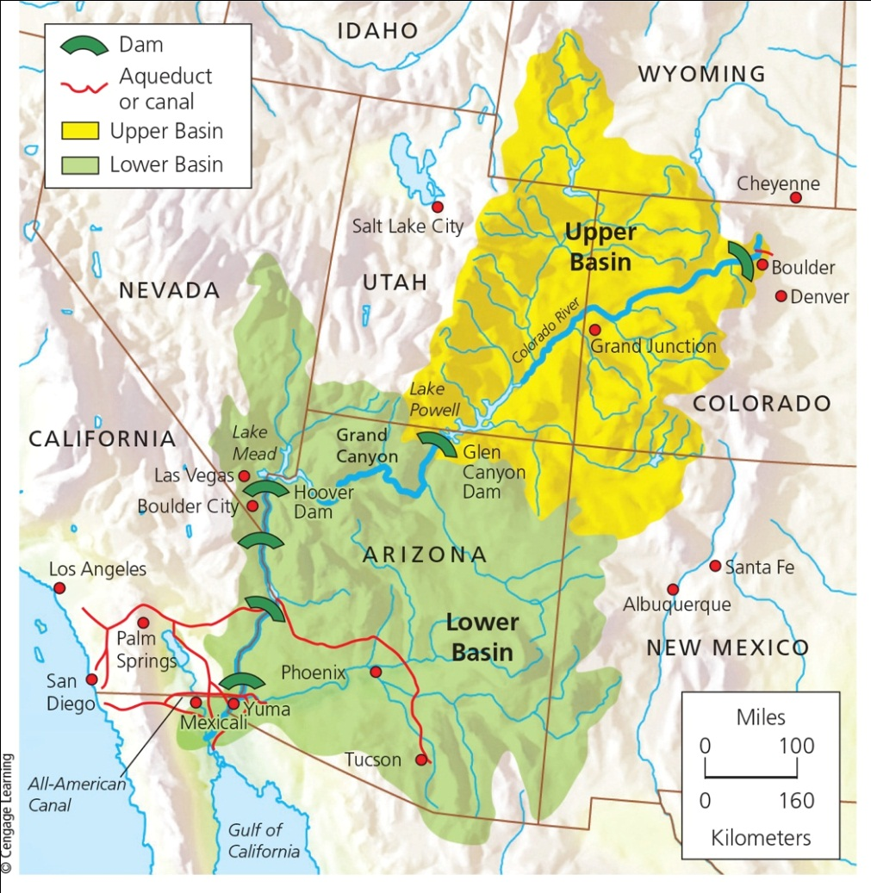
The Colorado River Basin
Notes:
Figure 13.1 The Colorado River basin: The area drained by this river system is more than one-twelfth of the land area of the lower 48 states. This map shows 6 of the river’s 14 dams.

Slide 5
13.1 Will We Have Enough Usable Water?
Freshwater
One of the earth’s most important forms of natural capital
Used inefficiently and polluted
Low cost encourages waste
Not accessible to many people

Slide 6
Freshwater Is an Irreplaceable Resource That We Are Managing Poorly
Access to freshwater a global health issue
Over 4,000 people die each day from lack of access to safe drinking water
Economic issue
Water vital for producing food and energy
National and global security issue
Environmental issue
Excessive withdrawal

Slide 7
Most of Earth’s Freshwater Is Not Available to Us (1 of 2)
Freshwater availability: 0.024% of water supply
Groundwater, lakes, rivers, and streams
Hydrologic cycle
Movement of water in the seas, land, and air
Distributed unevenly
Humans alter the hydrologic cycle
Withdrawing and polluting water, and causing climate change

Slide 8
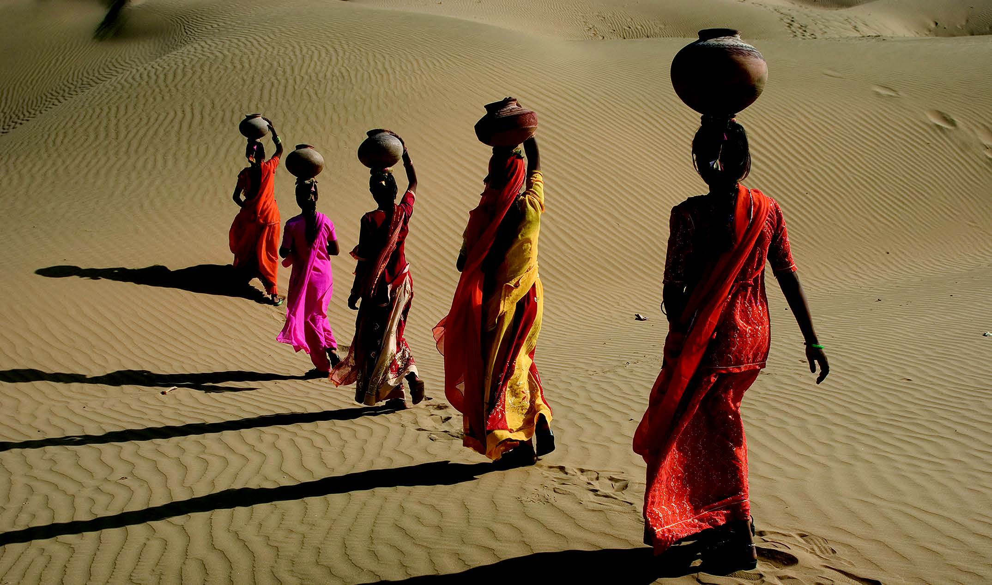
Most of Earth’s Freshwater Is Not Available to Us (2 of 2)
Shiv Ji Joshi/National Geographic Creative

Slide 9
Groundwater and Surface Water Are Critical Resources (1 of 3)
Zone of saturation
Spaces in soil below a certain depth are filled with water
Water table
Top of zone of saturation
Aquifers
Recharged naturally by precipitation or by nearby lakes, rivers, and streams

Slide 10
Groundwater and Surface Water Are Critical Resources (2 of 3)
Surface water
Surface runoff
Watershed (drainage) basin

Slide 11
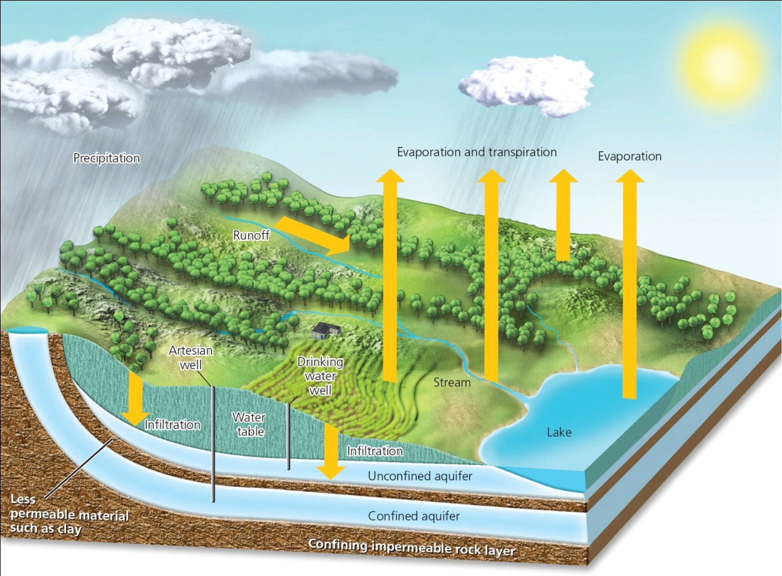
Groundwater and Surface Water Are Critical Resources (3 of 3)
Notes:
Figure 13.3 Natural capital: Much of the water that falls in precipitation seeps into the ground to become groundwater, stored in aquifers.

Slide 12
We Are Using Increasing Amounts of the World’s Reliable Runoff (1 of 2)
Two-thirds of surface runoff lost to seasonal floods
Reliable runoff
Remaining one-third reliable source of freshwater
Worldwide averages
Irrigation for crops and livestock: 70%
Industrial use: 20%
Cities and residences: 10%

Slide 13
We Are Using Increasing Amounts of the World’s Reliable Runoff (2 of 2)
Virtual water
Water used to produce food and other products
Notes:
Figure 13.4 Producing and delivering a single one of each of the products listed here requires the equivalent of nearly one and usually many bathtubs full of freshwater, called virtual water. Note: 1 bathtub = 151 liters (40 gallons).

Slide 14
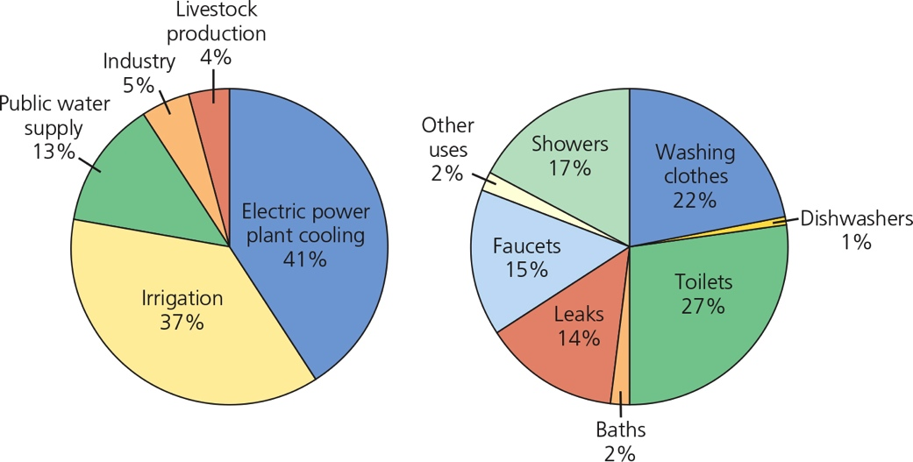
Case Study: Freshwater Resources in the United States (1 of 2)
More than enough renewable freshwater
Unevenly distributed and polluted
Notes:
Figure 13.5 Comparison of primary uses of water in the United States (left) and uses of water in a typical U.S. household (right). Data analysis: Which three categories, added together, are smaller than the amount of water lost in leaks?

Slide 15
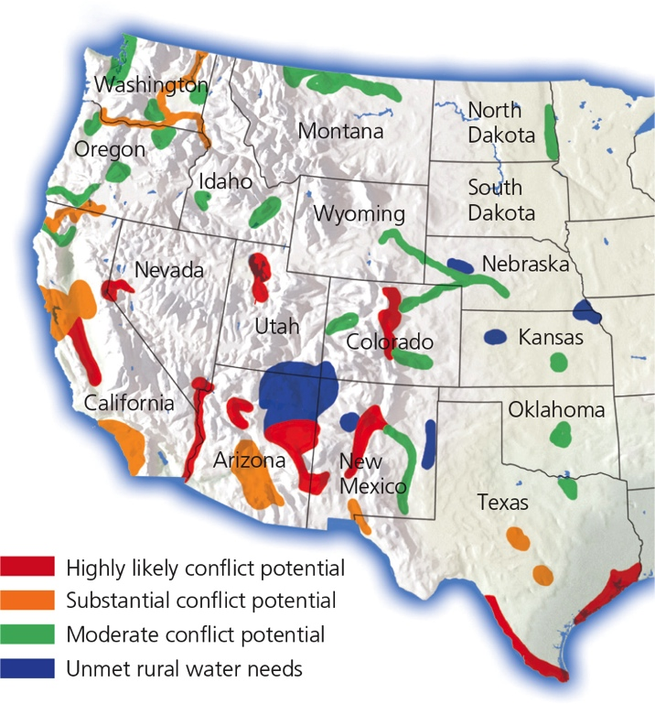
Case Study: Freshwater Resources in the United States (2 of 2)
Notes:
Figure 13.7 Water scarcity hotspots in 17 western states that, by 2025, could face intense conflicts over scarce water needed for urban growth, irrigation, recreation, and wildlife. Question: Which, if any, of these areas are found in the Colorado River basin (Core Case Study)?

Slide 16
Critical Concept: Your Water Footprint (1 of 2)
Rough measure of all the water an individual uses
Virtual water is water used indirectly to produce products and food, but is considered part of a person's water footprint depending on what they consume

Slide 17
Critical Concept: Your Water Footprint (2 of 2)
Producing and delivering a single one of each of the products listed here requires the equivalent of nearly one and usually many bathtubs full of freshwater, called virtual water. Note: 1 bathtub = 151 liters (40 gallons).
Bathtub: Baloncici/Shutterstock.com. Coffee: Aleksandra Nadeina/Shutterstock.com. Bread: Alexander Kalina/Shutterstock.com. Hamburger: Joe Belanger/Shutterstock.com. T-shirt: grmarc/Shutterstock.com.
Jeans: Eyes wide/Shutterstock.com. Car: L Barnwell/Shutterstock.com. House: Rafal Olechowski/Shutterstock.com

Slide 18
Freshwater Shortages Will Grow (1 of 2)
Many of the world’s major river systems are highly stressed
Nile, Jordan, Yangtze, and Ganges
More than 30 countries face freshwater scarcity
Estimate: 60 countries by 2050
30% of the earth’s land area experiences severe drought
Research predicts this will worsen

Slide 19
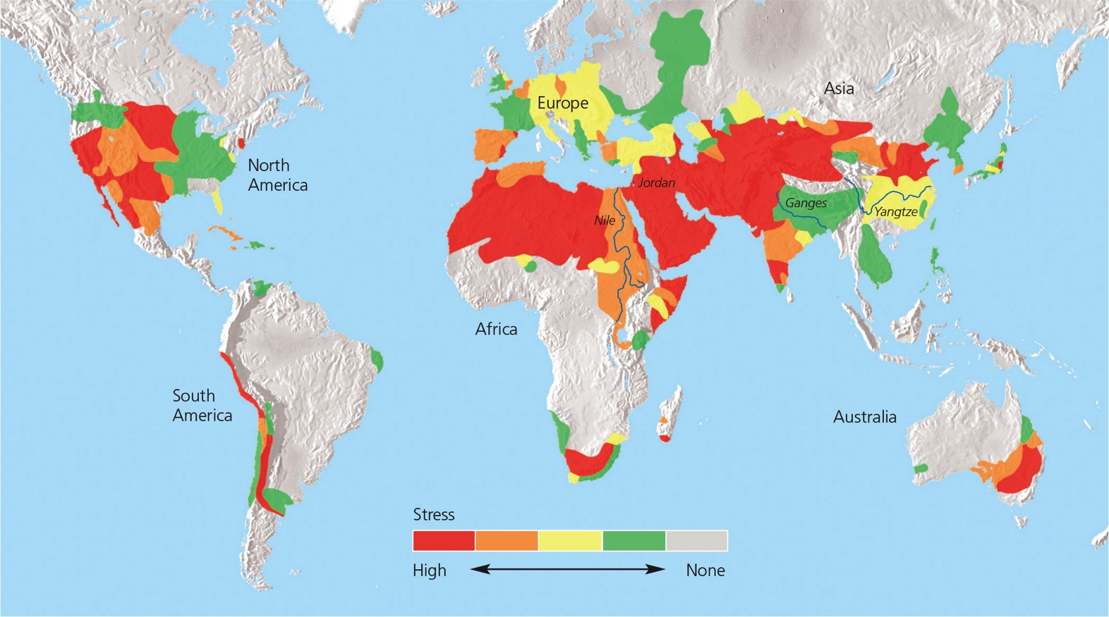
Freshwater Shortages Will Grow (2 of 2)
Notes:
Figure 13.8 Natural capital degradation The world’s major river basins differ in their degree of freshwater scarcity stress (Concept 13.1B).

Slide 20
13.2 Is Groundwater a Sustainable Resource?
Groundwater used to supply cities and grow food is being pumped form many aquifers faster than it is being replenished by precipitation.

Slide 21
Groundwater Withdrawals are Unsustainable in Some Areas (1 of 2)
Aquifers are renewable resources for fresh water unless they are contaminated
Widespread drilling of wells by farmers
Accelerated aquifer overpumping
Water tables falling
In 2008, Saudi Arabia announced it had depleted its major deep aquifer

Slide 22
Groundwater Withdrawals are Unsustainable in Some Areas (2 of 2)
Notes:
Figure 13.9 Withdrawing groundwater from aquifers has advantages and disadvantages. Critical thinking: Which two advantages and which two disadvantages do you think are the most important? Why?

Slide 23
Case Study: Overpumping the Ogallala Aquifer (1 of 2)
Ogallala Aquifer–largest known aquifer
Irrigates the Great Plains
Very slow recharge
Water table dropping
Water pumped 10–40 times faster than recharge rate
Government farm subsidies result in further depletion
Biodiversity threatened in some areas

Slide 24
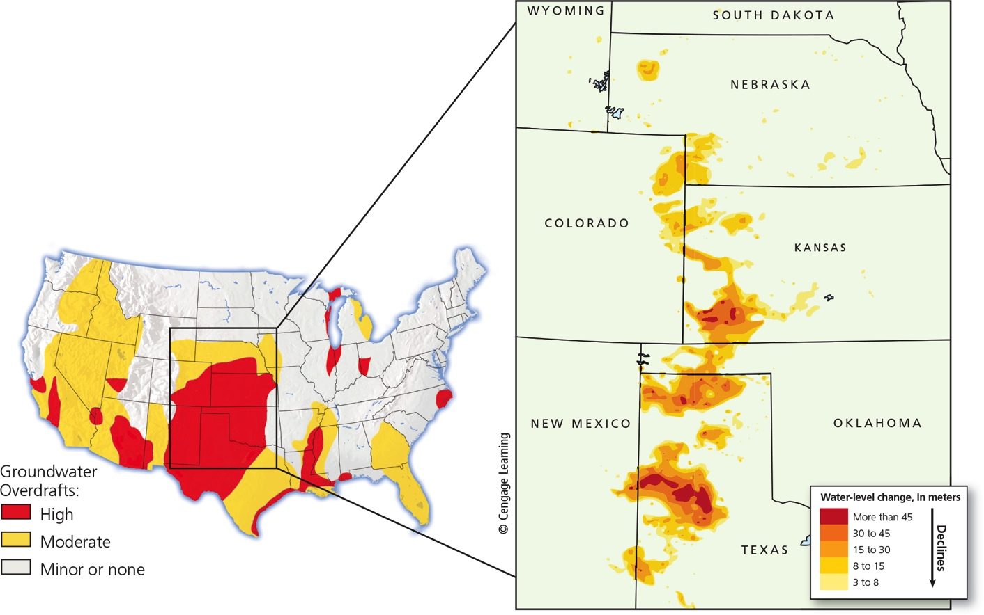
Case Study: Overpumping the Ogallala Aquifer (2 of 2)
Notes:
Figure 13.11 Natural capital degradation: Areas of greatest aquifer depletion from groundwater overdraft in the continental United States. The blowup section (right) shows where water levels in the Ogallala aquifer have dropped sharply at its southern end beneath parts of Kansas, Oklahoma, Texas, and New Mexico. Critical thinking: Should the amount of water that farmers can withdraw from the Ogallala aquifer be restricted? How would you enforce this? How might this affect food production?

Slide 25
Overpumping Aquifers Can Have Harmful Effects (1 of 3)
Limits food production and raises prices
Widens gap between rich and poor
Land subsidence
San Joaquin Valley in California
Mexico City
Groundwater overdrafts near coastal regions
Contamination of groundwater with saltwater

Slide 26
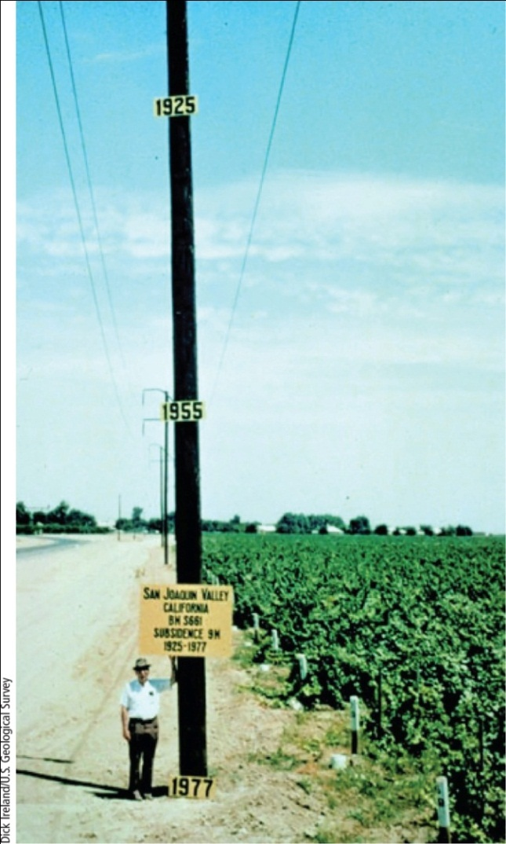
Overpumping Aquifers Can Have Harmful Effects (2 of 3)
Notes:
Figure 13.13 This pole shows subsidence from overpumping of an aquifer for irrigation in California’s San Joaquin Central Valley between 1925 and 1977. In 1925, the land surface in this area was near the top of this pole. Since 1977 this problem has gotten worse.

Slide 27
Overpumping Aquifers Can Have Harmful Effects (3 of 3)
Notes:
Figure 13.14 Ways to prevent or slow groundwater depletion by using freshwater more sustainably. Critical thinking: Which two of these solutions do you think are the most important? Why?

Slide 28
13.3 How Can We Increase Freshwater Supplies?
Large dam-and-reservoir systems
Greatly expanded water supplies in some areas
Disrupted ecosystems and displaced people

Slide 29
Large Dams Provide Benefits and Create Problems (1 of 6)
Main goal of a dam and reservoir system
Capture and store runoff
Release runoff as needed for:
Flood control
Generating electricity
Supplying irrigation water
Recreation (reservoirs)

Slide 30
Large Dams Provide Benefits and Create Problems (2 of 6)
Reservoirs
Increase the reliable runoff available for use
Displace people
Impair ecological services of rivers
Endanger plant and animal species
Fill up with sediment within 50 years

Slide 31
Large Dams Provide Benefits and Create Problems (3 of 6)
Oroville dam in California was compromised by extremely heavy rainfall after a severe drought
Main spillway was damaged which almost caused the weir to collapse
180,000 people were evacuated with only an hour’s notice.

Slide 32
Large Dams Provide Benefits and Create Problems (4 of 6)
Two images of Oroville Dam, before (left) and during (right) the spillway failure in February, 2017 when severe rain and snowmelt required use of the spillways to prevent the dam from overtopping.

Slide 33
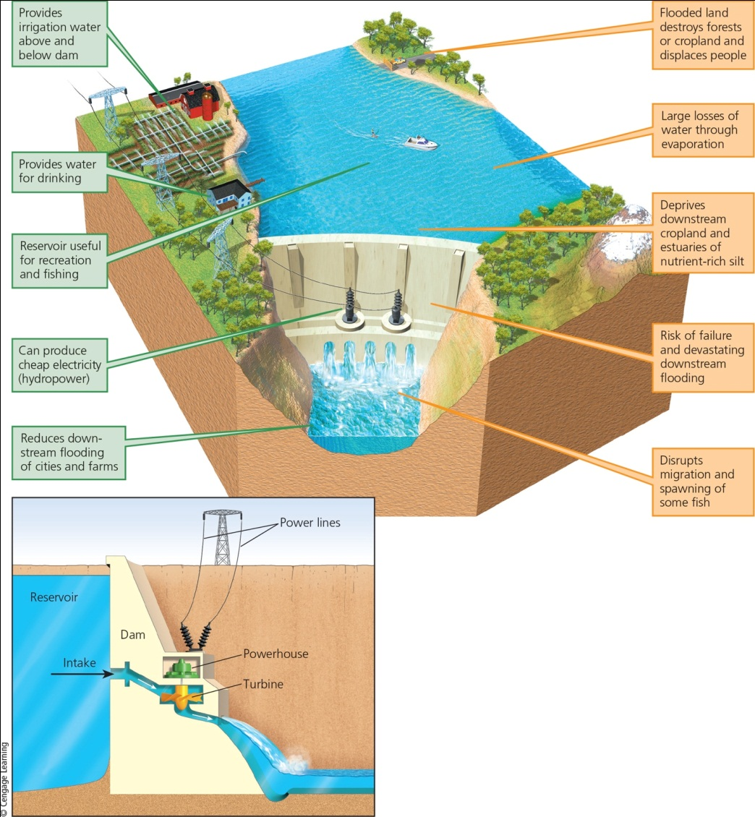
Large Dams Provide Benefits and Create Problems (5 of 6)
Notes:
Figure 13.15 Trade-offs: Large dam and reservoir systems have advantages (green) and disadvantages (orange) (Concept 13.3). Critical thinking: Which single advantage and which single disadvantage do you think are the most important? Why?

Slide 34
Large Dams Provide Benefits and Create Problems (6 of 6)
Climate change intensifies weather extremes
Mountain snowpack will be reduced, making less freshwater available downstream
When water levels drop, hydroelectric dams cannot function
Colorado River will most likely not be able to meet water needs in Arizona, New Mexico, and California

Slide 35
How Dams Can Kill an Estuary (1 of 3)
Only a small amount of Colorado River water reaches Gulf of California
Threatens aquatic species in river and species that live in the estuary
Current rate of river withdrawal is not sustainable
Inefficient use of irrigation water for agriculture

Slide 36
How Dams Can Kill an Estuary (2 of 3)
Proposed actions for states using Colorado river
Enact strict conservation measures
Phase out agricultural subsidies
Shift water-thirsty crops to less arid areas
Raise the price of freshwater

Slide 37
How Dams Can Kill an Estuary (3 of 3)
2014: Morelos dam near Yuma, AZ opened for two months to release water through the delta to the Gulf of California
Dramatic short-term results

Slide 38
Critical Concept: NEPA and Environmental Impact Statements
National Environmental Policy Act requires that an environmental impact statement be developed for every federal project likely to have an effect of environmental quality
Impact on water, soils, air quality, wildlife habitat, etc.

Slide 39
Removing Salt from Seawater to Provide Freshwater (1 of 2)
Desalination methods
Distillation
Reverse osmosis
More than 17,000 desalination plants currently operating in 150 countries
Most in arid nations of Middle East, North Africa, Caribbean, and Mediterranean
Issues: high cost, high energy use, and large amounts of salty wastewater

Slide 40
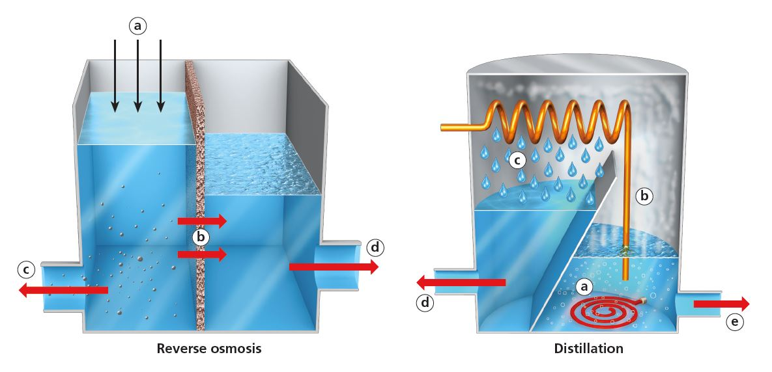
Removing Salt from Seawater to Provide Freshwater (2 of 2)
Desalination: Reverse osmosis (left) involves applying high pressure (a) to force sea water from one chamber into another through a semipermeable membrane (b) that separates the salt (c), producing freshwater (d). Distillation (right) involves heating sea water (a) to produce steam (b), which is then condensed (c) and collected as freshwater (d), while brine is also collected (e) for processing.

Slide 41
13.4 Can Water Transfers Expand Water Supplies?
Transferring water from one place to another has greatly increased water supplies in some areas
Has also disrupted ecosystems

Slide 42
Water Transfers Have Benefits and Drawbacks (1 of 2)
China
South-North Water Diversion Project
Diverts six trillion gallons of water per year
California central valley
Aqueducts
Water loss through evaporation and leaks
Ecosystem degradation

Slide 43
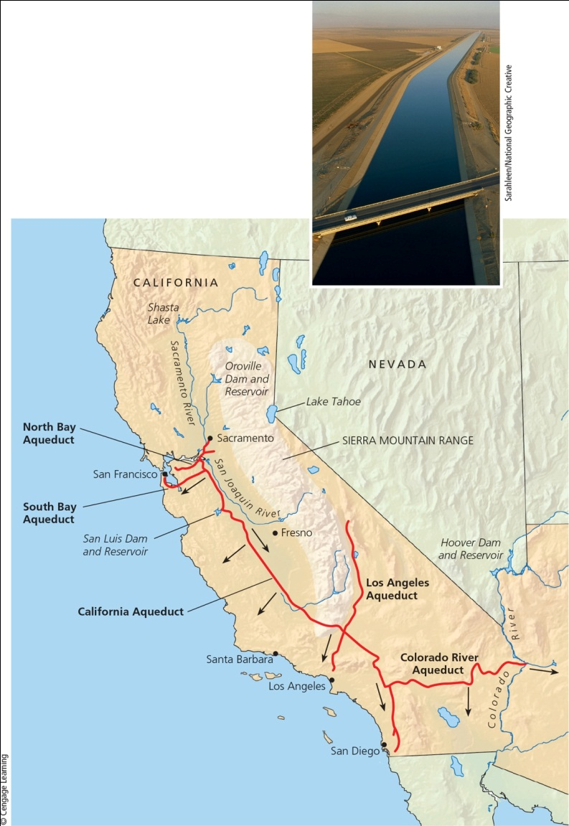
Water Transfers Have Benefits and Drawbacks (2 of 2)
Notes:
Figure 13.17 The California State Water Project transfers huge volumes of freshwater from one watershed to another. The arrows on the map show the general direction of water flow. The photo shows one of the aqueducts carrying water within the system. Critical thinking: What effects might this system have on the areas from which the water is taken?

Slide 44
Case Study: The Aral Sea Disaster (1 of 3)
Large-scale water transfers in dry central Asia have led to:
Wetland destruction
Desertification
Greatly increased salinity
Fish extinctions and decline of fishing
Blowing salt and dust destroying wildlife and crops
Increased glacial melting in the Himalayas

Slide 45
Case Study: The Aral Sea Disaster (2 of 3)
Shrinkage of the Aral Sea has altered local climate
Hot, dry summers, colder winters, and a shortened growing season
Restoration efforts
Cooperation of neighboring countries
More efficient irrigation
Dike construction raised level of Northern Sea

Slide 46
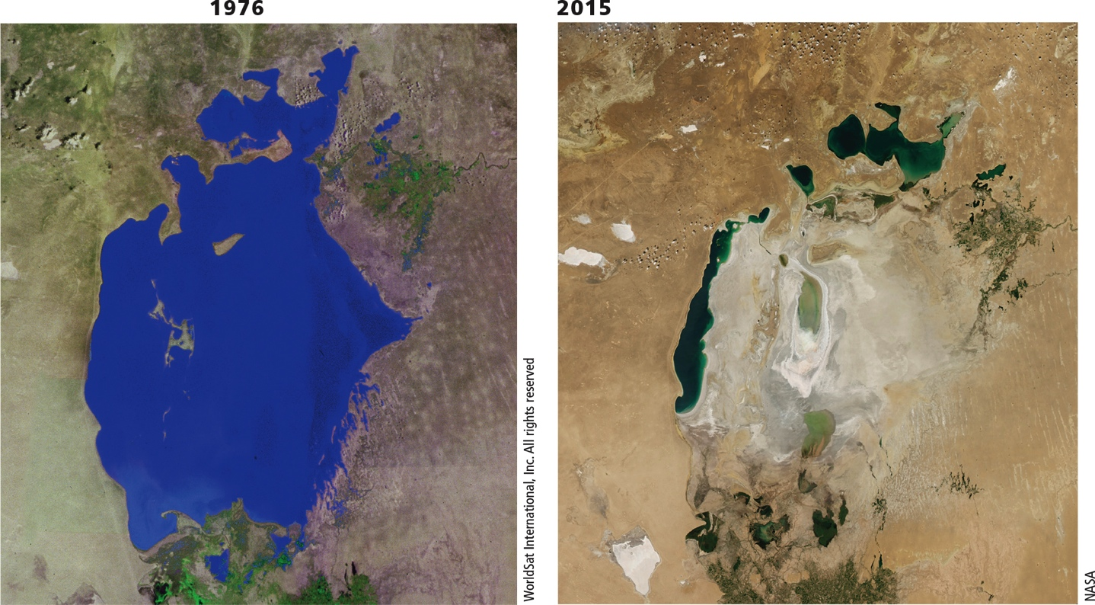
Case Study: The Aral Sea Disaster (3 of 3)
Notes:
Figure 13.18 Natural capital degradation: The Aral Sea, straddling the borders of Kazakhstan and Uzbekistan, was one of the world’s largest saline lakes. These satellite photos show the sea in 1976 (left) and in 2015 (right). Question: What do you think should be done to help prevent further shrinkage of the Aral Sea?

Slide 47
13.5 How Can We Use Freshwater More Sustainably?
Ways to use freshwater more sustainably
Cut water waste
Raise water prices
Slow population growth
Protect aquifers, forests, and other ecosystems that store and release freshwater

Slide 48
Cutting Water Waste Would Have Many Benefits
One-half to two-thirds of water is wasted
Evaporation, leaks, and inefficient use
The cost of water to users is low
Government subsidies mask the true cost of water
No subsidies for improved efficiency
Raising prices could hurt lower-income farmers and city dwellers
Solution: establish lifeline rates

Slide 49
We Can Improve Efficiency in Irrigation (1 of 3)
Flood irrigation
45% of water lost
More efficient techniques
Center pivot, low pressure sprinkler
Low-energy, precision application sprinklers
Drip or trickle irrigation, microirrigation
Costly
Less water waste

Slide 50
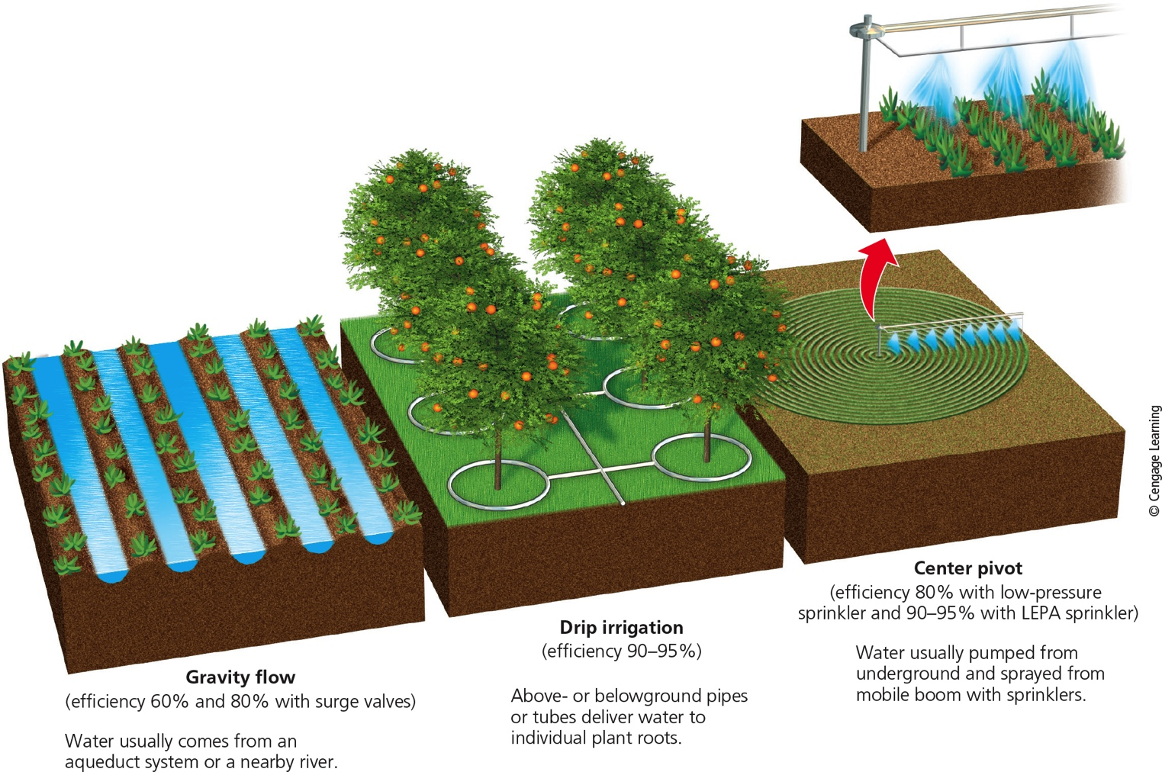
We Can Improve Efficiency in Irrigation (2 of 3)
Stepped Art
Notes:
Figure 13.19 Traditional irrigation methods rely on gravity and flowing water (left). Newer systems such as center-pivot, low-pressure sprinkler irrigation (right) and drip irrigation (center) are far more efficient.

Slide 51
We Can Improve Efficiency in Irrigation (3 of 3)

Slide 52
Poor Farmers Conserve Water Using Low-Tech Methods (1 of 2)
Human-powered treadle pumps bring water into irrigation ditches
Harvest and store rainwater
Capture water from fog
Use polyculture to create canopy vegetation
Reduces evaporation

Slide 53
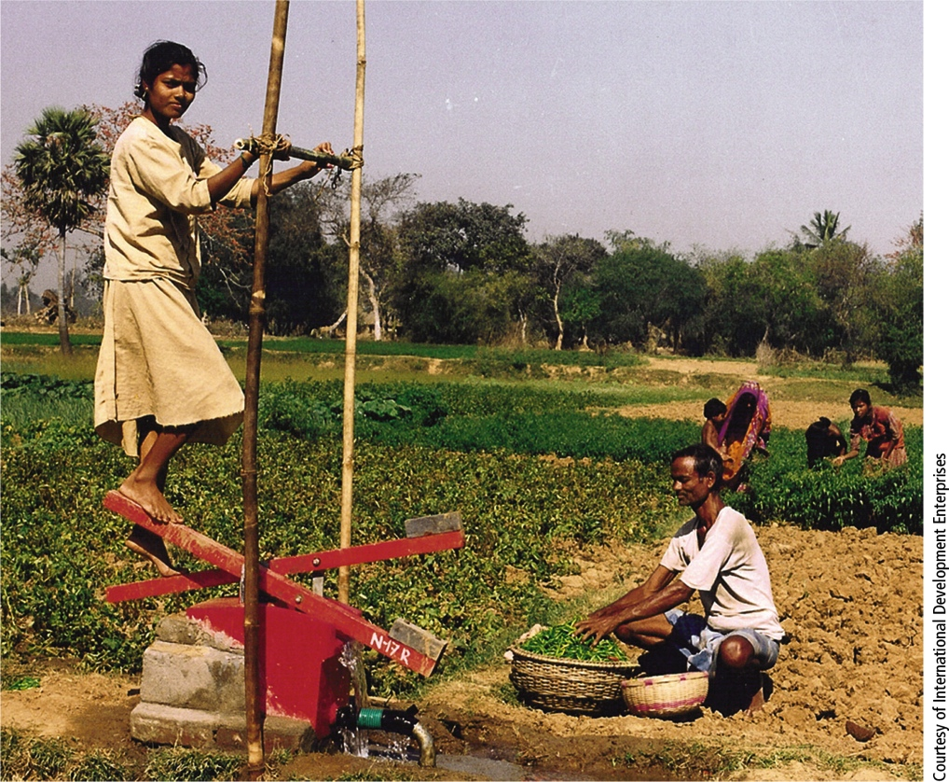
Poor Farmers Conserve Water Using Low-Tech Methods (2 of 2)
Notes:
FIGURE 13.20 Solutions: In areas of Bangladesh and India, where water tables are high, many small-scale farmers use treadle pumps to supply irrigation water to their fields.

Slide 54
Cutting Freshwater Losses in Industry and Homes (1 of 3)
Recycle water used in industry
Use low-flow toilets, showerheads, and front-loading washing machines
Fix leaks in the plumbing systems
Use native plants in landscaping
Use gray water
Water meters reduce water use

Slide 55
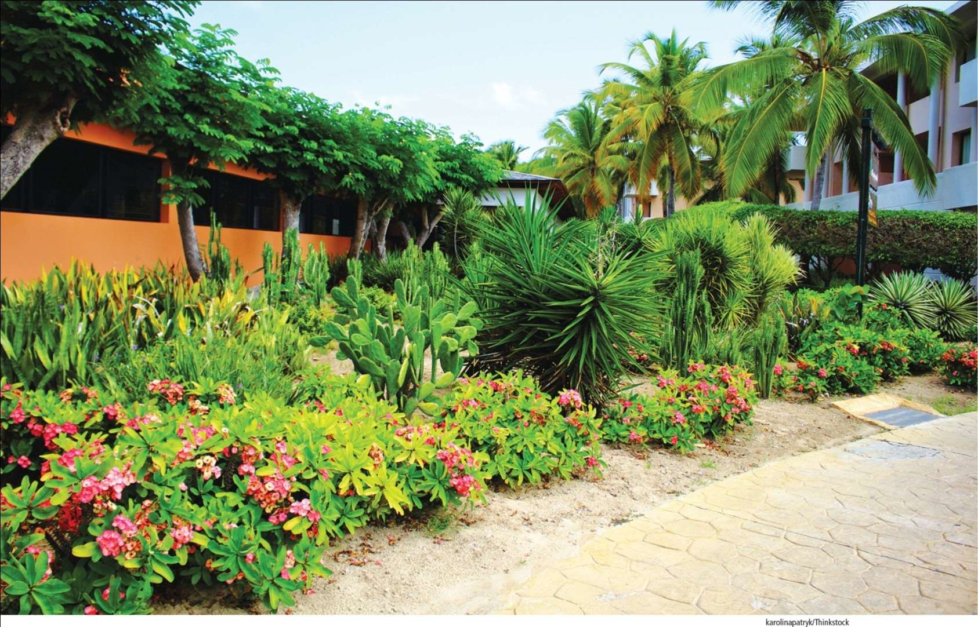
Cutting Freshwater Losses in Industry and Homes (2 of 3)
Notes:
Figure 13.22 This yard in Encinitas, a city in a dry area of southern California (USA), uses a mix of plants that are native to the arid environment and require little watering.

Slide 56
Cutting Freshwater Losses in Industry and Homes (3 of 3)
Notes:
Figure 13.23 Ways to reduce freshwater losses in industries, homes, and businesses (Concept 13.6). Critical thinking: Which three of these solutions do you think are the best ones? Why?

Slide 57
Using Less Water to Remove Wastes
Large amounts of freshwater used to flush away wastes
Reuse wastewater
Only about 7% of wastewater is currently recycled
Use waterless composting toilets

Slide 58
Using Water More Sustainably (1 of 2)
Protect water supplies
Apply strategies at local, regional, national, and international levels
Apply strategies at a personal level
Use less freshwater and use it more efficiently

Slide 59
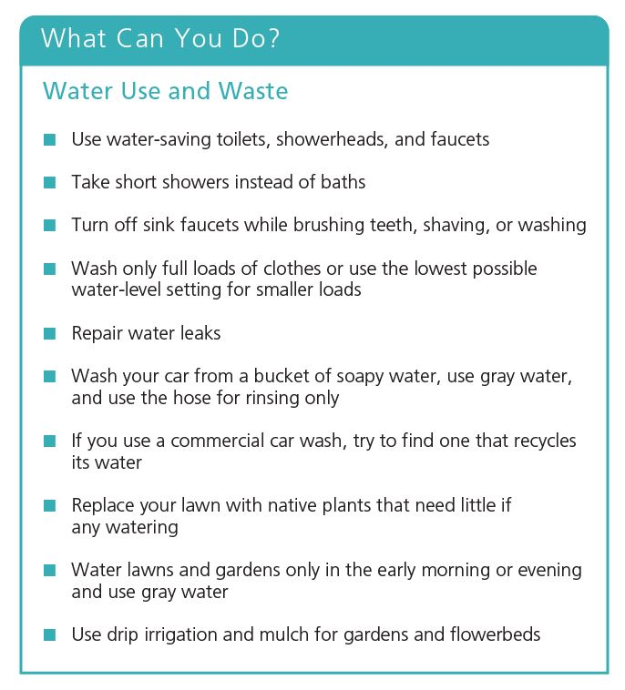
Using Water More Sustainably (2 of 2)
Notes:
Figure 13.25 Individuals matter: You can reduce your use and waste of freshwater. Question: Which of these steps have you taken? Which would you like to take?

Slide 60
13.6 How Can We Reduce the Threat of Flooding?
We can lessen the threat of flooding by:
Protecting more wetlands and natural vegetation in watersheds
Not building in areas subject to frequent flooding

Slide 61
Some Areas Get Too Much Water from Flooding (1 of 3)
Floodplain
Area flooded when a stream overflows its channel
Fertile soils for farming
Recharge groundwater and refill wetlands
Human activities that damage floodplains
Vegetation removal
Draining of wetlands

Slide 62
Some Areas Get Too Much Water from Flooding (2 of 3)
Human activities that damage floodplains (cont’d.)
Rising sea levels from global warming means more coastal flooding

Slide 63
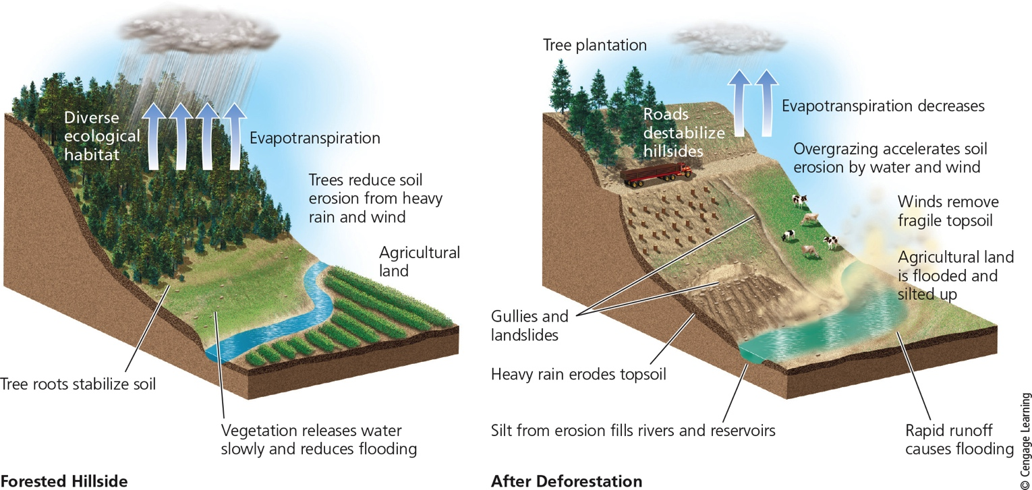
Some Areas Get Too Much Water from Flooding (3 of 3)
Stepped Art
Notes:
Figure 13.26 Natural capital degradation: A hillside before and after deforestation. Question: How might a drought in this area make these effects even worse?

Slide 64
Case Study: Living Dangerously on Floodplains in Bangladesh
Dense population on coastal floodplain
Moderate floods maintain fertile soil
Recent increased frequency of severe floods
Destruction of coastal wetlands
Mangrove forests cleared
Increased storm damage
Adapting: using more flood-tolerant crops

Slide 65
Reducing Flood Risks (1 of 2)
Rely more on nature’s systems
Wetlands
Natural vegetation in watersheds
Rely less on engineering devices
Dams
Levees
Channelized streams

Slide 66
We Can Reduce Flood Risks (2 of 2)
Notes:
Figure 13.27 Methods for reducing the harmful effects of flooding (Concept 13.7). Critical thinking: Which two of these solutions do you think are the best ones? Why?

