Slide 1
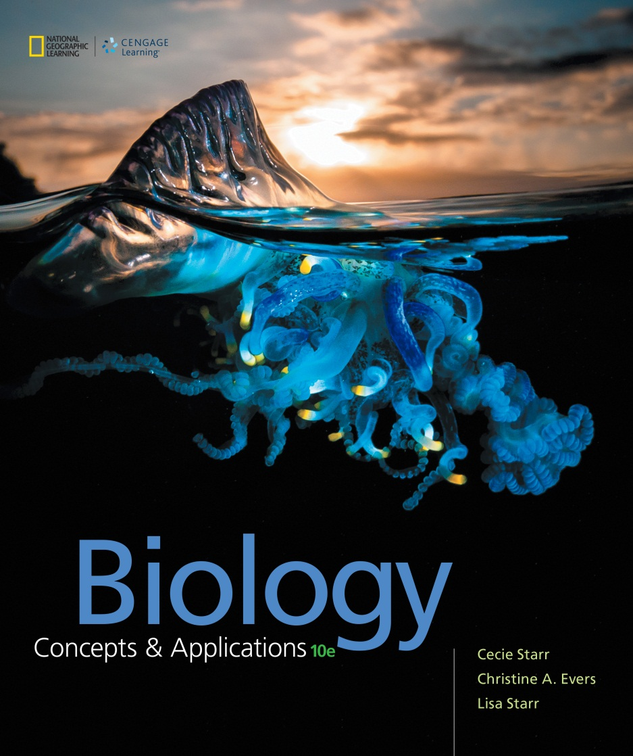
Biology Concepts & Applications
10 Edition
Chapter 13
Patterns in Inherited Traits
Copyright © 2018 Cengage Learning. All Rights Reserved. May not be copied, scanned, or duplicated, in whole or in part, except for use as permitted in a license distributed with a certain product or service or otherwise on a password-protected website for classroom use.

Slide 2
13.1 Mendel, Pea Plants, and Inheritance Patterns
Blending inheritance
  19th century idea
  Failed to explain how traits disappear over several generations and then reappear unaltered generations later
  Charles Darwin did not accept this idea

Slide 3
Gregor Mendel
Austrian monk
Started breeding thousands of pea plants
Kept detailed records of how traits passed from one generation to the next
Began to formulate how inheritance works

Slide 4
Mendel’s Experiments (1 of 2)
Garden pea plant is self-fertilizing
  The flowers produce male and female gametes
The experiments
  Controlled the pairings between individuals with specific traits and observed traits of their offspring
  Cross-fertilized plants and collected seeds
  Recorded traits of new pea plants

Slide 5
Mendel’s Experiments (2 of 2)
  Started with garden pea plants that “bred true” for a particular trait – the trait stayed the same generation after generation
  Cross-fertilized pea plants with different traits and offspring appeared in predictable patterns
  Concluded that hereditary information is passed in discrete units

Slide 6
Garden Pea Breeding
Notes:
Figure 13.1 Breeding experiments with the garden pea.
1 In garden pea plants (left), pollen grains that form in anthers of the flowers (right) produce male gametes. Female gametes form in carpels.
2 Experimenters control the transfer of hereditary material from one pea plant to another by cutting off a flower’s pollen-producing anthers (to prevent it from self-fertilizing), then brushing pollen from another flower onto its egg-producing carpel.
In this example, pollen from a plant with purple flowers is brushed onto the carpel of a white-flowered plant.
3 Later, seeds develop inside pods of the cross-fertilized plant. When the seeds are planted, the embryo in each develops into a pea plant.
4 In this example, every plant that arises from the cross has purple flowers. Predictable patterns such as this are evidence of how inheritance works.

Slide 7
Inheritance in Modern Terms
Individuals share certain traits because their chromosomes carry the same genes
The DNA sequence of each gene occurs at a specific location
  The location of a gene on a particular chromosome is called a locus

Slide 8
Loci of Some Human Genes
Notes:
Figure 13.2 Loci of a few human genes. Genetic disorders that result from mutations in the genes are shown in red. The number or letter below each chromosome is its name; the characteristic banding patterns appear after staining. A map of all 23 human chromosomes is in Appendix IV.

Slide 9
Inheritance in Modern Terms (1 of 3)
An individual carrying identical alleles for a gene is homozygous
An individual carrying two different alleles of a gene is heterozygous
Hybrids are heterozygous offspring of a cross between individuals that breed true for different forms of a trait

Slide 10
Inheritance in Modern Terms (2 of 3)
The particular set of alleles that an individual carries is their genotype
The observable traits, such as flower color, make up an individual’s phenotype

Slide 11
Inheritance in Modern Terms (3 of 3)
An allele is dominant when its effect masks that of a recessive allele paired with it
  A dominant allele is represented by italic capital letters such as (A)
  A recessive allele is represented by italic lowercase letters such as (a)

Slide 12
Genotype Gives Rise to Phenotype
Notes:
Figure 13.3 Genotype gives rise to phenotype. In this example, the dominant allele P, specifies purple flowers; the recessive allele p, white flowers.

Slide 13
13.2 Mendel’s Law of Segregation
A homozygous pea plant with two alleles (PP) has purple flowers, and one with two alleles (pp) has white flowers
If these homozygous plants are crossed (PP × pp), all offspring will be heterozygous
  The allele for purple (P) is dominant over the allele for white (p)
  Therefore, the heterozygote (Pp) will have purple flowers

Slide 14
Segregation of Gametes
Notes:
Figure 13.4 Segregation of genes on homologous chromosomes into gametes. Homologous chromosomes separate during meiosis, so the pairs of genes they carry separate too. Each of the resulting gametes carries one of the two members of each gene pair. For clarity, only one set of chromosomes is illustrated.
1 All gametes made by a parent homozygous for a dominant allele carry that allele.
2 All gametes made by a parent homozygous for a recessive allele carry that allele.
3 If these two parents are crossed, the union of any of their gametes at fertilization produces a zygote with both alleles. All offspring of this cross will be heterozygous.

Slide 15
Assessing Offspring
All first-generation (F₁) offspring of a PP × pp cross will be heterozygous
  Genotype = Pp
  Phenotype = purple
Punnett square
  A grid used to predict the genetic and phenotypic outcome of a cross

Slide 16
Punnett Square
Notes:
Figure 13.5 Making a Punnett square. Parental gametes are listed in circles on the top and left sides of the grid. Each square is filled with the combination of alleles that would result if the gametes in the corresponding row and column met up.

Slide 17
Determining Unknown Genotypes
Testcross
  Breeding experiments used to determine genotype
  An individual that has a dominant trait (but an unknown genotype) is crossed with one that is homozygous recessive

Slide 18
Testcross Results
  If all offspring have the dominant trait, then the unknown genotype is homozygous for dominant allele
  If any offspring have the recessive trait, then the unknown genotype is heterozygous

Slide 19
Monohybrid Cross
Breeding experiment in which individuals identically heterozygous for one gene are crossed
  Frequency of traits among offspring offers information about the dominance relationship between the alleles
  First generation = F₁
  Second generation = F₂

Slide 20
Mendel’s Pea Traits
Notes:
Table 13.1 Mendel’s Seven Pea Plant Traits

Slide 21
Monohybrid Cross (1 of 2)
In a monohybrid cross between two Pp plants (Pp × Pp), the two types of gametes can meet in four possible ways
  Sperm P meets egg P → zygote genotype PP
  Sperm P meets egg p → zygote genotype Pp
  Sperm p meets egg P → zygote genotype Pp
  Sperm p meets egg p → zygote genotype pp

Slide 22
Monohybrid Cross (2 of 2)
The probability that second-generation (F₂) offspring of (Pp × Pp) will have purple flowers
  A ratio of 3 purple to 1 white, or 3:1
  75% probability of having purple flowers

Slide 23
Law of Segregation
The 3:1 phenotype ratios in F₂ offspring of monohybrid crosses became the basis of Mendel’s law of segregation
  Diploid cells carry pairs of genes on each pair of homologous chromosomes
  The two genes of each pair are separated from each other during meiosis so that they end up on different gametes

Slide 24
13.3 Mendel’s Law of Independent Assortment
When homologous chromosomes separate during meiosis, either one of the pair can end up in a particular nucleus
Gene pairs on one chromosome get sorted into gametes independently of gene pairs on other chromosomes
Punnett squares can be used to predict inheritance

Slide 25
Dihybrid Cross (1 of 2)
Individuals identically heterozygous for alleles of two genes (dihybrids) are crossed, and the traits of the offspring are observed
  Frequency of traits among the offspring offers information about the dominance relationships between the paired alleles

Slide 26
Dihybrid Cross (2 of 2)
One parent plant that breeds true for purple flowers and tall stems (PPTT) is crossed with one that breeds true for white flowers and short stems (pptt)
Each plant makes only one type of gamete (PT or pt)
All F₁ offspring will be dihybrids (PpTt) and have purple flowers and tall stems

Slide 27
How Are Gene Pairs Distributed Into Gametes?
The result of crossing two F₁ plants (PpTt × PpTt)
  Four types of gametes can combine in sixteen possible ways

Slide 28
Dihybrid Cross Between Peas
Notes:
Figure 13.7 A dihybrid cross between plants that differ in flower color and plant height. In this example, P and p are dominant and recessive alleles for purple and white flower color; T and t are dominant and recessive alleles for tall and short plant height.
1 In each individual homozygous for alleles of two genes, meiosis results in only one type of gamete.
2 A cross between the two homozygous individuals yields offspring heterozygous for alleles of two genes (dihybrids).
3 Dihybrid individuals produce gametes with four possible combinations of alleles.
4 If two of the dihybrid individuals are crossed, the four types of gametes can meet up in 16 possible ways. Of 16 possible offspring genotypes, 9 will result in plants that are purple-flowered and tall; 3, purple-flowered and short; 3, white-flowered and tall; and 1, white-flowered and short. Thus, the ratio of phenotypes is 9:3:3:1.

Slide 29
Cross Results
In F₂ plants, four phenotypes result in a ratio of 9:3:3:1
  Nine tall with purple flowers
  Three short with purple flowers
  Three tall with white flowers
  One short with white flowers

Slide 30
Law of Independent Assortment
Mendel discovered the 9:3:3:1 ratio in his dihybrid experiments
  Each trait still kept its individual 3:1 ratio
  Each trait sorted into gametes independently of other traits
During meiosis, members of a pair of genes on homologous chromosomes get distributed into gametes independently of other gene pairs

Slide 31
The Contribution of Crossovers (1 of 2)
How two genes are sorted into gametes depends on whether they are found on the same chromosome
  Random assortment
  Genes on one chromosome assort into gametes independent of genes on other chromosomes

Slide 32
The Contribution of Crossovers (2 of 2)
Linkage group–all genes on a chromosome
  Genes that are far apart on a chromosome tend to assort into gametes independently
  Genes very close together on a chromosome are linked
    They do not assort independently because crossing over rarely happens between them

Slide 33
Independent Assortment and Crossing Over
Notes:
Figure 13.8 Independent assortment. Alleles of genes on different chromosomes assort independently into gametes. Alleles of genes that are far apart on the same chromosome usually assort independently too, because crossovers typically separate them.
A This example shows just two pairs of homologous chromosomes in the nucleus of a diploid (2n) germ cell. Maternal and paternal chromosomes, shown in pink and blue, have already been duplicated.
B Either chromosome of a pair may get attached to either spindle pole during meiosis I. With two pairs of homologous chromosomes, there are two ways in which the maternal and paternal chromosomes can become attached to the two spindle poles. Here, we track alleles of genes on different chromosomes.
C Two nuclei form with each scenario, so there are a total of four possible combinations of alleles in the nuclei that form after meiosis I.
D Thus, when sister chromatids separate during meiosis II, the gametes that result have one of four possible combinations of alleles.

Slide 34
13.4 Beyond Simple Dominance
Simple dominance
  A dominant allele fully masks the expression of a recessive one
Other patterns of inheritance are not so simple
  Incomplete dominance
  Codominance
  Epistasis
  Pleiotropy

Slide 35
Incomplete Dominance (1 of 2)
One allele is not fully dominant over another
  The heterozygous phenotype is intermediate between the two homozygous phenotypes

Slide 36
Incomplete Dominance (2 of 2)
Notes:
Figure 13.9 Incomplete dominance in heterozygous (pink) snapdragons. One allele (R) results in the production of a red pigment; the other (r) results in no pigment.
A Cross a red-flowered with a white-flowered snapdragon plant, and all of the offspring will have pink flowers.

Slide 37
Incomplete Dominance
In snapdragons, one allele (R) encodes an enzyme that makes a red pigment, and allele (r) makes no pigment
  RR = red; Rr = pink; rr = white
A cross between red and white (RR × rr) yields pink (Rr)
A cross between two pink (Rr × Rr) yields red, pink, and white in a 1:2:1 ratio

Slide 38
Codominance (1 of 3)
Two alleles that are both fully expressed in heterozygous individuals
  Multiple allele systems–gene for which three or more alleles persist in a population
    Example: an ABO gene for blood type

Slide 39
The Scientific Method (2 of 3)
Which two of the three alleles of the ABO gene you have determines your blood type
  The A and the B allele are codominant when paired
    Genotype AB = blood type AB
  The O allele is recessive when paired with either A or B
    Genotype AA or AO = blood type A
    Genotype BB or BO = blood type B
    Genotype OO = blood type O

Slide 40
Codominance (3 of 3)
Notes:
Figure 13.10 Combinations of alleles (genotype) that are the basis of human blood type (phenotype).

Slide 41
Epistasis (1 of 2)
A trait is influenced by the products of multiple genes
  Example: Fur color in dogs
  A dominant allele (B) specifies black fur, and its recessive partner (b) specifies brown fur
  A dominant allele of a different gene (E) causes color to be deposited in fur and its recessive partner (e) reduces color

Slide 42
Epistasis (2 of 2)
A dog with an E and a B allele has black fur
A dog with an E allele and homozygous for b is brown
A dog homozygous for the e allele has yellow fur regardless of its B or b alleles

Slide 43
Fur Color in Labrador Retrievers
Notes:
Figure 13.11 An example of epistasis. Interactions among products of two genes affect fur color in Labrador retrievers. Dogs with alleles E and B have black fur. Those with an E and two recessive b alleles have brown fur. Dogs homozygous for the recessive e allele have yellow fur.

Slide 44
Pleiotropy
A gene whose product influences multiple traits
  Mutations in pleiotropic genes are associated with complex genetic disorders
    Sickle-cell anaemia
    Cystic fibrosis
    Marfan syndrome

Slide 45
13.5 Does the Environment Affect Phenotype?
Epigenetic research is revealing that environment can influence phenotype
Some examples of environmental effects
  Seasonal changes in coat color
  Effect of altitude on yarrow
  Alternative phenotypes in water fleas
  Psychiatric disorders

Slide 46
13.5 Nature and Nurture
“Nature versus nurture” refers to a centuries-old debate about whether human behavioral traits arise from one’s genetics (nature) or from environmental factors (nurture)
  Today, we know that both play a substantial role

Slide 47
Environmental Cues Trigger Gene Expression Patterns
Environmental cues initiate cell-signaling pathways that in turn trigger changes in gene expression
  Mechanisms adjust phenotype in response to external cues
  Part of an individual’s normal ability to adapt to its environment

Slide 48
Seasonal Changes in Phenotype
Notes:
Figure 13.13 Some environmental effects on phenotype.
A Under low-oxygen conditions, a water flea switches on genes involved in producing hemoglobin. Making this red protein enhances the individual’s ability to take up oxygen from water. The flea on the left has been living in water with a normal oxygen content; the one on the right, in water with a low oxygen content.
B The color of the snowshoe hare’s fur varies by season. In summer, the fur is brown (left); in winter, white (right). Both forms offer seasonally appropriate camouflage from predators.
C The height of a mature yarrow plant depends on the elevation at which it grows.

Slide 49
13.7 Complex Variation in Traits
Phenotype often results from complex interactions among gene products and the environment
Many traits show a continuous range of variation
If a trait varies continuously, it will have bell-shaped curve of distribution

Slide 50
Continuous Variation
Some traits appear in two or three forms
  Others occur in a range of small differences
  The more genes and environmental factors that influence a trait, the more continuous the variation
  Examples
    Face length in dogs; human skin color; human height

Slide 51
Continuous Variation in Human Height
Notes:
Figure 13.15 How to determine whether a particular trait varies continuously.
A To see if human height varies continuously, male biology students at the University of Florida were divided into categories of one-inch increments in height and counted.
B Graphing the data that resulted from the experiment in A produces a bell-shaped curve, an indication that height does vary continuously in humans.

Slide 52
Complex Variation
Short tandem repeats
  Some genes have regions of DNA in which a series of two to six nucleotides is repeated hundreds or thousands of times in a row
    Example: 12 alleles of homeotic gene that influence face length in dogs

Slide 53
Face Length in Dogs
Notes:
Figure 13.14 Face length varies continuously in dogs. A gene with 12 alleles influences this trait. All of the alleles arose by spontaneous expansion or contraction of short tandem repeats. The longer the allele, the longer the face.

Slide 54
Application: Menacing Mucus
Cystic fibrosis
  Most common fatal genetic disorder in the United States
  Most CF patients live no more than 30 years
  The CFTR gene encodes a protein
    Protein moves chloride ions out of epithelial cells
    Binds disease-causing bacteria
  Occurs in people homozygous for a mutated allele of CFTR gene

Slide 55
Menacing Mucus
The CF allele has a 3 base pair deletion
  Called ΔF508 because the protein is missing the normal 508th amino acid
  People with CF inherit 2 copies of ΔF508
  The deletion causes mucus to accumulate, making breathing difficult
ΔF508 allele is at least 50,000 years old
  People who carry ΔF508 are probably less susceptible to bacterial diseases that begin in the intestinal tract

Slide 56
Discuss
List some human traits that you would guess are each governed by a single gene.
Discuss the significance of Mendel’s use of mathematical analysis in his research.
Why are the traits of (a) human skin color and (b) human height not suitable for explaining the concept of simple dominance?

