Slide 1
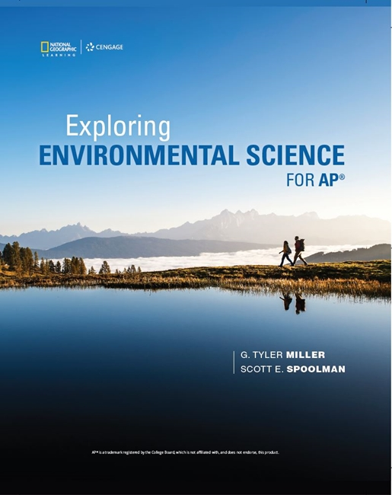
Exploring Environmental Science for AP®
1st Edition
Chapter 10
Sustaining Terrestrial Biodiversity: Forests, Public Lands, Grassland, Wetlands, and Cities
Copyright © 2018 Cengage Learning. All Rights Reserved. May not be copied, scanned, or duplicated, in whole or in part, except for use as permitted in a license distributed with a certain product or service or otherwise on a password-protected website for classroom use.

Slide 2
Core Case Study: Costa Rica–A Global Conservation Leader (1 of 2)
Costa Rica once covered in tropical forest
Suffered widespread deforestation between 1963 and 1983
Still harbors great biodiversity
Microclimates provide variety of habitats
More than 25% of its land is nature reserves and national parks
Government pays landowners to restore forests

Slide 3
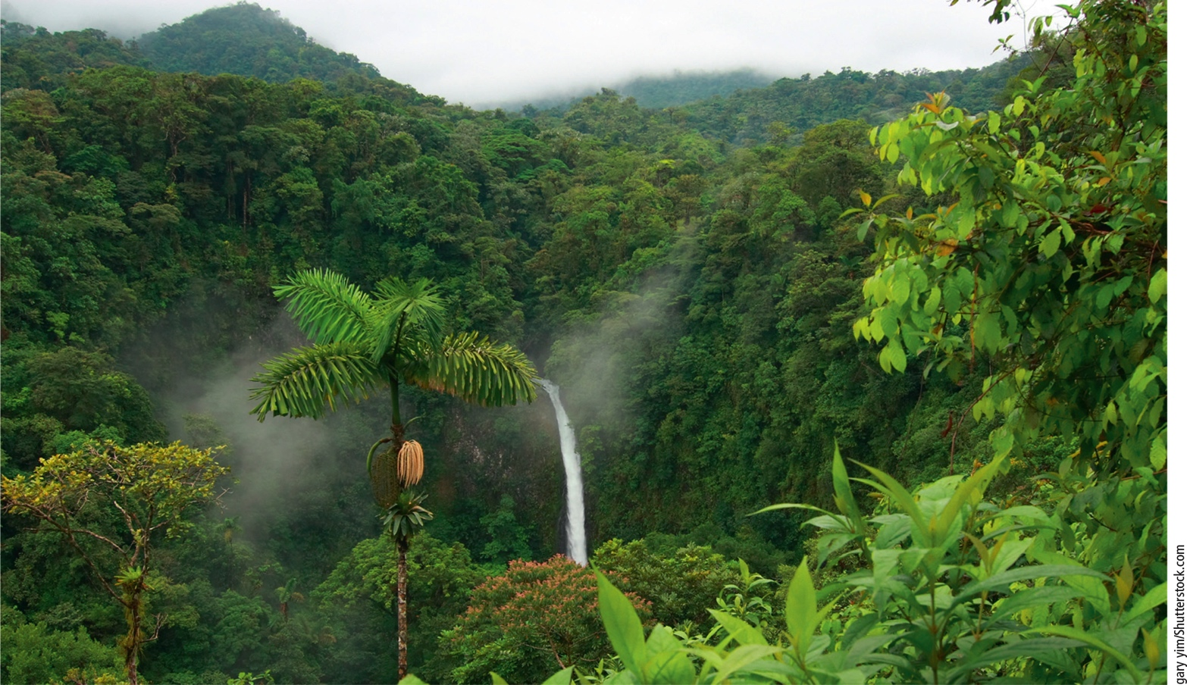
Core Case Study: Costa Rica–A Global Conservation Leader (2 of 2)
Notes:
Figure 10.1 La Fortuna Falls is located in a tropical rain forest in Costa Rica’s Arenal Volcano National Park.

Slide 4
10.1 How Should We Manage and Sustain Forests and Public Lands?
Forest ecosystems provide ecosystem services far greater in value than the value of wood and other raw materials
Forests can be preserved by halting government subsidies that hasten their destruction, by protecting gold-growth forests, and sustainably harvesting trees

Slide 5
Forests Provide Important Economic and Ecosystem Services (1 of 2)
Forests remove CO₂ from the atmosphere
Helps stabilize atmospheric temperatures
Forests store water and release it slowly
Forests provide habitats for two-thirds of world’s terrestrial species
Forests provide biofuel, industrial wood, and traditional medicines

Slide 6
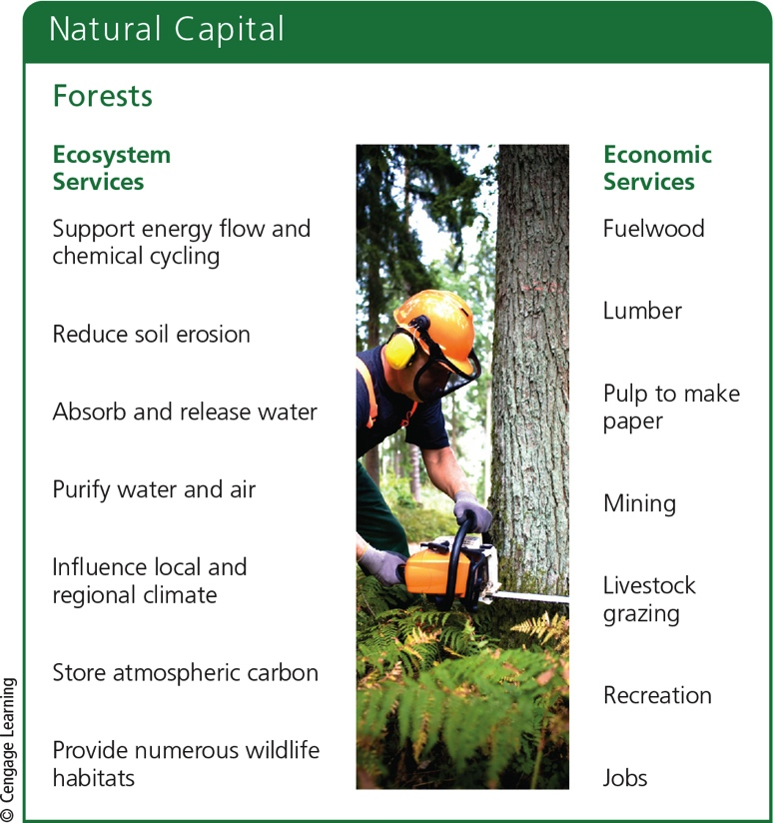
Forests Provide Important Economic and Ecosystem Services (2 of 2)
Notes:
Figure 10.2 Forests provide many important ecosystem and economic services (Concept 10.1A). Critical thinking: Which two ecosystem services and which two economic services do you think are the most important?

Slide 7
Forests Vary in Age and Structure (1 of 2)
Old-growth or primary forest
Uncut or undisturbed for 200 years or more
Reservoirs of biodiversity
Second-growth forest
Trees from secondary ecological succession
Tree plantation (tree farm, commercial forest)
Same-age trees clear-cut and replanted to supply industrial wood

Slide 8
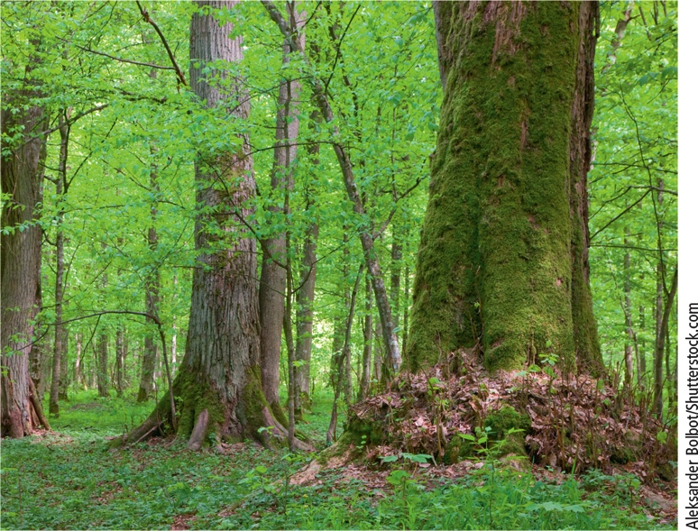
Forests Vary in Age and Structure (2 of 2)
Notes:
Figure 10.3 Od-growth forest in Poland.

Slide 9
Putting a Price on Nature’s Ecosystem Services (1 of 3)
Ecological economists estimate value of earth’s ecosystem services
Waste treatment ($22.5 trillion per year)
Recreation ($20.6 trillion per year)
Erosion control ($16.2 trillion per year)
Food production ($14.8 trillion per year)
Nutrient cycling ($11.1 trillion per year)

Slide 10
Putting a Price on Nature’s Ecosystem Services (2 of 3)
Since 1997, the world has been losing ecosystem services valued at $20.2 trillion per year
Ongoing source of ecological income
If used sustainably
Need to use full-cost pricing to include value of ecosystem services in prices of forest goods and services

Slide 11
Putting a Price on Nature’s Ecosystem Services (3 of 3)
Notes:
Figure 10.4 Oil palm tree plantation. A large area of diverse tropical forest was cleared and planted with this monoculture of oil palm trees.

Slide 12
Ways to Harvest Trees (1 of 3)
First step: building logging roads
Selective cutting
Intermediate-age or mature trees cut singly or in small groups
Clear-cutting
Removing all trees in an area
Strip cutting
Clear-cutting in strips

Slide 13
Ways to Harvest Trees (2 of 3)
Notes:
Figure 10.5 Natural capital degradation Building roads into previously inaccessible forests is the first step in harvesting timber, but it also paves the way to fragmentation, destruction, and degradation of forest ecosystems.

Slide 14
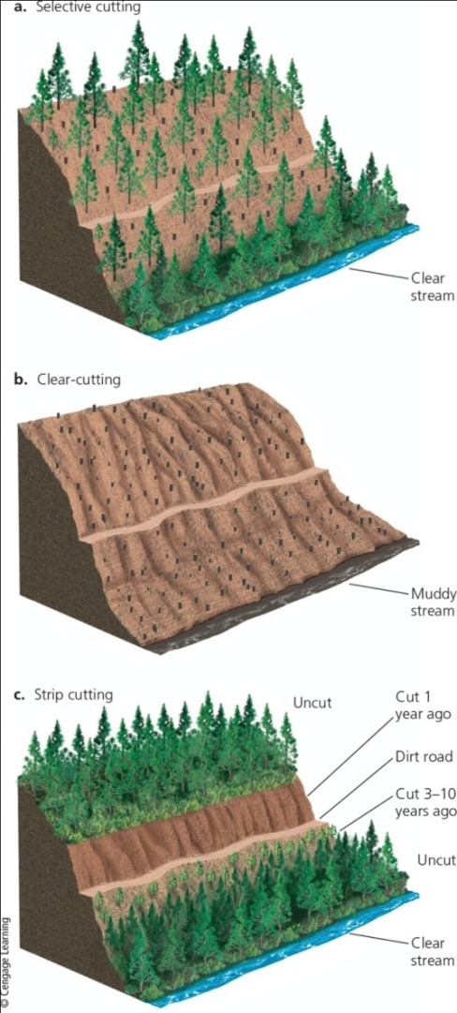
Ways to Harvest Trees (3 of 3)
Notes:
Figure 10.6 Three major ways to harvest trees. Critical thinking: If you were cutting trees in a forest you owned, which method would you choose and why?

Slide 15
Fires Affect Forest Ecosystems (1 of 2)
Surface fires
Usually burn leaf litter and undergrowth
Provide several ecological benefits
Crown fires
Extremely hot–burn whole trees
Kill wildlife
Increase topsoil erosion
Climate change lengthening fire seasons

Slide 16
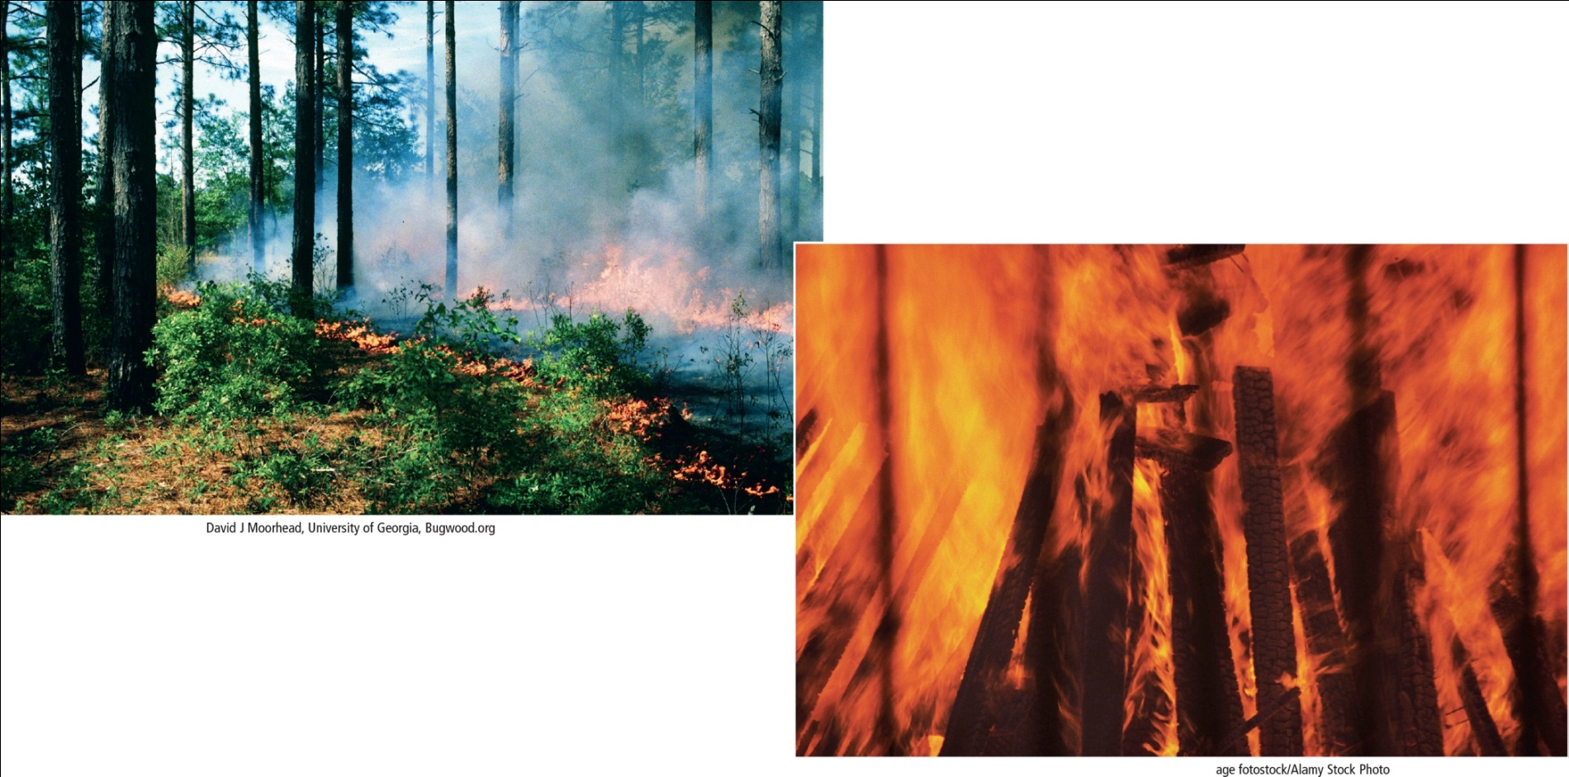
Fires Affect Forest Ecosystems (2 of 2)
Notes:
Figure 10.8 Surface fires (left) usually burn only undergrowth and leaf litter on a forest floor. They can help to prevent more destructive crown fires (right).

Slide 17
Almost Half of the World’s Forests Have Been Cut Down (1 of 3)
Deforestation
Temporary or permanent removal of large expanses of forest for agriculture, settlements, or other uses
Tropical forests
Especially in Latin America, Indonesia, and Africa
Boreal forests
Especially in Alaska, Canada, Scandinavia, and Russia

Slide 18
Almost Half of the World’s Forests Have Been Cut Down (2 of 3)
Notes:
Figure 10.10 Deforestation has some harmful environmental effects that can reduce biodiversity and degrade the ecosystem services provided by forests (Figure 10.4, left).

Slide 19
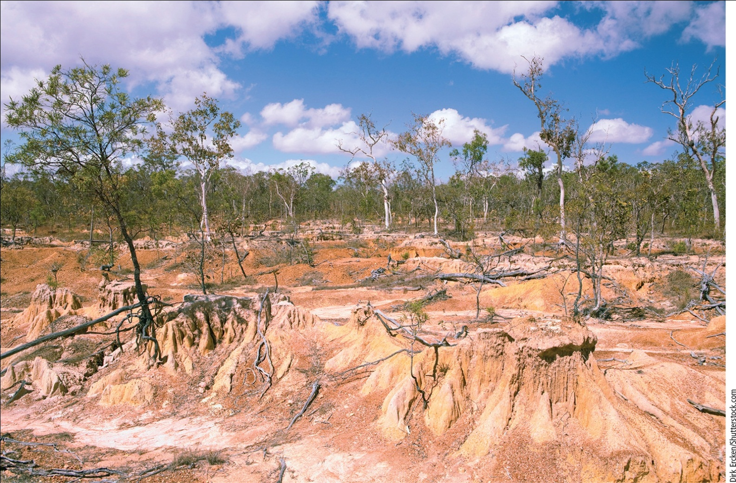
Almost Half of the World’s Forests Have Been Cut Down (3 of 3)
Notes:
Figure 10.11 Severe soil erosion and desertification caused by the clearing an area of tropical forest followed by livestock overgrazing.

Slide 20
Case Study: Managing Public Lands in the United States
Forests of the eastern U.S. decimated between 1620 and 1920
Grown back naturally through secondary ecological succession
Large areas of old-growth and second-growth forests cut down and replaced with biologically simplified tree plantations
Growing threat: hardwood forests cleared to produce wood pellets for export

Slide 21
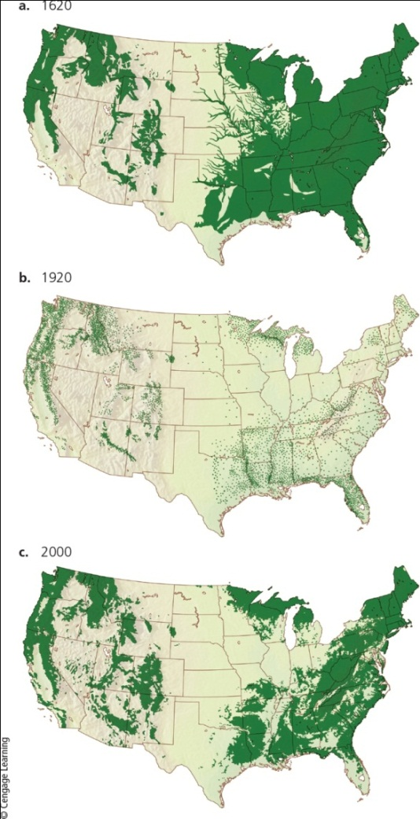
Forests Are Disappearing Rapidly in the U.S.
Notes:
Figure 10.13 In 1620, (a) when European settlers were moving to North America, forests covered more than half of the current land area of the continental United States. By 1920, (b) most of these forests had been decimated. In 2000, (c) secondary and commercial forests covered about a third of U.S. land in the lower 48 states.

Slide 22
Tropical Forests are Disappearing Rapidly (1 of 2)
Majority of loss since 1950
Mostly in Africa, Southeast Asia, South America
Clearing trees accelerates climate change
Indonesia leads world in tropical deforestation
Destroying rain forest to produce palm oil

Slide 23
Tropical Forests Are Disappearing Rapidly (2 of 2)
Various causes
Population growth
Poverty of subsistence farmers
Ranching
Lumber
Plantation farms–palm oil
Global trade

Slide 24
How Can We Manage and Sustain Forests?
Methods to sustain forests
Emphasize the value of their ecosystem services
Halt government subsidies that hasten their destruction
Protect old-growth forests
Harvest trees no faster than they are replenished
Plant trees to reestablish forests

Slide 25
Managing Forests More Sustainably (1 of 2)
Widely used approaches
Maximum sustainable yield
Harvest maximum amount of trees that will not reduce future yield
Ecosystem-based management
Minimize harmful harvesting impacts on ecosystem
Adaptive management
Harvest forests, evaluate results, and modify approach

Slide 26
Managing Forests More Sustainably (2 of 2)
Solutions
More Sustainable Forestry
Include ecosystem services of forests in estimates of their economic value
Identify and protect highly diverse forest areas
Stop logging in old-growth forests
Stop clear-cutting on steep slopes
Reduce road-building in forests and rely more on selective and strip cutting
Leave most standing dead trees and larger fallen trees for wildlife habitat and nutrient cycling
Put tree plantations only on deforested and degraded land
Certify timber grown by sustainable methods
Notes:
Figure 10.14 Ways to grow and harvest trees more sustainably (Concept 10.2). Critical thinking: Which three of these methods of more sustainable forestry do you think are the best methods? Why?

Slide 27
Improving Management of Forest Fires (1 of 2)
The U.S. Smokey Bear educational campaign
Pros and cons of fires
Prescribed burns
Remove flammable material and underbrush
Allow fires on public lands to burn
As long as structures not threatened

Slide 28
Improving Management of Forest Fires (2 of 2)
Protect structures in fire-prone areas
Thin nearby trees and vegetation
Eliminate use of highly flammable construction materials
Use drones with infrared sensors to detect fires and monitor progress in fighting them

Slide 29
Reducing the Demand for Harvested Trees
Improve the efficiency of wood use
60% of U.S. wood use is wasted
Make tree-free paper
Kenaf
Rice straw
Hemp
Reduce use of throwaway paper products

Slide 30
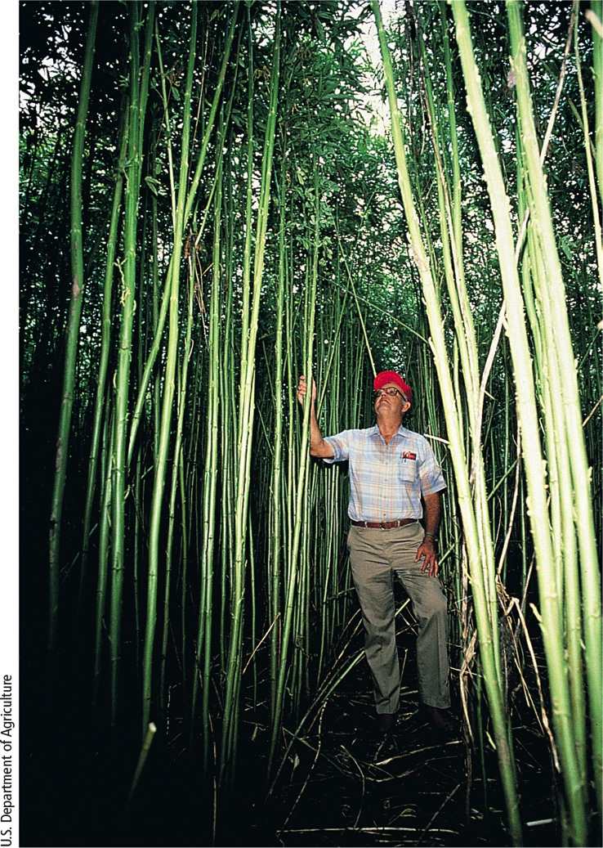
Solutions: Fast-Growing Plant: Kenaf
Notes:
Figure 10.15 Solutions: The pressure to cut trees to make paper could be greatly reduced by planting and harvesting a fast-growing plant known as kenaf.

Slide 31
Reducing Tropical Deforestation (1 of 2)
Debt-for-nature swaps and conservation concessions
Protect forests in return for aid
Crack down on illegal logging
End government subsidies for logging roads
Purchase only sustainably produced wood
Plant forests on degraded land

Slide 32
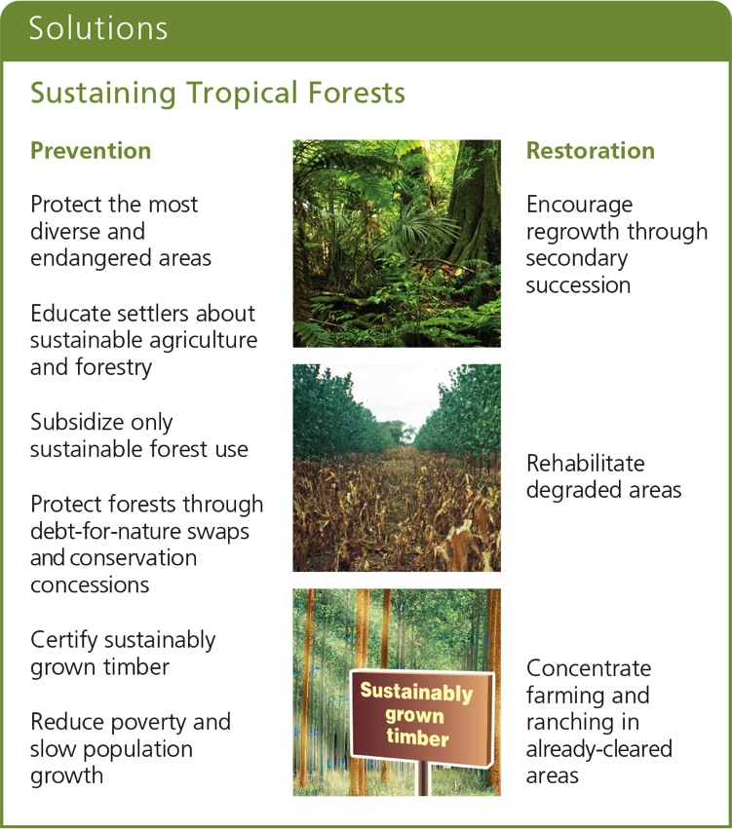
Reducing Tropical Deforestation (2 of 2)
Notes:
Figure 10.18 Ways to protect tropical forests and to use them more sustainably (Concept 10.2). Critical thinking: Which three of these solutions do you think are the best ones? Why?

Slide 33
10.2 How Can We Manage and Sustain Grasslands?
Methods to sustain the productivity of grasslands
Control the numbers and distribution of grazing livestock
Restore degraded grasslands

Slide 34
Some Rangelands Are Overgrazed (1 of 3)
Rangelands
Unfenced grasslands in temperate and tropical climates that supply forage for animals
Pastures
Managed grasslands or fenced meadows used for grazing livestock

Slide 35
Some Rangelands Are Overgrazed (2 of 3)
Moderate levels of grazing healthy for grasslands
Overgrazing of rangelands
Reduces grass cover
Compacts the soil
Lessens capacity to hold water
Leads to erosion of soil by water and wind
Promotes invasion of plant species that cattle won’t eat

Slide 36
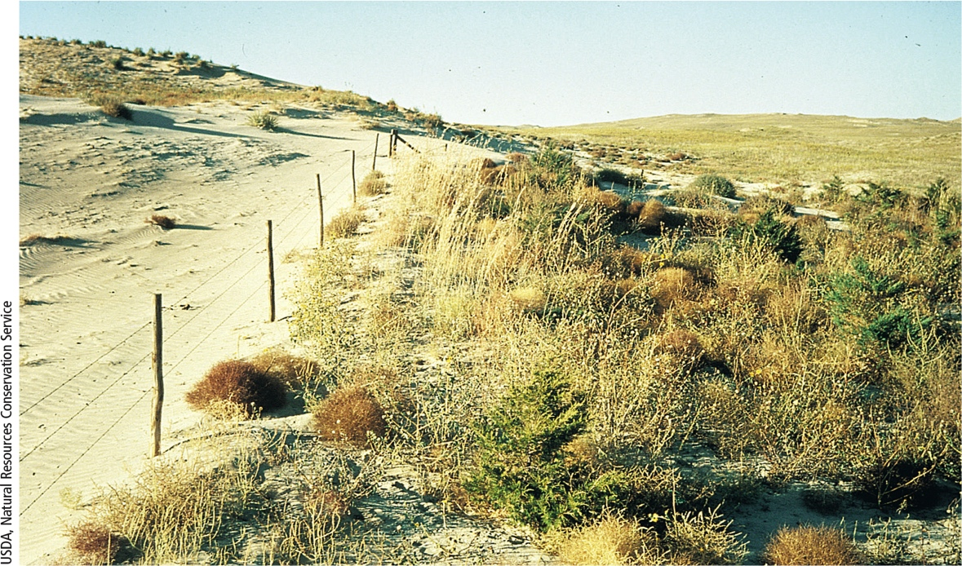
Some Rangelands Are Overgrazed (3 of 3)
Notes:
Figure 10.20 Natural capital degradation: To the left of the fence is overgrazed rangeland. The land to the right of the fence is lightly grazed.

Slide 37
Managing Rangelands More Sustainably (1 of 2)
Rotational grazing
Cattle moved around regularly
Fence off damaged areas
Holistic herd management
Short term trampling by moving herd aerates the soil
Increases nutrient recycling and soil fertility by pressing decaying grasses into the soil

Slide 38
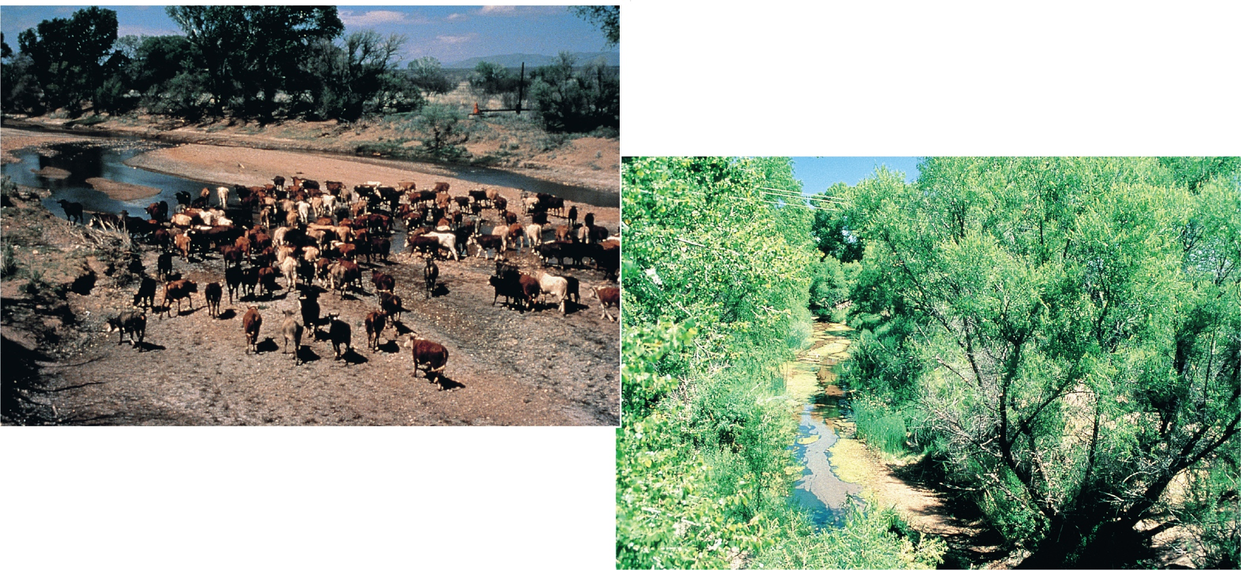
Managing Rangelands More Sustainably (2 of 2)
Notes:
Figure 10.21 Natural capital restoration. In the mid-1980s, cattle had degraded the vegetation and soil on this stream bank along the San Pedro River in the U.S. state of Arizona (left). Within 10 years, the area was restored through secondary ecological succession (right) after grazing and off-road vehicle use were banned (Concept 10.3).

Slide 39
10.3 How Can We Manage and Sustain Wetlands?
Wetlands are disappearing
The United States has lost more than half of its coastal and inland wetlands since 1900.
Other countries have lost even more, and the rate of loss of wetlands throughout the world is accelerating.

Slide 40
Wetlands Are Disappearing
For centuries, people have drained, filled in, or covered over swamps, marshes, and other wetlands:
to create rice fields or other cropland
to accommodate expanding cities and suburbs
to build roads
to extract minerals, oil, and natural gas
to eliminate breeding grounds for insects that cause diseases such as malaria

Slide 41
Preserving and Restoring Wetlands
Only about 6% of the country’s remaining inland wetlands are federally protected, and state and local wetland protection is inconsistent and generally weak.
Private investment bankers make money by buying wetland areas and restoring or upgrading them or creating new wetland. This creates wetlands banks or credits that the bankers sell to developers.
However, is difficult to restore, enhance, or create wetlands.

Slide 42
Case Study: Can We Restore the Florida Everglades? (1 of 4)
To help preserve the Everglades system, in 1947, the US government established Everglades National Park.
However, this protection effort did not work because
of a massive water distribution and land development project to the north.
Much of the original Everglades has been drained, paved over, polluted by agricultural runoff, and invaded by a number of plant and animal species.

Slide 43
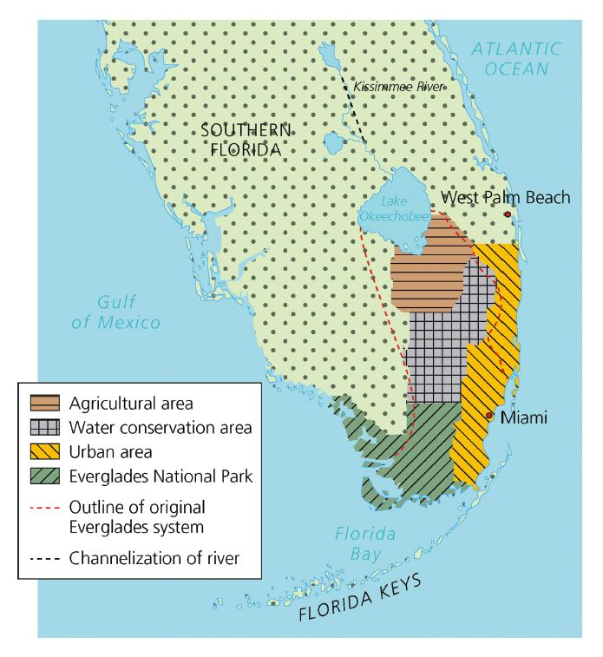
Notes:
Figure 10.21 Natural capital restoration. In the mid-1980s, cattle had degraded the vegetation and soil on this stream bank along the San Pedro River in the U.S. state of Arizona (left). Within 10 years, the area was restored through secondary ecological succession (right) after grazing and off-road vehicle use were banned (Concept 10.3).

Slide 44
Case Study: Can We Restore the Florida Everglades? (3 of 4)
Its biodiversity has been decreasing, mostly because of habitat loss, pollution, and invasive species.
About 90% of the wading birds in Everglades National Park have vanished.
In addition, populations of vertebrates, from deer to turtles, are down 75–95%.

Slide 45
Case Study: Can We Restore the Florida Everglades? (4 of 4)
The world’s largest ecological restoration project, known as the Comprehensive Everglades Restoration Plan, has several ambitious goals:
Restoration of the flow of the Kissimmee River
Removal of canals and levees that block natural water flows south of Lake Okeechobee
Conversion of large areas of farmland to marshes
Creation of 18 large reservoirs and underground water storage areas for the lower Everglades and south Florida’s population
Building a canal–reservoir system for catching the water now flowing out to sea and pumping it back into the Everglades.

Slide 46
10.4 How Can We Sustain Terrestrial Biodiversity and Ecosystem Services?
Establish and protect wilderness parks
Identify and protect biological hotspots
Highly threatened areas of biodiversity
Protect ecosystem services
Restore damaged ecosystems
Share areas that we dominate with other species

Slide 47
Restoring Damaged Ecosystems
Map world’s terrestrial ecosystems and create inventory of species
Identify resilient and fragile ecosystems
Protect the most endangered ecosystems and species
Emphasis on protecting plant biodiversity and ecosystem services
Restore degraded ecosystems
Provide incentives to landowners

Slide 48
Strategies for Sustaining Terrestrial Biodiversity (1 of 2)
Protect species from extinction
Set aside wilderness areas
Establish parks and nature preserves where people can interact with nature
Identify and protect biodiversity hotspots
Shift new development to lands already cleared or degraded
Protect important ecosystem services

Slide 49
Strategies for Sustaining Terrestrial Biodiversity (2 of 2)
Increase crop productivity on existing cropland
Rehabilitate and restore partially damaged ecosystems
Share areas we dominate with other species

Slide 50
Protecting Biodiversity Hotspots (1 of 2)
34 biodiversity hot spots
Cover 2% of Earth’s surface, but 50% of flowering plant species and 42% of terrestrial vertebrates
1.2 billion people
Only 5% of the total area of these hotspots is truly protected

Slide 51
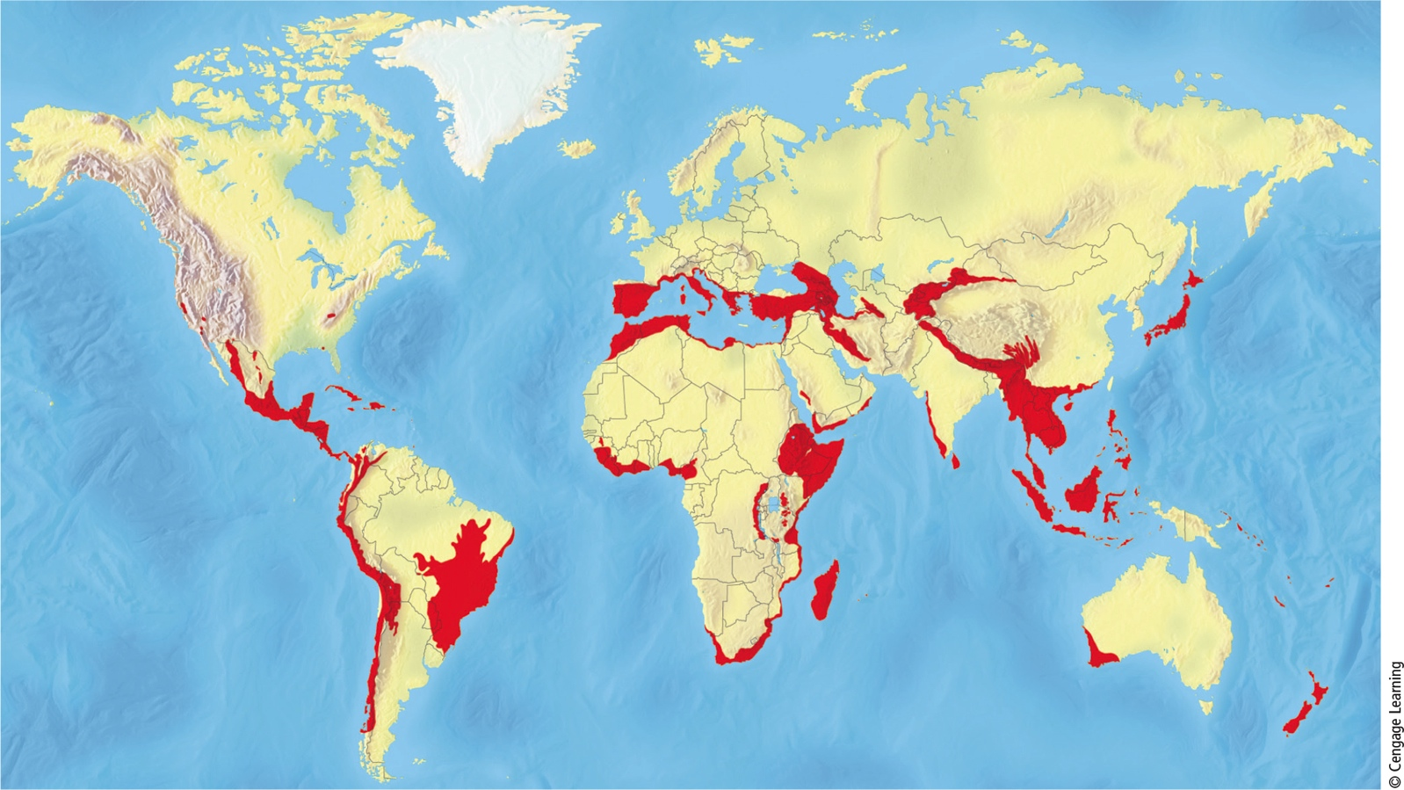
Protecting Biodiversity Hotspots (2 of 2)
Notes:
Figure 10.26: Endangered natural capital. Biologists have identified these 34 biodiversity hotspots. Compare this map with the global map of the human ecological footprint, shown in Figure 1.8. Question: Why do you think so many hotspots are located near coastal areas?

Slide 52
Establishing Wilderness Areas
1964 Wilderness Act
U.S. government may set aside undeveloped tracts of public land
Only 5% of U.S. land is protected as wilderness
More than half of it in Alaska
As human population and ecological footprint expand, increasingly difficult to establish new wilderness areas

Slide 53
Establishing Parks and Other Nature Reserves
More than 6,600 national parks in 120 countries
Most too small to sustain large animal species
Some so popular that human use is degrading
Parks in less-developed countries have the greatest diversity
Subject to illegal poaching, logging, mining, and other uses

Slide 54
Stresses on U.S. Public Parks
The U.S. has 59 major national parks
Factors that degrade parks
Popularity
Off-road vehicle use
Cell phone towers
Nonnative species
Nearby air pollution and traffic
Overdue maintenance and repairs

Slide 55
Designing and Managing Nature Reserves
Large nature reserves typically sustain more species and provide greater habitat diversity than small reserves
Habitat corridors can benefit species
Allows migration in response to climate change
Buffer zone concept
Strictly protect inner core of reserve
Sustainable resource extraction in buffer zone

Slide 56
Science Focus 10.1 Reintroducing the Gray Wolf to Yellowstone National Park (1 of 2)
Number of gray wolves declined between 1850 and 1900
Killed by humans
1996: Relocated 41 gray wolves caught in Canada to Yellowstone
2014: 104 wolves in Yellowstone national park
Notes:
Figure 10.B After becoming almost extinct in much of the western United States, the gray wolf was listed and protected as an endangered species in 1974.

Slide 57
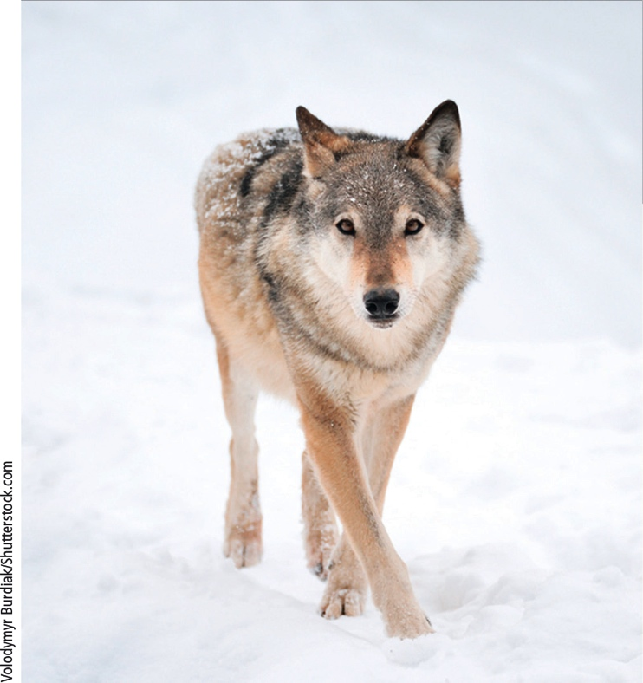
Science Focus 10.1 Reintroducing the Gray Wolf to Yellowstone National Park (2 of 2)
Notes:
Figure 10.B After becoming almost extinct in much of the western United States, the gray wolf was listed and protected as an endangered species in 1974.

Slide 58
Case Study: Identifying and Protecting Biodiversity in Costa Rica (1 of 3)
Costa Rica protects a larger portion of its land than any other country
Principles of biodiversity
Respect biodiversity and understand the value of sustaining it
Rely less on fossil fuels and more on direct solar energy
Place a value on ecosystem services and help implement full-cost pricing

Slide 59
Case Study: Identifying and Protecting Biodiversity in Costa Rica (2 of 3)
Megareserves–large conservation areas
Designed to sustain about 80% of the country’s biodiversity
Protected inner core surrounded by two buffer zones that local people can use
Large ecotourism industry

Slide 60
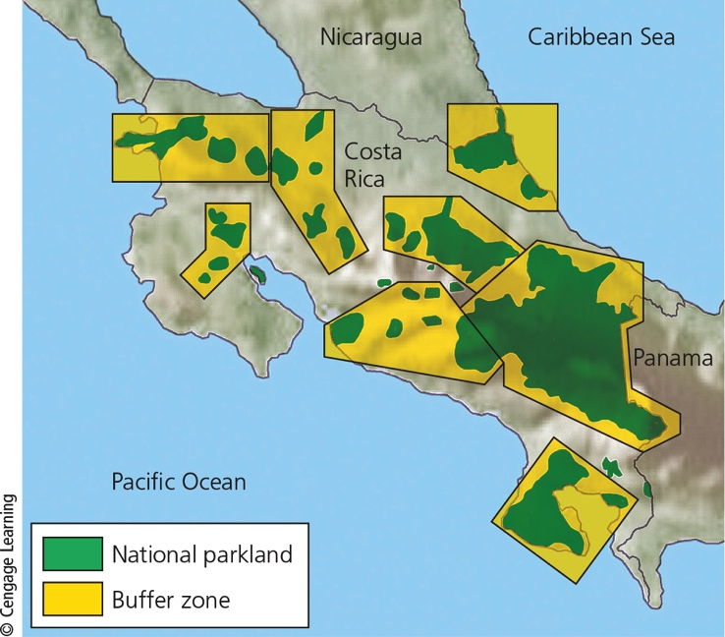
Case Study: Identifying and Protecting Biodiversity in Costa Rica (3 of 3)
Notes:
Figure 10.25: Solutions: Costa Rica has created several megareserves. Green areas are protected natural parklands and yellow areas are the surrounding buffer zones.

Slide 61
Protecting Ecosystem Services
Identify highly stressed life raft ecosystems
Areas with high poverty levels
Most people depend on ecosystem services for survival
Residents, public officials, and conservation scientists would work together
Win–win principle of sustainability

Slide 62
Restoring Damaged Ecosystems (1 of 2)
Ecological restoration examples
Replanting forests
Reintroducing keystone native species
Removing harmful invasive species
Removing dams
Restoring grasslands, coral reefs, wetlands, and stream banks

Slide 63
Restoring Damaged Ecosystems (2 of 2)
Four-step strategy for carrying out rehabilitation
Identify causes of the degradation
Stop the degradation by eliminating or sharply reducing those factors
Reintroduce keystone species, if possible
Protect from further degradation

Slide 64
Sharing Areas We Dominate with Other Species (1 of 2)
Reconciliation ecology
Invent and maintain habitats for species diversity where people live, work, and play
Community-based conservation
Plant garden as food for bees, butterflies, and other pollinators
Eliminate or reduce pesticide use
Provide nesting boxes for birds

Slide 65
Sharing Areas We Dominate with Other Species (2 of 2)
What Can You Do?
Sustaining Terrestrial Biodiversity
Plant trees and take care of them
Recycle paper and buy recycled paper products
Buy sustainably produced wood and wood products and wood substitutes such as recycled plastic furniture and decking
Help restore a degraded forest or grassland
Landscape your yard with a diversity of native plants
Notes:
Figure 10.28 Individuals matter: Ways to help to sustain terrestrial biodiversity. Critical thinking: Which two of these actions do you think are the most important ones to take? Why? Which of these things do you already do?

Slide 66
10.5 How Can Cities Become More Sustainable and Livable?
Most cities are unsustainable because of high levels of resource use, waste, pollution, and poverty.
An eco-city allows people to choose walking, biking, or mass transit for most transportation needs; recycle or reuse most of their wastes; grow much of their food; and protect biodiversity by preserving surrounding land.

Slide 67
Three Important Urban Trends
Three major trends
Proportion of global population living in urban areas is increasing
Number and size of urban areas is mushrooming
Megacities; hypercities
Poverty is becoming increasingly urbanized
Mostly in less-developed countries

Slide 68
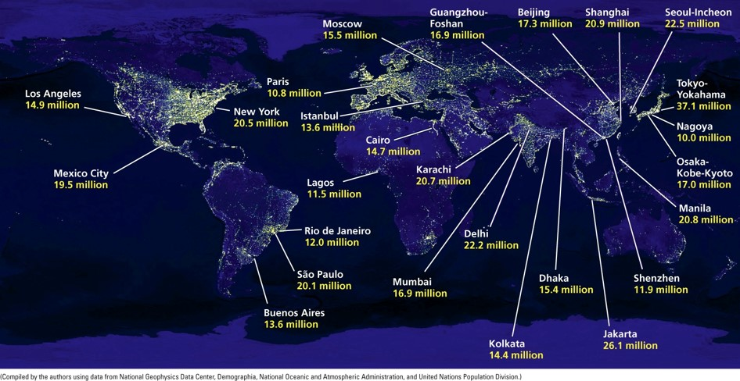
Megacities, or major urban areas. with 10 million or more people, in 2015.
Notes:
Figure 10.26: Endangered natural capital. Biologists have identified these 34 biodiversity hotspots. Compare this map with the global map of the human ecological footprint, shown in Figure 1.8. Question: Why do you think so many hotspots are located near coastal areas?

Slide 69
Urbanization in the United States
Between 1800 and 2016, the percentage of the US population living in urban areas increased from 5% to 82%
Three phases between 1800 and 2008
Migration from rural areas to large central cities
Migration from large central cities to suburbs and smaller cities
Migration from North and East to South and West

Slide 70
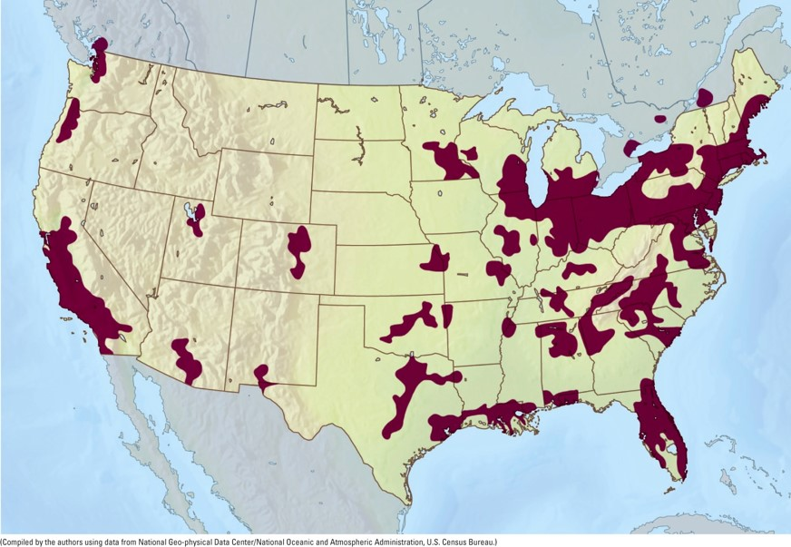
Major urban areas in the United States with more than 1 million people each
Notes:
Figure 10.26: Endangered natural capital. Biologists have identified these 34 biodiversity hotspots. Compare this map with the global map of the human ecological footprint, shown in Figure 1.8. Question: Why do you think so many hotspots are located near coastal areas?

Slide 71
Urbanization Has Advantages and Disadvantages (1 of 3)
Advantages:
Centers of economic development, innovation, education, technological advances, and jobs
Recycling economically feasible
Preservation of biodiversity outside of urban areas
Mass transportation

Slide 72
Urbanization Has Advantages and Disadvantages (2 of 3)
Disadvantages
Huge ecological footprints
Consume 75% of the world’s resources
Lack of vegetation
Water problems
Deprive wild and rural areas of water; flooding
Concentration of pollution/health problems
Air and water pollution
Solid and hazardous wastes

Slide 73
Urbanization Has Advantages and Disadvantages (3 of 3)
Disadvantages
Urban heat islands
Leads to higher energy consumption and greenhouse gas emissions
Altered climate and light pollution
Cities tend to be warmer, rainier, foggier, and cloudier than rural areas
Artificial light has affected some species

Slide 74
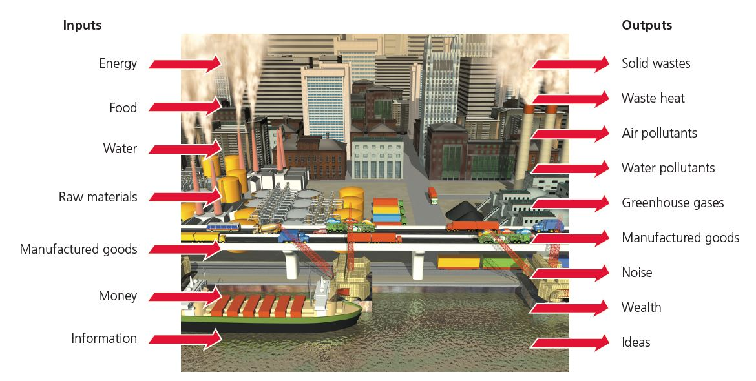
Cities depend on nonurban areas for matter and energy resources, and they generate large outputs of pollution, waste matter, and heat.
Notes:
Figure 10.26: Endangered natural capital. Biologists have identified these 34 biodiversity hotspots. Compare this map with the global map of the human ecological footprint, shown in Figure 1.8. Question: Why do you think so many hotspots are located near coastal areas?

Slide 75
Cities Can Grow Upward or Outward
Compact cities
Hong Kong, China
Tokyo, Japan
Mass transit
Dispersed cities
U.S. and Canada
Car-centered cities

Slide 76
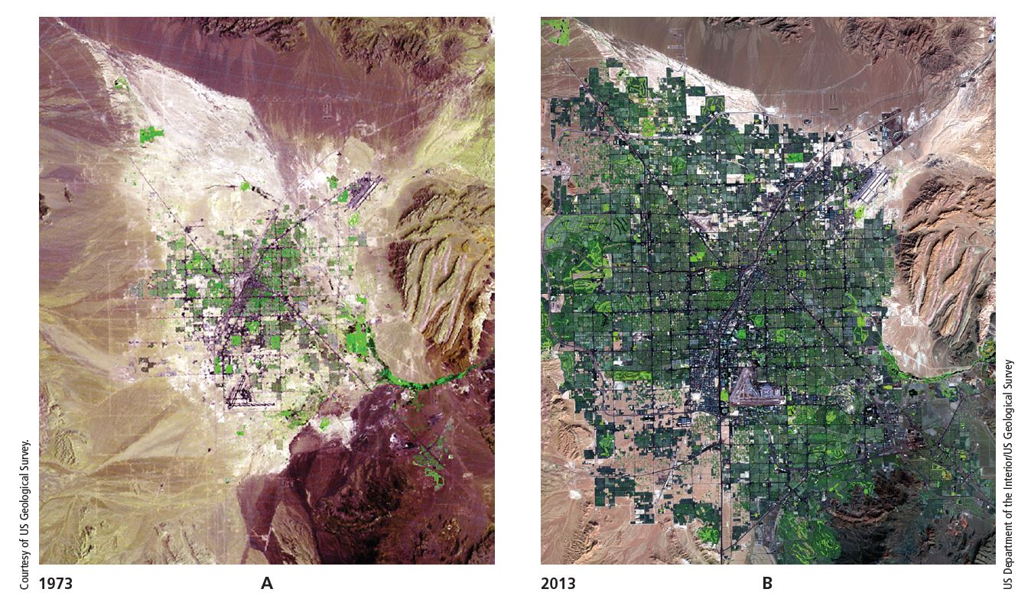
Urban sprawl in and around Las Vegas, Nevada, between 1973 and 2013.
Notes:
Figure 10.26: Endangered natural capital. Biologists have identified these 34 biodiversity hotspots. Compare this map with the global map of the human ecological footprint, shown in Figure 1.8. Question: Why do you think so many hotspots are located near coastal areas?

Slide 77
Natural Capital Degradation in Urban Sprawl
Notes:
Figure 10.26: Endangered natural capital. Biologists have identified these 34 biodiversity hotspots. Compare this map with the global map of the human ecological footprint, shown in Figure 1.8. Question: Why do you think so many hotspots are located near coastal areas?

Slide 78
Alternatives to Cars (1 of 4)
Notes:
Figure 10.26: Endangered natural capital. Biologists have identified these 34 biodiversity hotspots. Compare this map with the global map of the human ecological footprint, shown in Figure 1.8. Question: Why do you think so many hotspots are located near coastal areas?

Slide 79
Alternatives to Cars (2 of 4)
Notes:
Figure 10.26: Endangered natural capital. Biologists have identified these 34 biodiversity hotspots. Compare this map with the global map of the human ecological footprint, shown in Figure 1.8. Question: Why do you think so many hotspots are located near coastal areas?

Slide 80
Alternatives to Cars (3 of 4)
Notes:
Figure 10.26: Endangered natural capital. Biologists have identified these 34 biodiversity hotspots. Compare this map with the global map of the human ecological footprint, shown in Figure 1.8. Question: Why do you think so many hotspots are located near coastal areas?

Slide 81
Alternatives to Cars (4 of 4)
Notes:
Figure 10.26: Endangered natural capital. Biologists have identified these 34 biodiversity hotspots. Compare this map with the global map of the human ecological footprint, shown in Figure 1.8. Question: Why do you think so many hotspots are located near coastal areas?

Slide 82
Land-Use Planning
Through land-use planning, governments can control the uses of certain parcels of land by legal and economic methods.
Zoning can be used to control growth and to protect areas from certain types of development. But zoning has its drawbacks:
Developers can influence or modify zoning decisions in ways that threaten or destroy wetlands, prime cropland, forested areas, and open space.
Zoning often favors high-priced housing, factories, hotels, and other businesses over protecting environmentally sensitive areas and providing low-cost housing.

Slide 83
Smart Growth
Smart growth
Reduces dependence on cars
Controls and directs sprawl
Protects ecologically sensitive areas
Uses zoning laws to channel growth

Slide 84
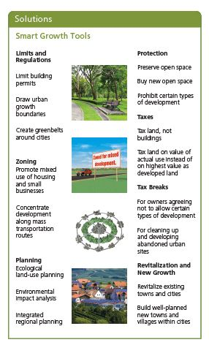
Notes:
Figure 10.26: Endangered natural capital. Biologists have identified these 34 biodiversity hotspots. Compare this map with the global map of the human ecological footprint, shown in Figure 1.8. Question: Why do you think so many hotspots are located near coastal areas?

Slide 85
The Eco-City Concept
An eco-city allows people to:
Choose walking, biking, or mass transit for most transportation needs
Buildings, vehicles, and appliances meet high energy-efficiency standards
Abandoned lots and industrial sites are cleaned up and used.
Much of their food is grown locally
Protect biodiversity by preserving surrounding land

Slide 86
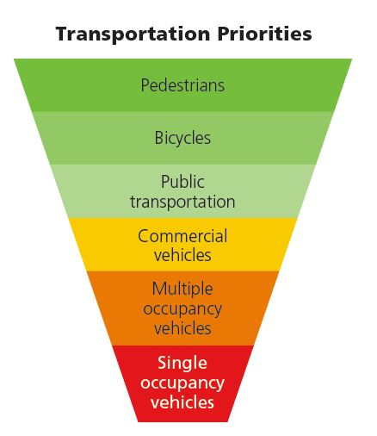
Transportation Priorities in More-Sustainable Cities
Notes:
Figure 10.26: Endangered natural capital. Biologists have identified these 34 biodiversity hotspots. Compare this map with the global map of the human ecological footprint, shown in Figure 1.8. Question: Why do you think so many hotspots are located near coastal areas?

Slide 87
Case Study: The Eco-City Concept in Curitiba, Brazil
Ecological capital of Brazil
Superb bus rapid-transit system
72% of the city’s commuters use the system
Cars banned for 49 blocks in the center of the city
Only high-rise apartment buildings allowed near major bus routes, with retail stores in each building, which reduces the need for residents to travel
Recycles roughly 70% of its paper and 60% of its metal, glass, and plastic
Care for the poor includes free medical and dental care, childcare, and job training

Slide 88
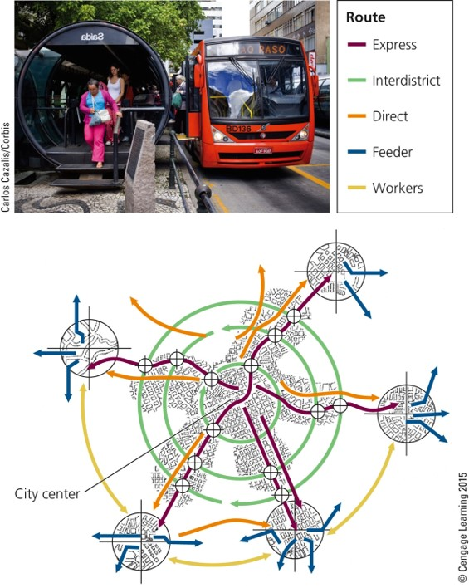
The Rapid-Transit System in Curitiba
Notes:
Figure 10.26: Endangered natural capital. Biologists have identified these 34 biodiversity hotspots. Compare this map with the global map of the human ecological footprint, shown in Figure 1.8. Question: Why do you think so many hotspots are located near coastal areas?

Slide 89
Key Ideas (1 of 3)
We can sustain forests by emphasizing the economic value of their ecosystem services, halting government subsidies that hasten their destruction, protecting old-growth forests, harvesting trees no faster than they are replenished, and planting trees to reestablish forests.

Slide 90
Key Ideas (2 of 3)
We can sustain terrestrial biodiversity and ecosystem services by protecting severely threatened areas and ecosystem services and restoring damaged ecosystems.

Slide 91
Key Ideas (3 of 3)
Most urban areas are unsustainable with their large and growing ecological footprints and high levels of poverty but they can be made more sustainable and livable.

