Slide 1
Chapter 4
0
A Tour of the Cell

Slide 2
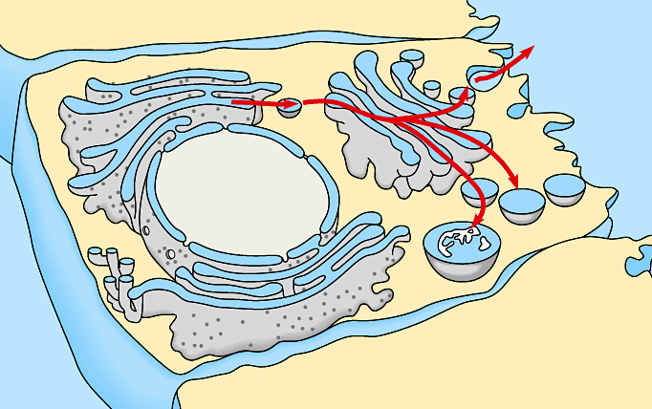
Concept Check
0
The cell is sometimes described as a protein factory. Using the cell-as-factory analogy, which of the following accurately describes the functions of the endomembrane system?
The ribosomes on the rough endoplasmic reticulum are analogous to a production line in a factory.
The golgi apparatus is analogous to the packaging and shipping department.
The nucleus is analogous to management offices.
All of the above.

Slide 3
Answer
0
The cell is sometimes described as a protein factory. Using the cell-as-factory analogy, which of the following accurately describes the functions of the endomembrane system?
All of the above.

Slide 4
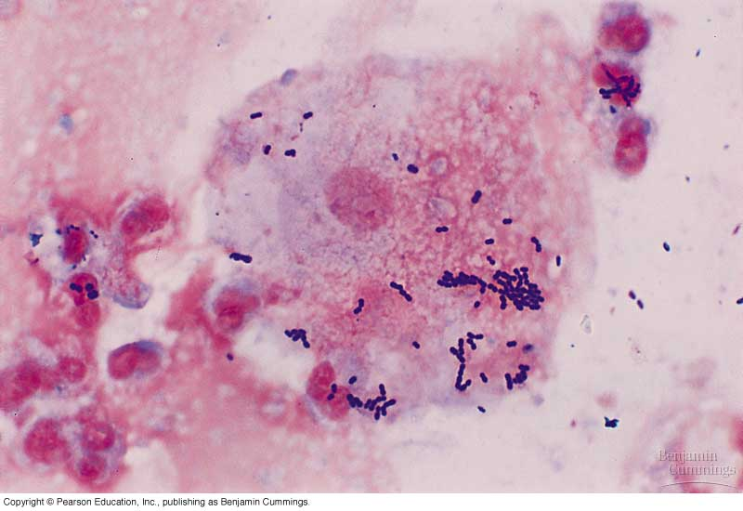
Concept Check
The three domains of life described by biologists today include the bacteria, the archaea and the eukarya (all other forms of life). What is the principle difference between the eukarya or eukaryotes and the prokaryotes (archaea and bacteria)?
The prokaryotes do not have a plasma membrane surrounding the cell.
The prokaryotes use RNA and not DNA to pass on the genetic message.
The eukaryotes have the interior of the cell divided by internal membranes into specialized compartments.
The eukaryotes engage in cellular metabolism while the prokaryotes do not.

Slide 5
Answer
The three domains of life described by biologists today include the bacteria, the archaea and the eukarya (all other forms of life). What is the principle difference between the eukarya or eukaryotes and the prokaryotes (archaea and bacteria)?
The eukaryotes have the interior of the cell divided by internal membranes into specialized compartments.

Slide 6
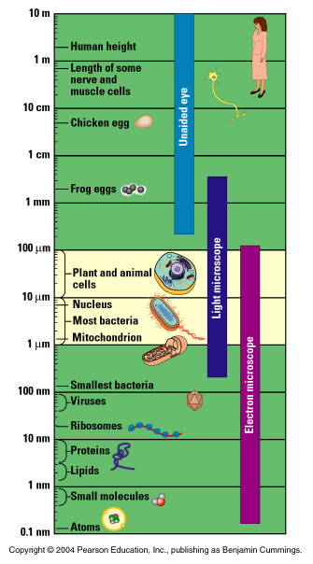
Interpreting Data
0
The scale of life at the cellular level can be difficult to understand. The scale on this chart is logarithmic. Each line represents a factor of 10. Compared to a typical animal or plant cell (about 100 µm in diameter) how much smaller is a mitochondria?
Mitochondria and animal cells are essentially the same size.
The length of mitochondria is about 1/10 the diameter of an animal cell.
The length of mitochondria is about 1/100 the diameter of an animal cell.
The length of mitochondria is about 1/1000 the diameter of an animal cell.

Slide 7
Answer
0
The scale of life at the cellular level can be difficult to understand. The scale on this chart is logarithmic. Each line represents a factor of 10. Compared to a typical animal or plant cell (about 100 µm in diameter) how much smaller is a mitochondria?
The length of mitochondria is about 1/100 the diameter of an animal cell.

Slide 8
Interpreting Data
0
Cells are small but molecules are even smaller. Compared to a water molecule about how many times larger is a typical animal or plant cell (about 100 µm in diameter)?
Cells are 1 million times larger (diameter) than a water molecule.
Cells are 100,000 times larger (diameter) than a water molecule.
Cells are 10,000 times larger (diameter) than a water molecule.
Cells are 1,000 times larger (diameter) than a water molecule.

Slide 9
Answer
0
Cells are small but molecules are even smaller. Compared to a water molecule about how many times larger is a typical animal or plant cell (about 100 µm in diameter)?
Cells are 100,000 times larger (diameter) than a water molecule.

Slide 10
Interpreting Data
0
Compared to the images generated by the Hubble telescope or the planetary probes like Voyager telescope images are limited. Likewise looking at cells under a light microscope is limited. Which of the following cell parts are visible under a light microscope?
Ribosomes.
Large macromolecules.
Microtubules.
Mitochondria—just barely.

Slide 11
Answer
0
Compared to the images generated by the Hubble telescope or the planetary probes like Voyager telescope images are limited. Likewise looking at cells under a light microscope is limited. Which of the following cell parts are visible under a light microscope?
Mitochondria—just barely.

Slide 12
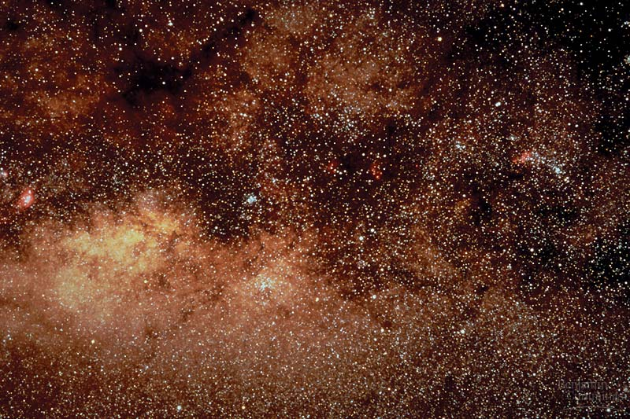
Biology and Society
0
NASA has a number of research programs that are looking for evidence of life beyond the planet, Earth. Recently two Mars Rovers specifically looked for evidence of liquid water as one key component for life. Do you think that these NASA’s programs are justified economically?
Strongly
Agree
Strongly
Disagree
A.
B.
C.
D.
E.

Slide 13
Biology and Society
0
NASA has a number of research programs that are looking for evidence of life beyond the planet, Earth. Recently two Mars Rovers specifically looked for evidence of liquid water as one key component for life. Do you think that these NASA’s programs are justified scientifically?
Strongly
Agree
Strongly
Disagree
A.
B.
C.
D.
E.

Slide 14
Biology and Society
0
Life on another planet would require extraordinary evidence to be recognized and accepted. Looking for evidence of cells might be some of the most compelling evidence. Do you think that eventually we will find evidence of life elsewhere in the universe?
Strongly
Agree
Strongly
Disagree
A.
B.
C.
D.
E.

