Slide 1
Chapter 4
0
A Tour of the Cell

Slide 2
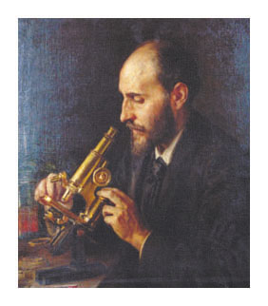
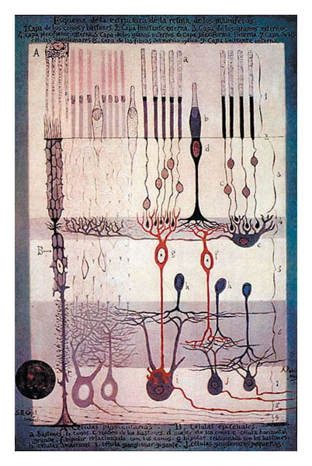
The Art of Looking at Cells
Early scientists who obser ved cells
Made detailed sketches of what they saw

Slide 3
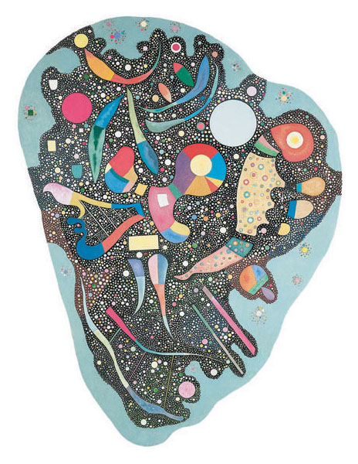
These early sketches revealed an impor tant relationship
Between art and biology, the most visual of the sciences

Slide 4
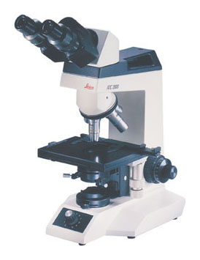
INTRODUCTION TO THE CELL
4.1 Microscopes provide windows to the world of the cell
The light microscope (LM)
Enables us to see the overall shape and structure of a cell
Eyepiece
Ocular lens
Objective lens
Specimen
Condenser lens
Light source
Figure 4.1A

Slide 5
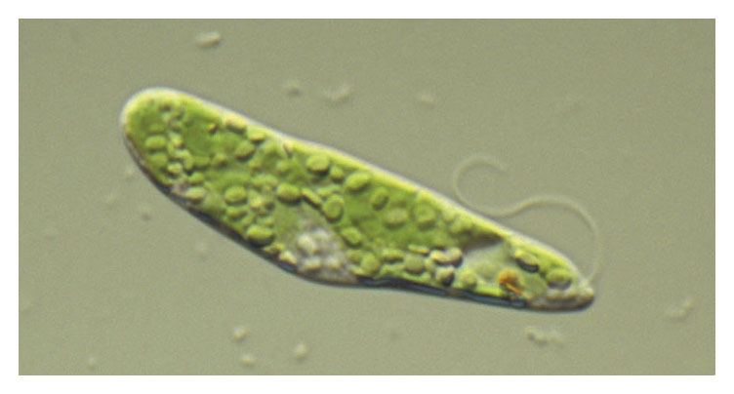
Light microscopes
Magnify cells, living and preser ved, up to 1,000 times
LM 1,000×
Figure 4.1B

Slide 6
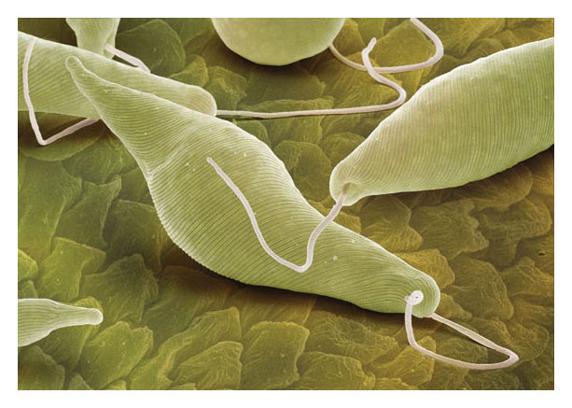
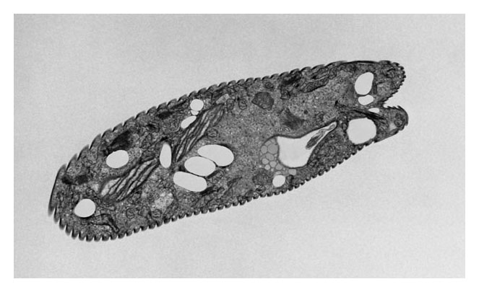
The electron microscope
Allows greater magnification and reveals cellular details
SEM 2,000 ×
TEM 2,800 ×
Figure 4.1C
Figure 4.1D

Slide 7
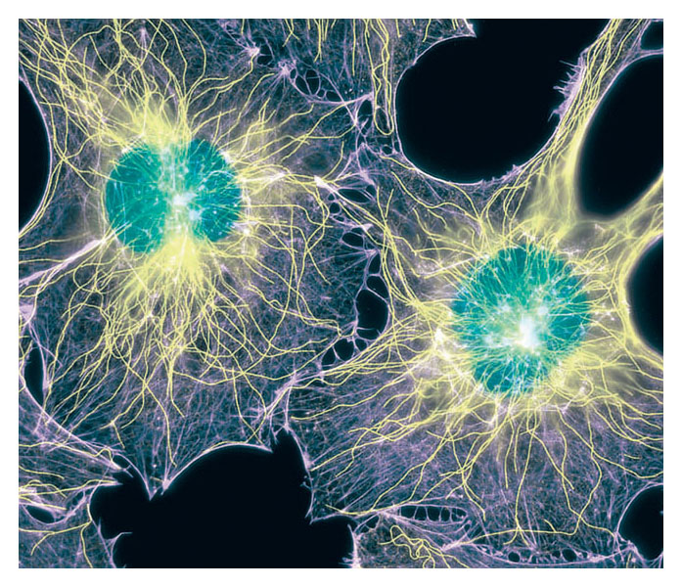
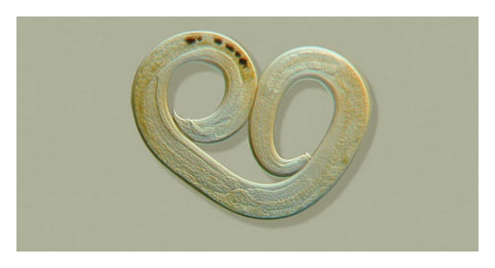
Different types of light microscopes
Use different techniques to enhance contrast and selectively highlight cellular components
220×
1,000×
Figure 4.1E
Figure 4.1F

Slide 8
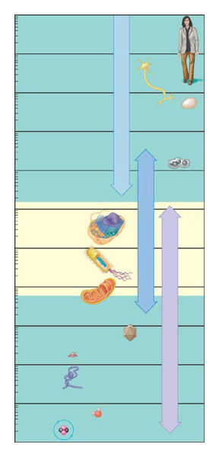
4.2 Most cells are microscopic
Cells vary in size and shape
10 m
1 m
Human height
Length of some nerve and muscle cells
100 mm (10 cm)
Chicken egg
Unaided eye
10 mm (1 cm)
1 mm
Frog egg
100 μm
Most plant and animal cells
Light microscope
10 μm
Nucleus
Most bacteria
1 μm
Mitochondrion
Mycoplasmas (smallest bacteria)
100 nm
Viruses
Electron microscope
10 nm
Ribosome
Proteins
Lipids
1 nm
Small molecules
Figure 4.2A
0.1 nm
Atoms

Slide 9
The microscopic size of most cells ensures a sufficient sur face area
Across which nutrients and wastes can move to ser vice the cell volume

Slide 10
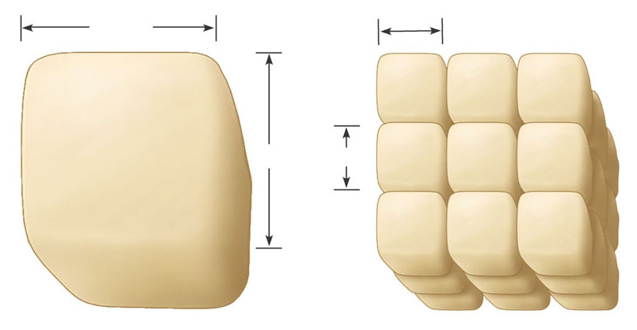
A small cell has a greater ratio of sur face area to volume
Than a large cell of the same shape
30 μm
10 μm
30 μm
10 μm
Surface area of one large cube = 5,400 μm²
Total surface area of 27 small cubes = 16,200 μm²
Figure 4.2B

Slide 11
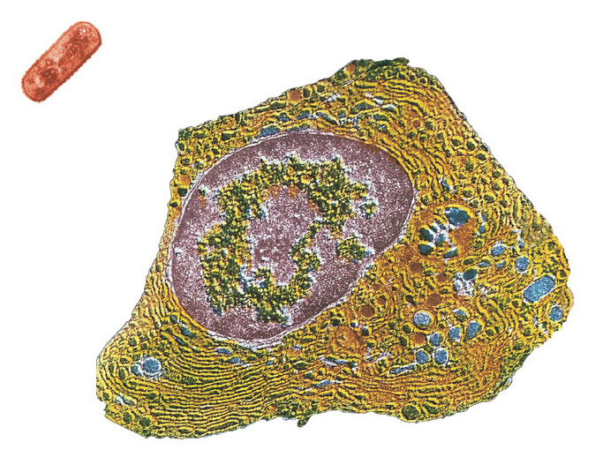
4.3 Prokaryotic cells are structurally simpler than eukar yotic cells
There are two kinds of cells
Prokaryotic and eukaryotic
Prokaryotic cell
Nucleoid region
Colorized TEM 15,000 ×
Nucleus
Figure 4.3A
Eukar yotic cell
Organelles

Slide 12
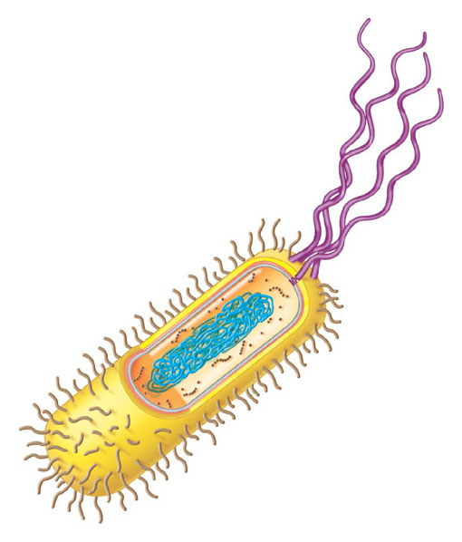
Prokaryotic cells are small, relatively simple cells
That do not have a membrane-bound nucleus
Prokar yotic flagella
Ribosomes
Capsule
Cell wall
Plasma membrane
Nucleoid region (DNA)
Pili
Figure 4.3B

Slide 13
4.4 Eukaryotic cells are par titioned into functional compar tments
All other forms of life are composed of more complex eukaryotic cells
Distinguished by the presence of a true nucleus

Slide 14
Membranes form the boundaries of many eukar yotic cells
Compar tmentalizing the interior of the cell and facilitating a variety of metabolic activities

Slide 15
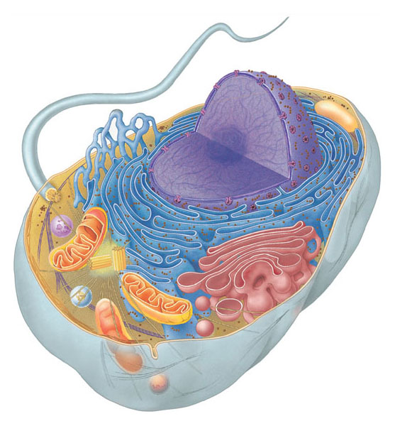
A typical animal cell
Contains a variety of membranous organelles
Smooth endoplasmic reticulum
Nucleus
Rough endoplasmic reticulum
Flagellum
Not in most plant cells
Lysosome
Ribosomes
Centriole
Peroxisome
Golgi apparatus
Microtubule
Plasma membrane
Cytoskeleton
Intermediate filament
Mitochondrion
Figure 4.4A
Microfilament

Slide 16
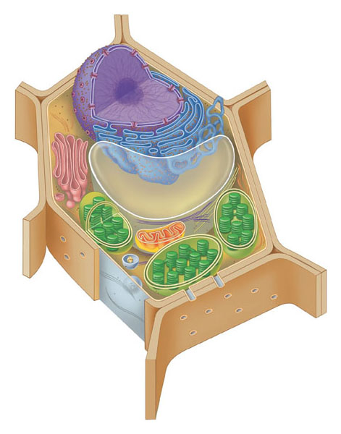
A typical plant cell has some structures that an animal cell lacks
Such as chloroplasts and a rigid cell wall
Rough endoplasmic reticulum
Nucleus
Ribosomes
Smooth endoplasmic reticulum
Golgi apparatus
Microtubule
Central vacuole
Intermediate filament
Cytoskeleton
Not in animal cells
Chloroplast
Microfilament
Cell wall
Mitochondrion
Peroxisome
Plasma membrane
Figure 4.4B

Slide 17
ORGANELLES OF THE ENDOMEMBRANE SYSTEM
4.5 The nucleus is the cell’s genetic control center
The largest organelle is usually the nucleus
Which is separated from the cytoplasm by the nuclear envelope

Slide 18
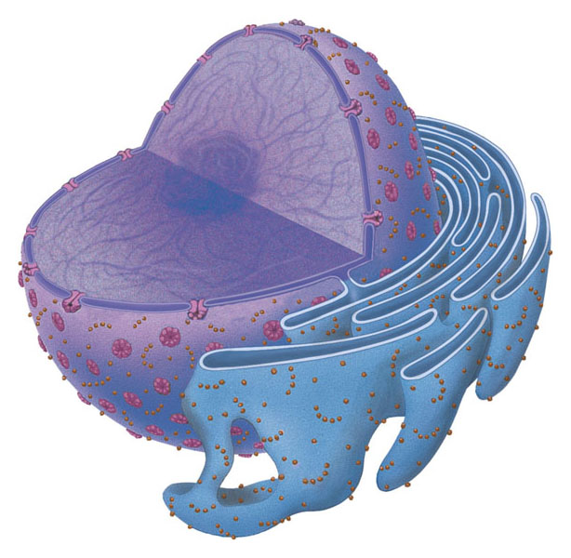
The nucleus is the cellular control center
Containing the cell’s DNA, which directs cellular activities
Chromatin
Nucleus
Two membranes of nuclear envelope
Nucleolus
Pore
Rough endoplasmic reticulum
Figure 4.5
Ribosomes

Slide 19
4.6 Over view: Many cell organelles are connected through the endomembrane system
The endomembrane system is a collection of membranous organelles
That manufactures and distributes cell products

Slide 20
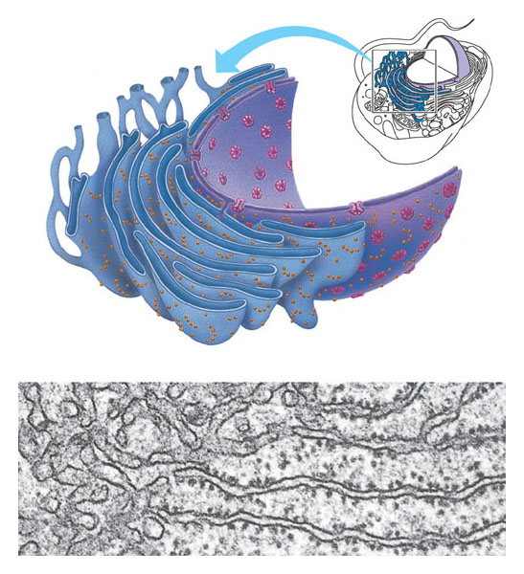
4.7 Smooth endoplasmic reticulum has a variety of functions
Smooth endoplasmic reticulum, or smooth ER
Synthesizes lipids
Processes toxins and drugs in liver cells
Stores and releases calcium ions in muscle cells
Smooth ER
Rough ER
Nuclear envelope
Ribosomes
Smooth ER
Rough ER
TEM 45,000×
Figure 4.7

Slide 21
4.8 Rough endoplasmic reticulum makes membrane and proteins
The rough ER
Manufactures membranes

Slide 22
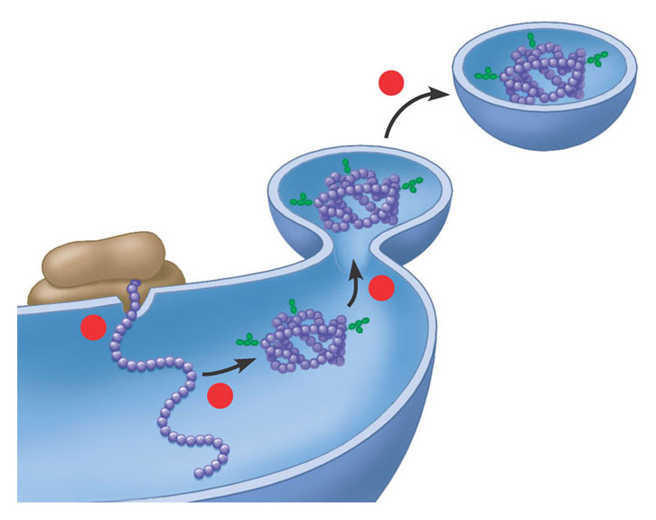
Ribosomes on the sur face of the rough ER
Produce proteins that are secreted, inser ted into membranes, or transpor ted in vesicles to other organelles
Transport vesicle buds off
4
Ribosome
Secretory (glyco-) protein inside trans- port vesicle
3
1
Sugar chain
2
Glycoprotein
Polypeptide
Rough ER
Figure 4.8

Slide 23
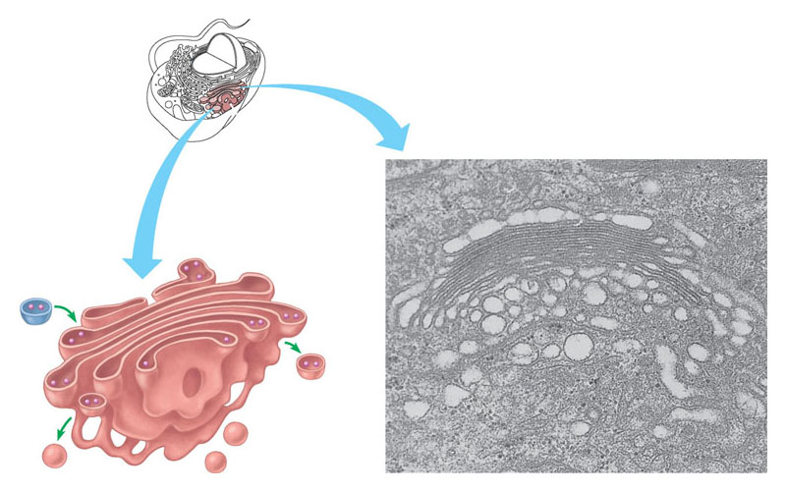
4.9 The Golgi apparatus finishes, sor ts, and ships cell products
Stacks of membranous sacs receive and modify ER products
Then ship them to other organelles or the cell sur face
“Receiving” side of Golgi apparatus
Golgi apparatus
Golgi apparatus
Transport vesicle from ER
New vesicle forming
TEM 130,000×
Transport vesicle from the Golgi
Figure 4.9
“Shipping” side of Golgi apparatus

Slide 24
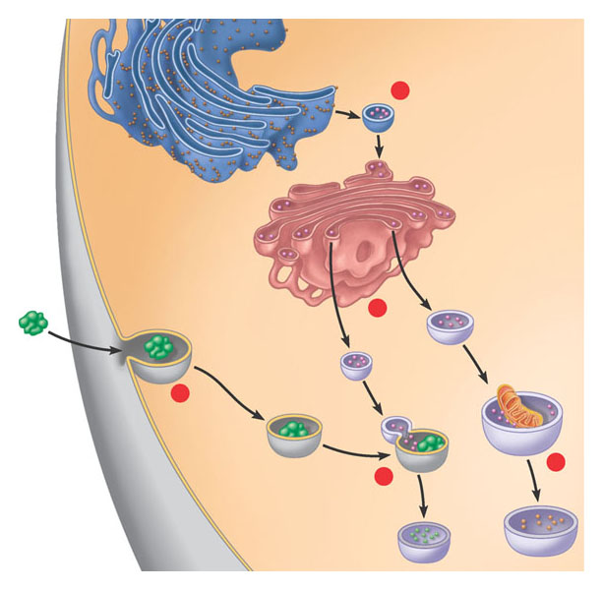
4.10 Lysosomes are digestive compar tments within a cell
Lysosomes are sacs of enzymes
That function in digestion within a cell
Rough ER
1
Transport vesicle (containing inactive hydrolytic enzymes)
Plasma membrane
Golgi apparatus
Engulfment of particle
2
Lysosome engulfing damaged organelle
“Food”
3
Lysosomes
Food vacuole
4
5
Digestion
Figure 4.10A

Slide 25
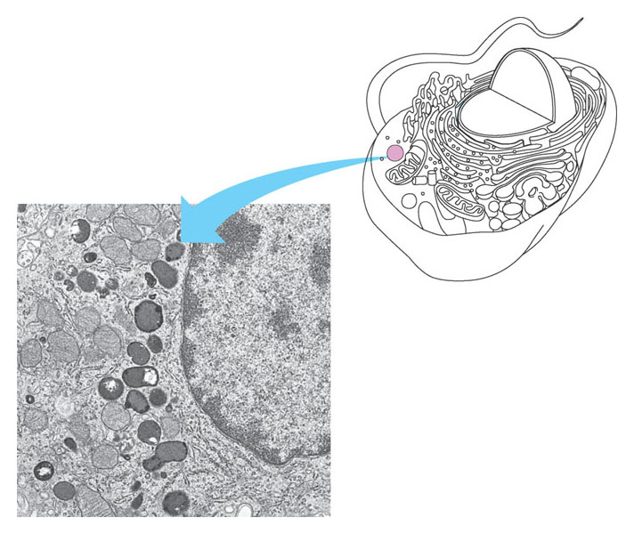
Lysosomes in white blood cells
Destroy bacteria that have been ingested
Lysosome
Nucleus
TEM 8,500×
Figure 4.10B

Slide 26
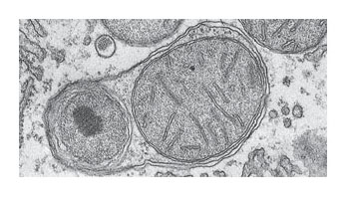
Lysosomes also recycle damaged organelles
Lysosome containing two damaged organelles
Mitochondrion fragment
TEM 42,500×
Peroxisome fragment
Figure 4.10C

Slide 27
CONNECTION
4.11 Abnormal lysosomes can cause fatal diseases
Lysosomal storage diseases
Inter fere with various cellular functions

Slide 28
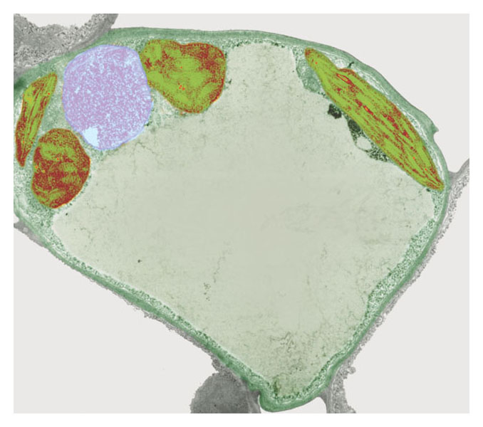
4.12 Vacuoles function in the general maintenance of the cell
Plant cells contain a large central vacuole,
Which has lysosomal and storage functions
Nucleus
Chloroplast
Central vacuole
Colorized TEM 8,700×
Figure 4.12A

Slide 29
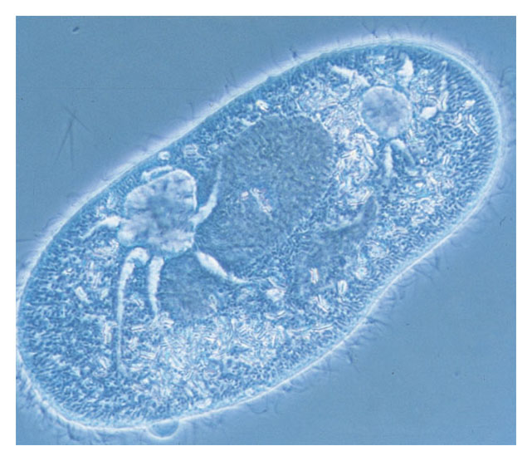
Some protists have contractile vacuoles
That pump out excess water
Nucleus
Contractile vacuoles
LM 650×
Figure 4.12B

Slide 30
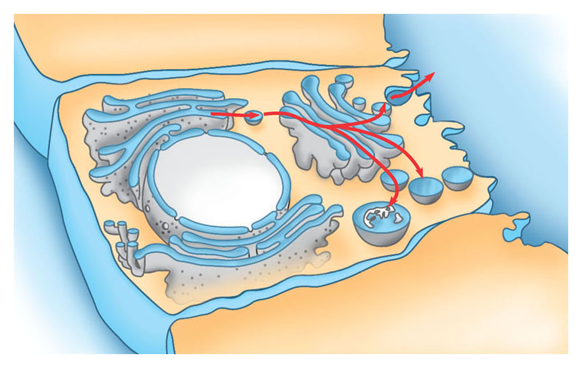
4.13 A review of the endomembrane system
The various organelles of the endomembrane system
Are interconnected structurally and functionally
Transport vesicle from ER to Golgi
Transport vesicle from Golgi to plasma membrane
Rough ER
Plasma membrane
Nucleus
Vacuole
Lysosome
Figure 4.13
Smooth ER
Nuclear envelope
Golgi apparatus

Slide 31
ENERGY-CONVERTING ORGANELLES
4.14 Chloroplasts conver t solar energy to chemical energy
Chloroplasts, found in plants and some protists
Conver t solar energy to chemical energy in sugars
Chloroplast
Stroma
Inner and outer membranes
Granum
TEM 9,750×
Intermembrane space
Figure 4.14

Slide 32
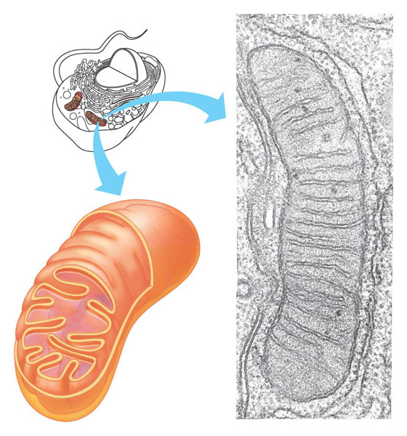
4.15 Mitochondria har vest chemical energy from food
Mitochondria carry out cellular respiration
Which uses the chemical energy in food to make ATP for cellular work
Mitochondrion
Outer membrane
Intermembrane space
Inner membrane
TEM 44,880×
Cristae
Figure 4.15
Matrix

Slide 33
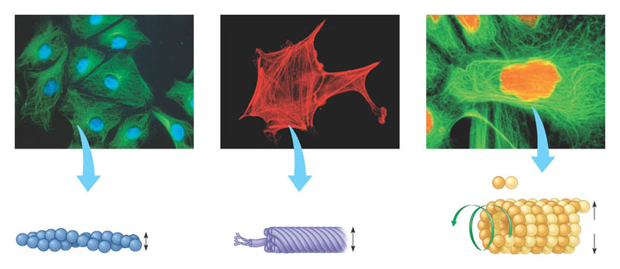
THE CYTOSKELETON AND RELATED STRUCTURES
4.16 The cell’s internal skeleton helps organize its structure and activities
A network of protein fibers
Make up the cytoskeleton.
Tubulin subunit
Actin subunit
Fibrous subunits
25 nm
7 nm
10 nm
Microfilament
Intermediate filament
Microtubule
Figure 4.16

Slide 34
Microfilaments of actin
Enable cells to change shape and move
Intermediate filaments
Reinforce the cell and anchor cer tain organelles
Microtubules give the cell rigidity
And provide anchors for organelles and act as tracks for organelle movement

Slide 35
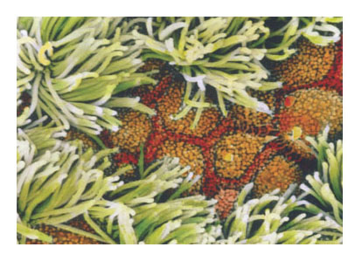
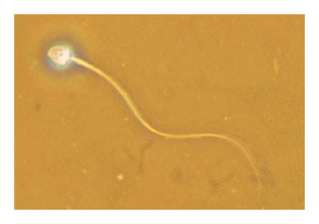
4.17 Cilia and flagella move when microtubules bend
Eukaryotic cilia and flagella
Are locomotor appendages that protrude from cer tain cells
Colorized SEM 4,100×
LM 600×
Figure 4.17A
Figure 4.17B

Slide 36
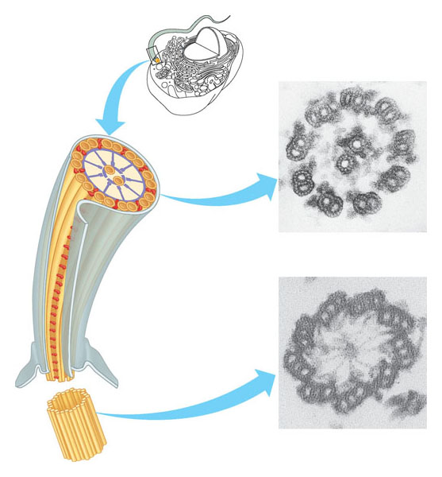
Clusters of microtubules
Drive the whipping action of these organelles
Flagellum
Electron micrographs of cross sections:
Outer microtubule doublet
Central microtubules
Radial spoke
TEM 206,500×
Dynein arms
Flagellum
Plasma membrane
TEM 206,500×
Basal body (structurally identical to centriole)
Basal body
Figure 4.17C

Slide 37
CELL SURFACES AND JUNCTIONS
4.19 Cell sur faces protect, suppor t, and join cells
Cells interact with their environments and each other via their sur faces.

Slide 38
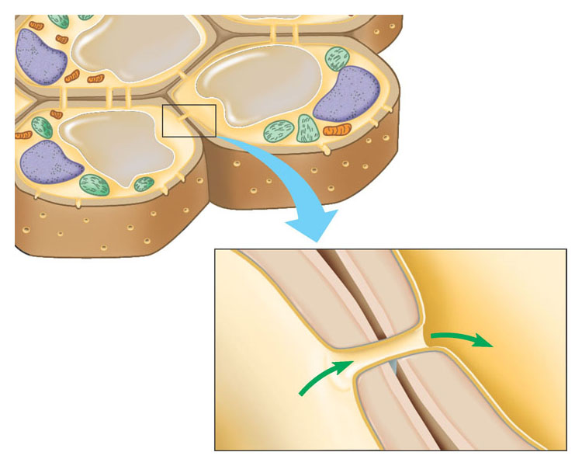
Plant cells
Are suppor ted by rigid cell walls made largely of cellulose
Connect by plasmodesmata, which are connecting channels
Walls of two adjacent plant
cells
Vacuole
Plasmodesmata
Layers of one plant cell wall
Cytoplasm
Plasma membrane
Figure 4.18A

Slide 39
Animal cells are embedded in an extracellular matrix
Which binds cells together in tissues

Slide 40
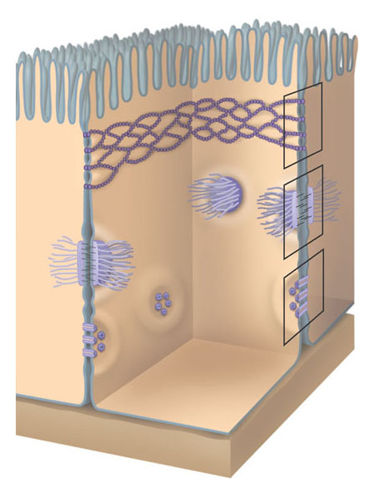
Tight junctions can bind cells together into leakproof sheets
Anchoring junctions link animal cells into strong tissues
Gap junctions allow substances to flow from cell to cell
Tight junctions
Anchoring junction
Gap junctions
Extracellular matrix
Space between cells
Figure 4.18B
Plasma membranes of adjacent cells

Slide 41
FUNCTIONAL CATEGORIES OF ORGANELLES
4.19 Eukaryotic organelles comprise four functional categories
Eukar yotic organelles fall into four functional groups
Manufacturing
Breakdown
Energy processing
Suppor t, movement, and communication between cells

Slide 42
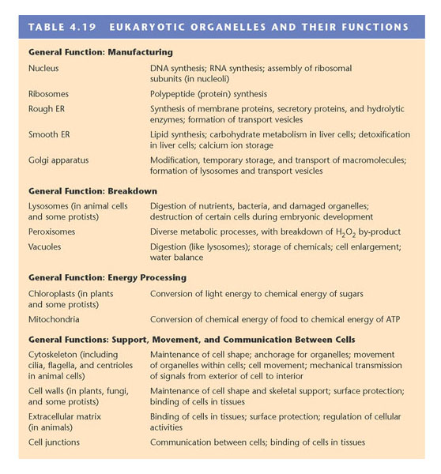
Eukar yotic organelles and their functions
Table 4.19

