Slide 1
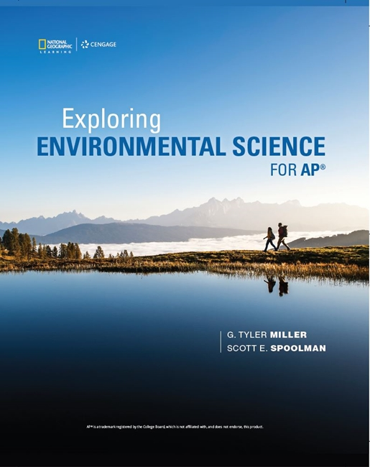
Exploring Environmental Science for AP®
1st Edition
Chapter 1
The Environment and Sustainability
Copyright © 2018 Cengage Learning. All Rights Reserved. May not be copied, scanned, or duplicated, in whole or in part, except for use as permitted in a license distributed with a certain product or service or otherwise on a password-protected website for classroom use.

Slide 2
Core Case Study: The Tragedy of the Commons
Sustainability
Capacity of the earth’s natural systems to survive, flourish, or adapt to changing environmental conditions indefinitely
Commons
Renewable resources with open access to everyone; when used unsustainably, a commons can be destroyed
Examples: fisheries, forests, clean air, clean fresh water

Slide 3
1.1 What Are Some Key Principles of Sustainability? (1 of 2)
Environmental science studies connections in nature
How the earth works and has survived and thrived
How humans interact with the environment
How we can live more sustainably
Ecology
Branch of biology focusing on interaction of living things with their environment

Slide 4
What Are Some Key Principles of Sustainability? (2 of 2)
Ecosystem
Set of organisms interacting in a defined area
Environmentalism (environmental activism)
Social movement dedicated to protecting the earth’s life and resources
Practiced in realms of politics and ethics
Findings of environmental science can provide evidence

Slide 5
Learning from the Earth: Three Scientific Principles of Sustainability (1 of 2)
Dependence on solar energy
The sun provides warmth and provides energy plants use to produce nutrients
Biodiversity
Astounding variety and adaptability of natural systems and species
Chemical (nutrient) cycling
Circulation from the environment to organisms and then back to the environment

Slide 6
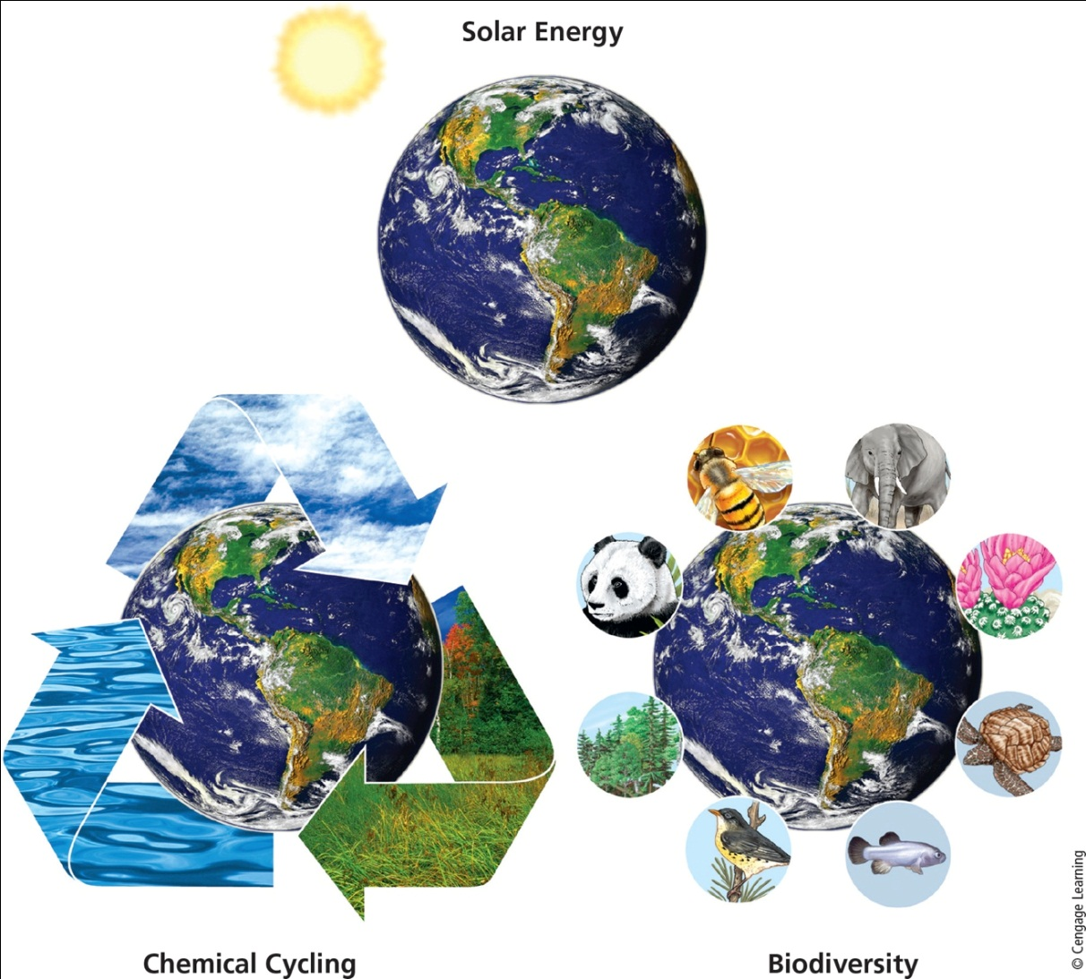
Learning from the Earth: Three Scientific Principles of Sustainability (2 of 2)
Notes:
Figure 1.2 Three scientific principles of sustainability based on how nature has sustained a huge variety of life on the earth for 3.8 billion years, despite drastic changes in environmental conditions.

Slide 7
Key Components of Sustainability (1 of 6)
Natural capital keeps humans and other species alive and supports economies
Natural resources: useful materials and energy in nature
May be inexhaustible, renewable, or nonrenewable (exhaustible)
Ecosystem services
Processes provided by healthy ecosystems

Slide 8
Key Components of Sustainability (2 of 6)
Natural resource examples
Inexhaustible: solar energy
Renewable: forests, grasslands, topsoil, fishes, air, freshwater
Highest rate of renewable resource use without reducing its supply is its sustainable yield
Nonrenewable: oil, coal, natural gas, copper, salt, and sand

Slide 9
Key Components of Sustainability (3 of 6)
Nutrient cycling is a vital ecosystem service
Human activities can degrade natural capital
Using renewable resources too fast
Overloading air, water, and soil with wastes and pollutants
Humans must provide solutions to environmental problems

Slide 10
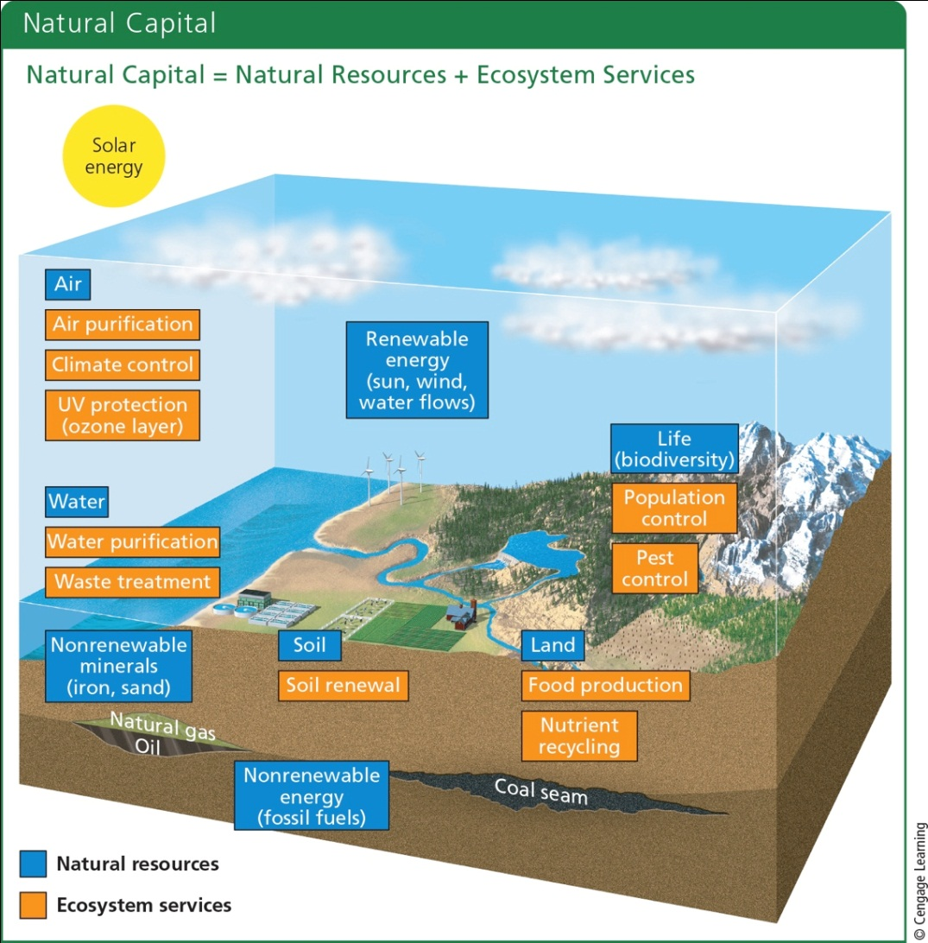
Key Components of Sustainability (4 of 6)
Notes:
Figure 1.3 Natural capital consists of natural resources (blue) and ecosystem services (orange) that support and sustain the earth’s life and human economies.

Slide 11
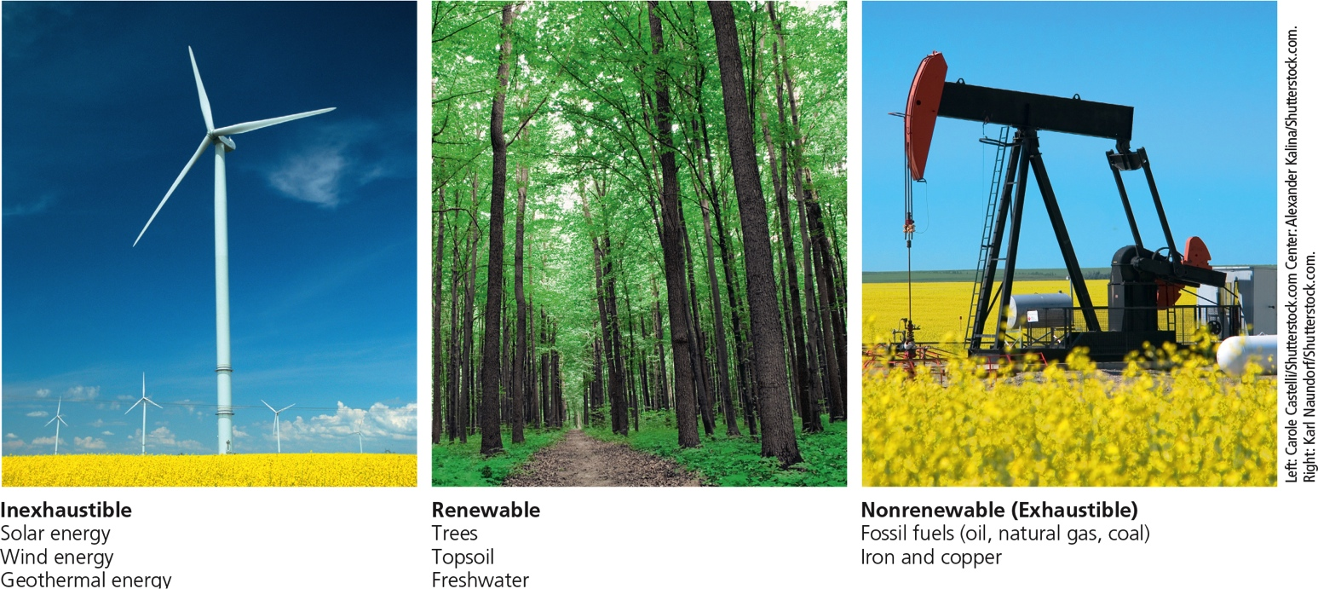
Key Components of Sustainability (5 of 6)
Notes:
Figure 1.4 We depend on a combination of inexhaustible, renewable, and exhaustible (nonrenewable) natural resources.

Slide 12
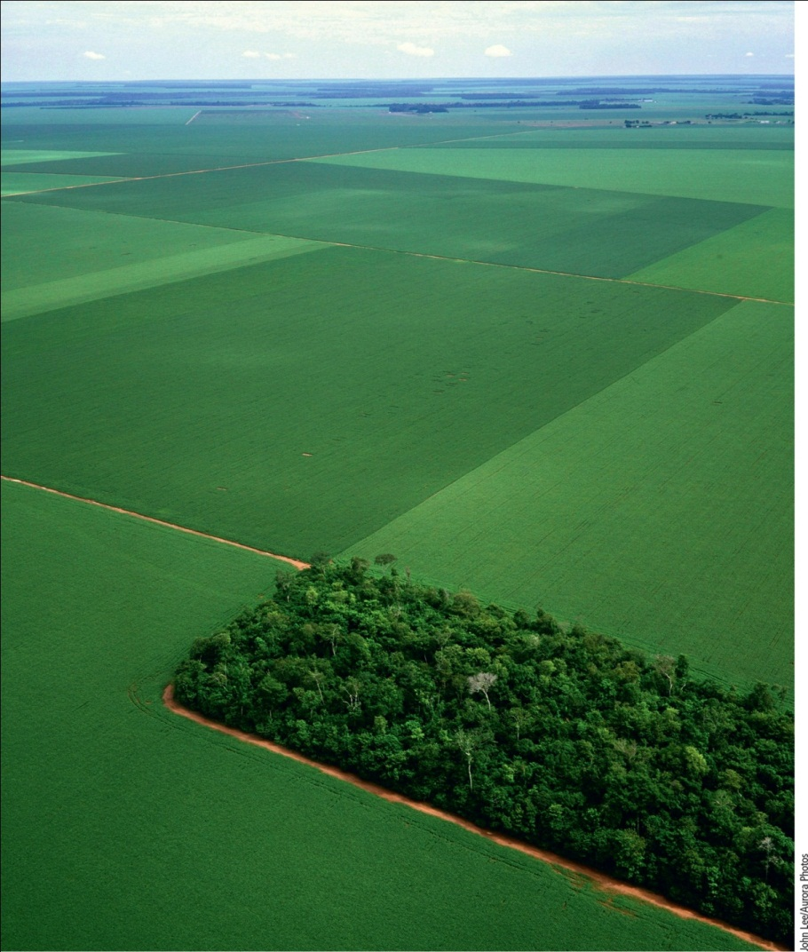
Key Components of Sustainability (6 of 6)
Notes:
Figure 1.5 Small remaining area of once diverse Amazon rain forest surrounded by vast soybean fields in the Brazilian state of Mato Grosso.

Slide 13
Three Additional Principles of Sustainability (1 of 2)
Full-cost pricing
Include harmful environmental and health costs in market prices of goods and services
Win-win solutions
Look for solutions that will benefit people and the environment
A responsibility to future generations
Leave planet’s life-support system in same or better condition than it is now

Slide 14
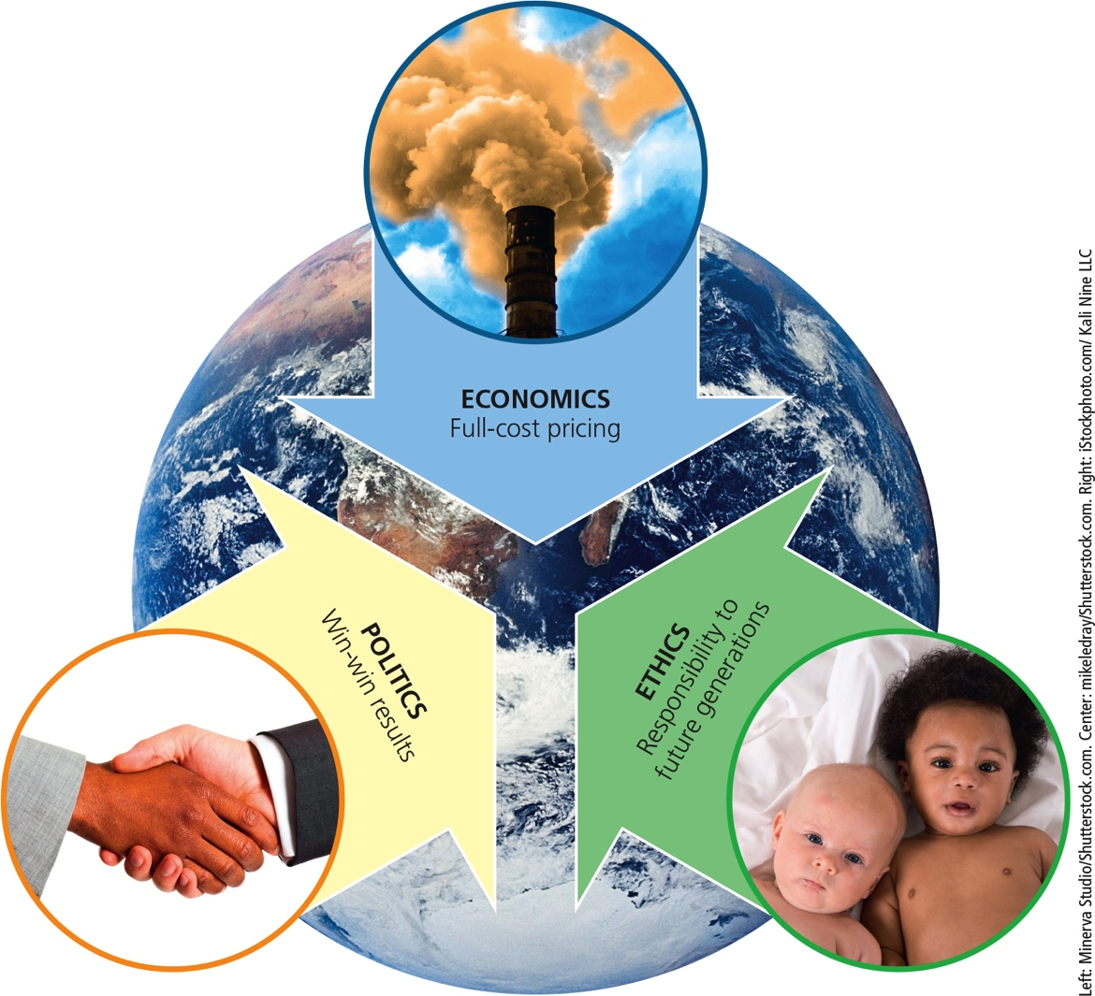
Three Additional Principles of Sustainability (2 of 2)
Notes:
Figure 1.6 Three principles of sustainability based on economics, political science, and ethics can help us make a transition to a more environmentally and economically sustainable future.

Slide 15
Countries Differ in Their Resource Use and Environmental Impact
More-developed countries
Industrialized nations with high average income per person
17% of the world’s population
Use 70% of world’s natural resources
Less-developed countries
83% of the world’s population
Use about 30% of world’s natural resources

Slide 16
1.2 How Are Our Ecological Footprints Affecting the Earth?
Many people have a better quality of life
Humans have developed useful materials and products
Life spans increasing
Food supply more abundant and safer
Exposure to toxic chemicals more avoidable
Humans have protected some endangered species and ecosystems
Taken steps to restore cleared lands

Slide 17
We Are Living Unsustainably (1 of 3)
Environmental degradation
Wasting, depleting, and degrading the earth’s natural capital
Human activities directly affect 83% of earth’s land surface
Urban development, crop and energy production, mining, timber cutting, and more
Species are becoming extinct 100 times faster than in prehuman times

Slide 18
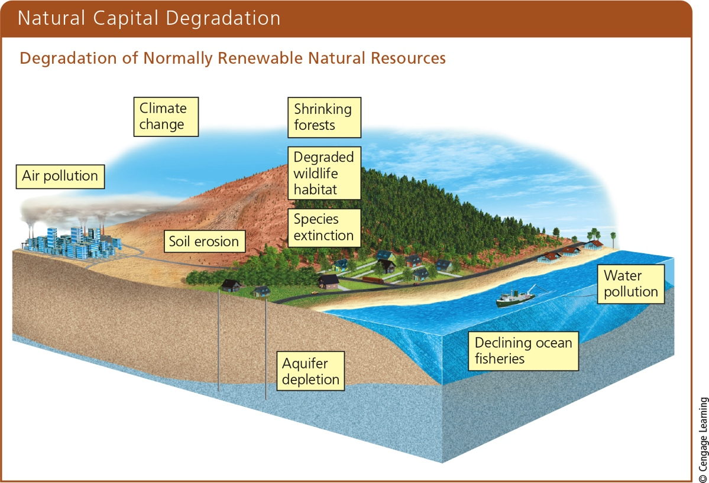
We Are Living Unsustainably (2 of 3)
Notes:
Figure 1.7 Natural capital degradation: Degradation of normally renewable natural resources and natural services (Figure 1.3), mostly from population growth and increased resource use per person.

Slide 19
Human Land Use: Private and Public Land (1 of 2)
Humans use 83% of earth’s land
Examples of degradation: forest loss, overgrazing of grasslands, soil erosion, oil spills, runoff of fertilizers in waterways
Private lands
Owned by individuals or businesses
Public lands
Jointly owned by citizens and government

Slide 20
Human Land Use: Private and Public Land (1 of 2)
Types of Federal Public Land
National Park System
National Forest System
Land managed by Bureau of Land Management
National Park System
National Wildlife Refuges
National Wilderness Preservation

Slide 21
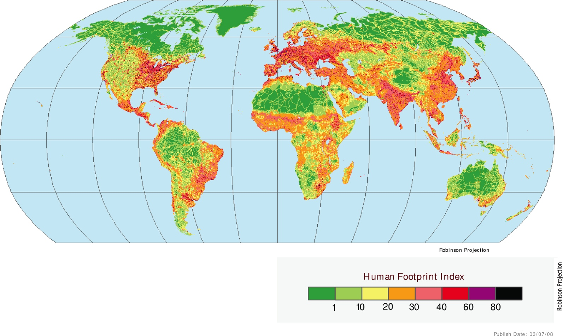
We Are Living Unsustainably (3 of 3)
Notes:
Figure 1.8 Natural capital use and degradation: The human ecological footprint has an impact on about 83% of the earth’s total land surface.

Slide 22
Our Growing Ecological Footprint
Ecological footprint
Amount of biologically productive land and water needed to supply a population with renewable resources and recycle wastes
Sustainability measure that relates to the earth’s biocapacity
Ecological deficit
Footprint larger than biological capacity for replenishment

Slide 23
IPAT is Another Environmental Impact Model
Simple environmental impact model developed in the 1970s
I = P x A x T
I = Environmental impact
P = Population
A = Affluence
T = Technology
Population in India has more impact, while affluence in the U.S. has more impact

Slide 24
Cultural Changes Can Increase or Shrink Our Ecological Footprints
Humans were hunter-gatherers 10,000 years ago
Three major cultural events
Agricultural revolution
Industrial–medical revolution
Information–globalization revolution
Current need for a sustainability revolution

Slide 25
1.3 What Causes Environmental Problems and Why Do They Persist?
Basic causes of environmental problems
Population growth
Unsustainable resource use
Poverty
Omission of harmful environmental costs in market pricing of goods and services
Increasing isolation from nature
Competing environmental worldviews

Slide 26
Human Population is Growing at a Rapid Rate (1 of 2)
Human population has grown exponentially
Current population: 7.5 billion people
By 2050, population could reach 9.8 billion
We don’t know how many people the earth can support indefinitely

Slide 27
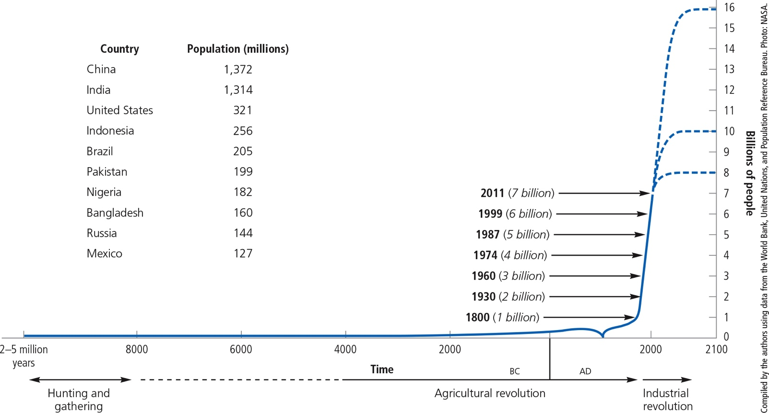
Human Population is Growing at a Rapid Rate (2 of 2)
Notes:
Figure 1.11 Exponential growth: The J-shaped curve represents past exponential world population growth, with projections to 2100 showing possible population stabilization as the J-shaped curve of growth changes to an S-shaped curve. The top 10 countries (left) represent nearly 60% of the world’s total population. Data Analysis: By what percentage did the world’s population increase between 1960 and 2015? (This figure is not to scale.)

Slide 28
Affluence and Unstainable Resource Use
Affluence results in increased resource consumption per person
Increases environmental degradation, wastes, and pollution
Positive aspects of affluence
Better and widespread education
Increased awareness of environmental issues
Money available to develop technologies with beneficial environmental impacts

Slide 29
Poverty Has Harmful Environmental and Health Effects (1 of 3)
People lack enough money to fulfill basic needs
Adequate food, water, shelter, health care, and education
Short-term survival more important than environmental concerns
Malnutrition and lack of clean drinking water
Causes premature death for 7 million children under age 5 each year

Slide 30
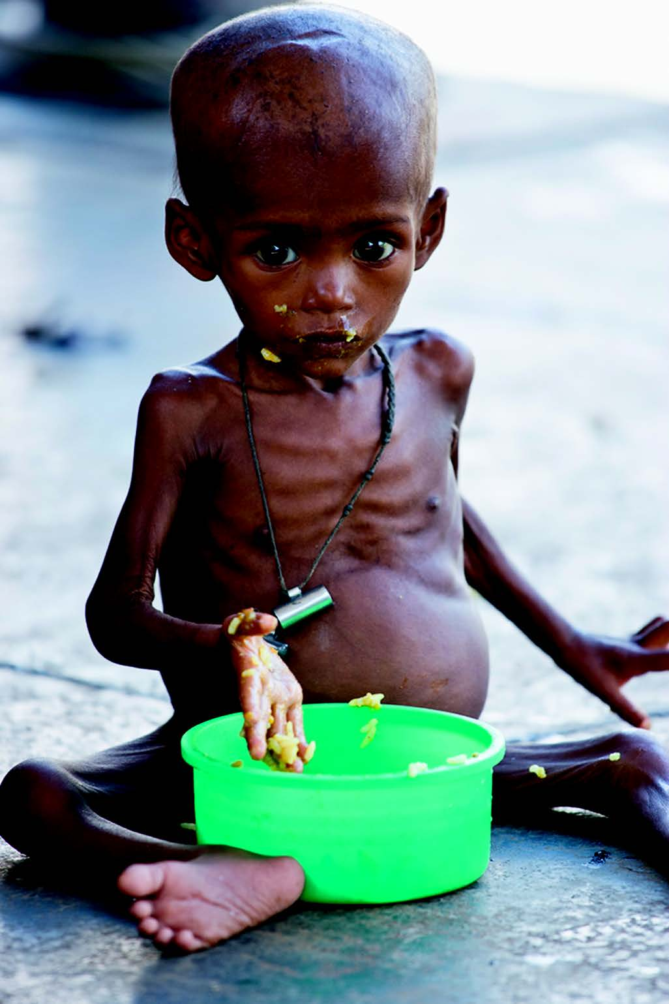
Poverty Has Harmful Environmental and Health Effects (2 of 3)
One of every three children younger than age 5 in less-developed countries, such as this starving child in
Bangladesh, suffers from severe malnutrition caused by a lack of calories and protein.
Rowan Gillson/Design Pics/Superstock

Slide 31
Poverty Has Harmful Environmental and Health Effects (3 of 3)
Ways to reduce poverty include
Reduce malnutrition and infectious diseases
Provide universal primary school education
Reduce population growth
Make small, low-interest loans to poor people

Slide 32
Prices of Goods and Services Rarely Include Their Harmful Environmental and Health Costs
Companies do not pay the environmental cost of resource use
Goods and services do not include the harmful environmental costs
Consumers lack information
Companies receive tax breaks and subsidies
Some subsidies encourage depletion of natural capital

Slide 33
People Are Increasingly Isolated from Nature
Increasing populations in urban areas
Lack of contact with nature
Benefits of outdoor activities
Better health
Reduced stress
Improved mental capabilities
Increased imagination and creativity
Sense of connection with the earth

Slide 34
People Have Different Views on Environmental Problems and Their Solutions (1 of 3)
Environmental worldview
Set of assumptions and values about interactions with the natural world
Environmental ethics
Example ethical questions
Why should we care about the environment?
Do we have an obligation to protect other species against extinction caused by human actions?
Should every person be entitled to equal protection from environmental hazards?

Slide 35
People Have Different Views on Environmental Problems and Their Solutions (2 of 3)
Human-centered environmental worldview
Planetary management worldview
Stewardship worldview
Environmental wisdom

Slide 36
People Have Different Views on Environmental Problems and Their Solutions (3 of 3)
Planetary Management
We are apart from the rest of nature and can manage nature to meet our increasing needs and wants.
Because of our ingenuity and technology, we will not run out of resources.
The potential for economic growth is essentially unlimited.
Our success depends on how well we manage the earth's life-support systems mostly for our benefit.
Stewardship
We have an ethical responsibility to be caring managers, or stewards, of the earth.
We will probably not run out of resources, but they should not be wasted.
We should encourage environmentally beneficial forms of economic growth and discourage environmentally harmful forms.
Our success depends on how well we manage the earth's life-support systems for our benefit and for the rest of nature.
Environmental Wisdom
We are a part of and totally dependent on nature, and nature exists for all species.
Resources are limited and should not be wasted.
We should encourage earth- sustaining forms of economic growth and discourage earth-degrading forms.
Our success depends on learning how nature sustains itself and integrating such lessons from nature into the ways we think and act.

Slide 37
Revisiting the Tragedy of the Commons
Increasing human population and affluence increases the demand for more fish, ultimately depleting fish resources
Isolation from nature results in a lack of understanding of the earth’s life support systems and how these systems support out economy
Cooperative allotment and enforcement systems control fish catches and ensure that harvests are kept at a sustainable level

Slide 38
1.4 What is the Role of Economics?
Economic Systems Depend on Natural Capital
Economics is the social science that deals with the production, distribution, and consumption of goods and services
Natural capital
Human capital
Manufactured capital
A low-throughput system uses nature as a model for a more sustainable economy

Slide 39
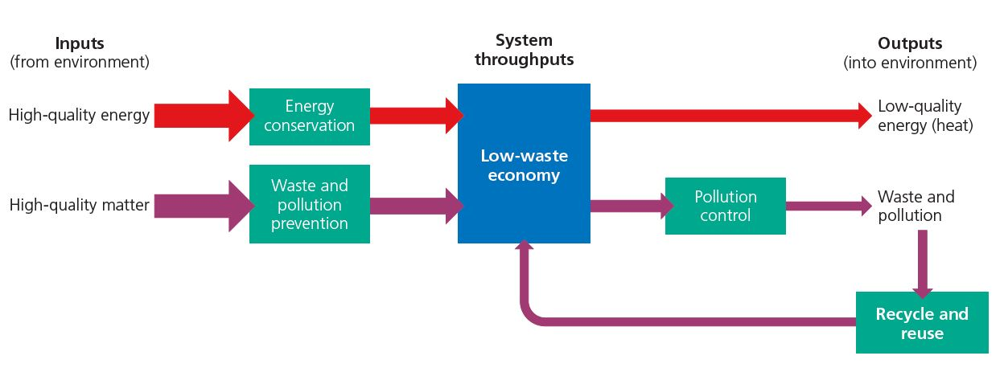
Economic Systems Depend on Natural Capital (1 of 3)

Slide 40
Economic Systems Depend on Natural Capital (2 of 3)
In a free market society, economic decisions are governed by the interaction of supply and demand

Slide 41
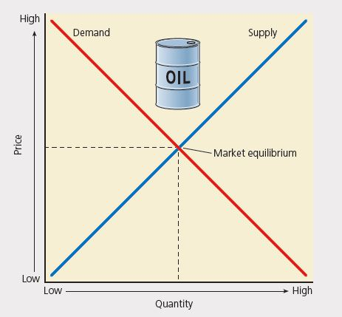
Economic Systems Depend on Natural Capital (3 of 3)

Slide 42
Using Economic Tools to Deal with Environmental Problems (1 of 2)
Full Cost Pricing
Inclusion of health and environmental costs in the price of products
Subsidies
Tax break given to a company in order to make them more competitive
Can help to provide jobs, but can also encourage environmental degradation

Slide 43
Using Economic Tools to Deal with Environmental Problems (2 of 2)
Taxes
can encourage sustainability by taxing pollution but lowering taxes on labor, income, and wealth

Slide 44
1.5 What is the Role of Government?
Environmental policy
environmental laws, regulations, and programs that are designed , implemented, and enforced by one or more governmental agencies.
Environmental agencies
Environmental Protection Agency, Department of Energy, U.S. Fish and Wildlife Service, National Marine Fisheries Service, Occupational Safety and Health Administration
Implementing laws reduces pollution, saves wild species from extinction, and creates jobs and new technologies.

Slide 45
Global Environmental Security
Both military security and economic security are preserved when environmental security is protected
The United Nations works to protect human health, the environment, reduce poverty, and provide infrastructure internationally

Slide 46
1.6 What is an Environmentally Sustainable Society?
Protecting Natural Capital and Living on its Income
Living sustainably means living on the natural capital that nature provides
plants, animals, soil, clean air, clean water

Slide 47
We Can Live More Sustainably
To live more sustainably
learn from nature
protect natural capital
stop wasting resources
recycle and reuse
use renewable resources no faster than they can regenerate
incorporate costs to health and environment in the price of the product
accept the responsibility of working together to pass the earth on to future generations in a condition as good or better than it is at present

