Slide 1
Vascular Tissue
Vascular tissue:
runs continuous throughout the plant
transports materials between roots and shoots.
Xylem transports water and dissolved minerals upward from roots into the shoots. (water the xylem)
Phloem transports food from the leaves to the roots and to non-photosynthetic parts of the shoot system. (feed the phloem)

Slide 2
Xylem
The water conducting elements of xylem are the tracheids and vessel elements.

Slide 3
Xylem
Tracheids
Characteristics
tapered elongated cells
connect to each other through pits
secondary cell walls strengthened with lignin
Functions
transport of water plus dissolved minerals
support

Slide 4
Xylem
Vessel Elements
Characteristics
shorter and wider than tracheids
possess thinner cell walls than tracheids
Aligned end-to-end to form long micropipes
dead at functional maturity
Functions
transport of water plus dissolved minerals
support

Slide 5
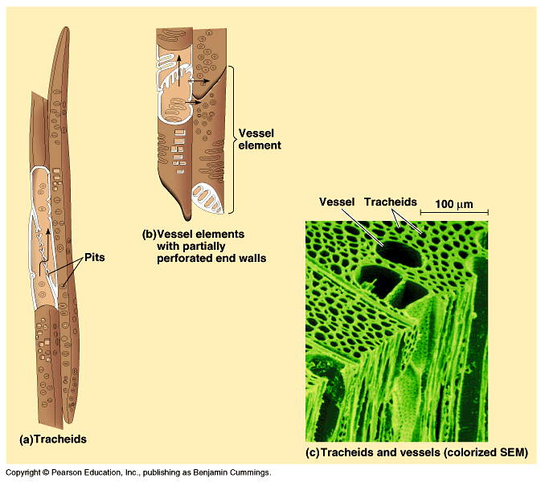
Water conducting cells of the xylem

Slide 6
Phloem
Food and minerals move through tubes formed by chains of cells, sieve-tube members.
sieve plates
companion cell

Slide 7
Phloem
Sieve-tube Members
Characteristics
living cells arranged end-to-end to form food-conducting cells of the phloem
lack lignin in their cell walls
mature cells lack nuclei and other cellular organelles
alive at functional maturity
Functions
transport products of photosynthesis

Slide 8
Phloem
Companion Cells
Characteristics
living cells adjacent to sieve-tube members
connected to sieve-tube members via plasmodesmata
Functions
support sieve-tube members
may assist in sugar loading into sieve-tube members

Slide 9
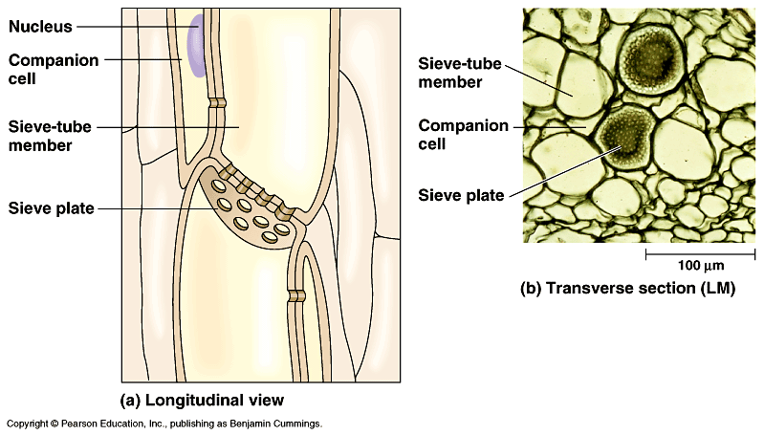
Food conducting cells of the phloem

