Slide 1
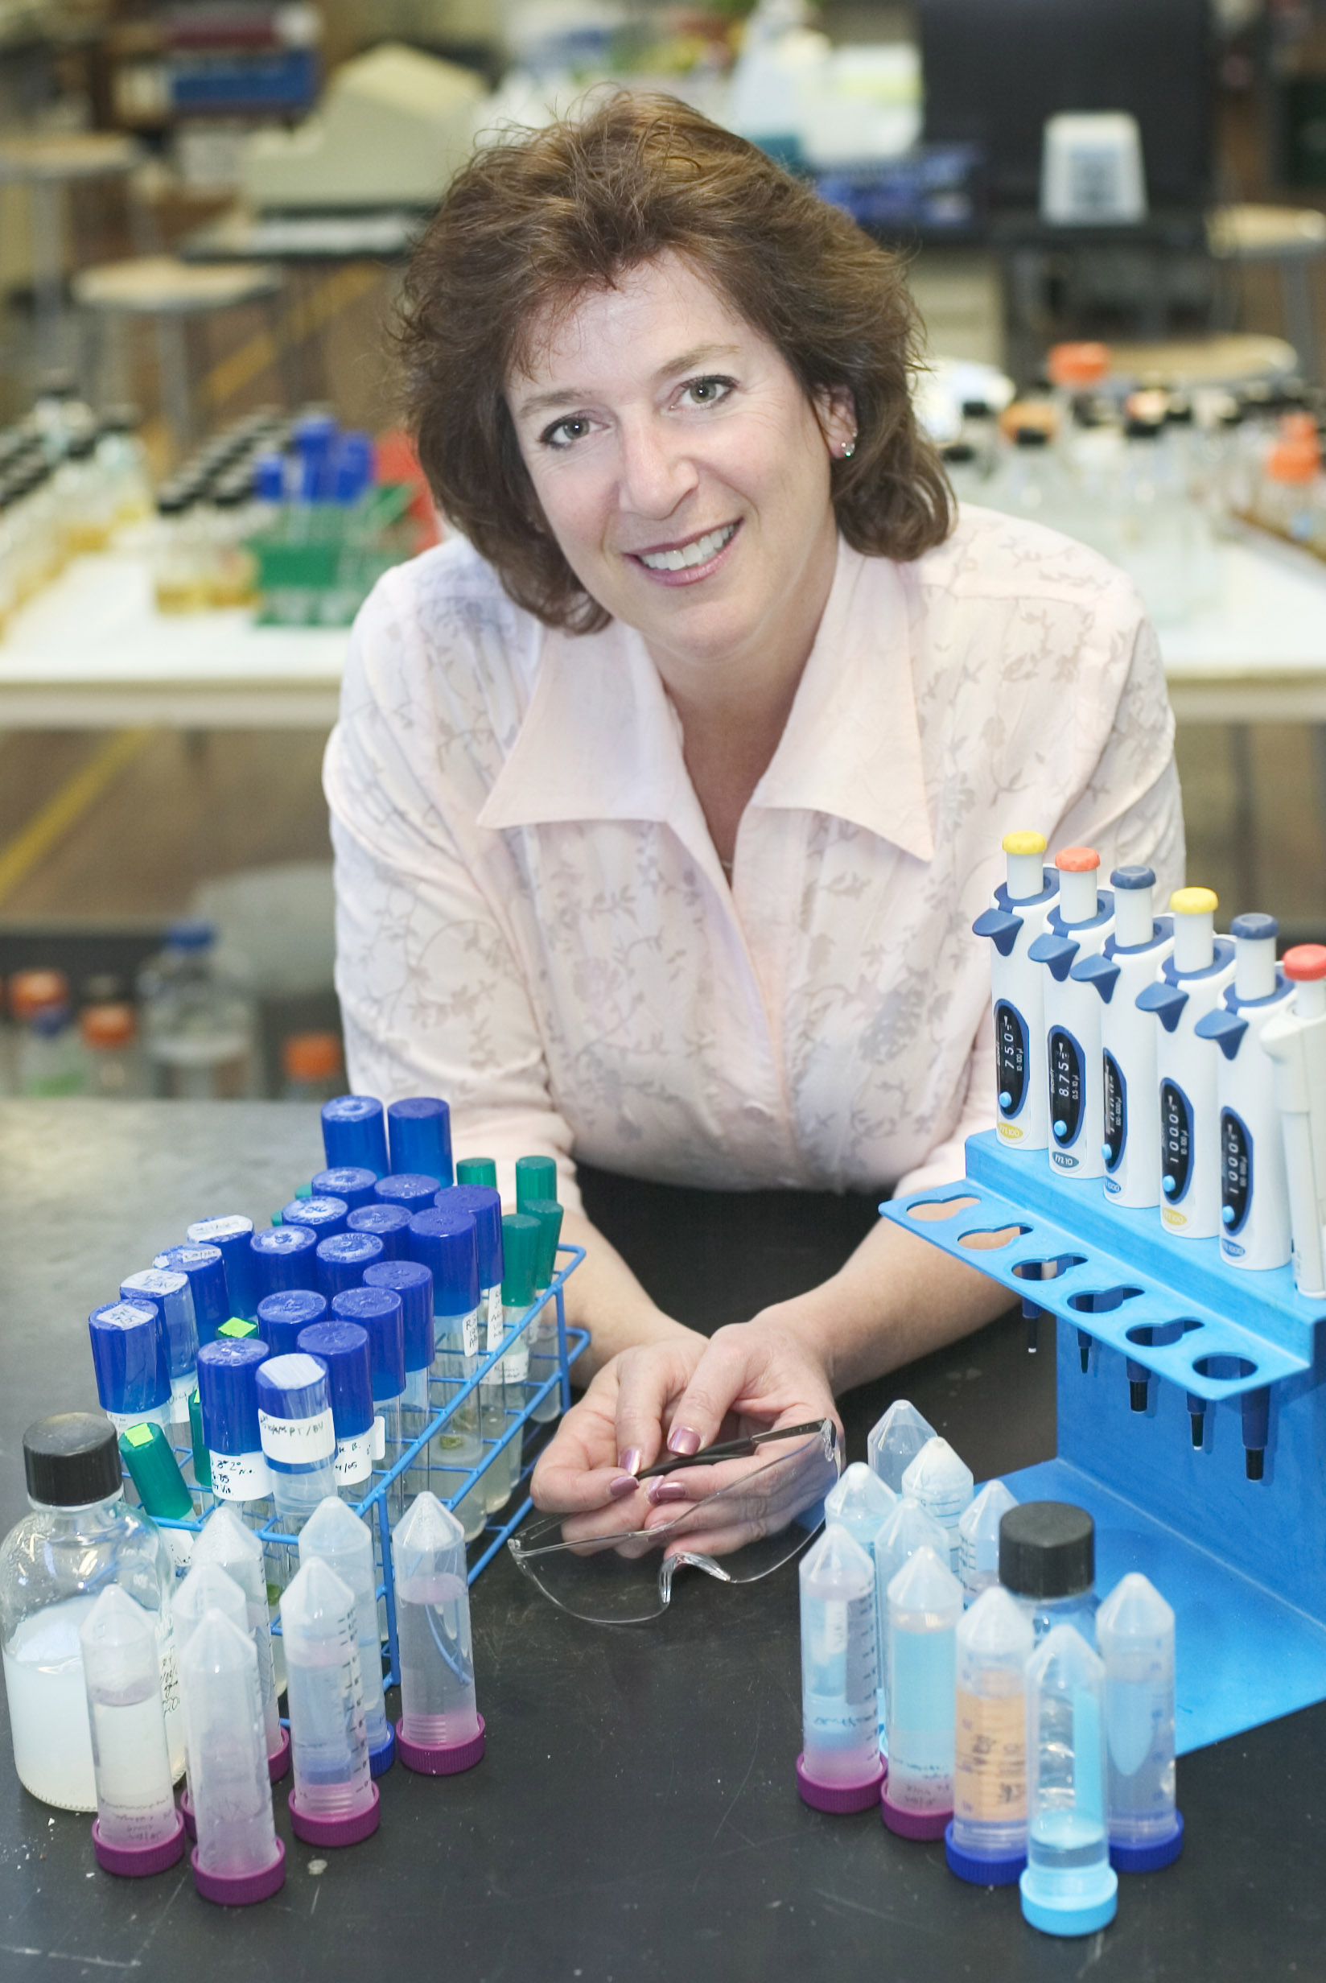
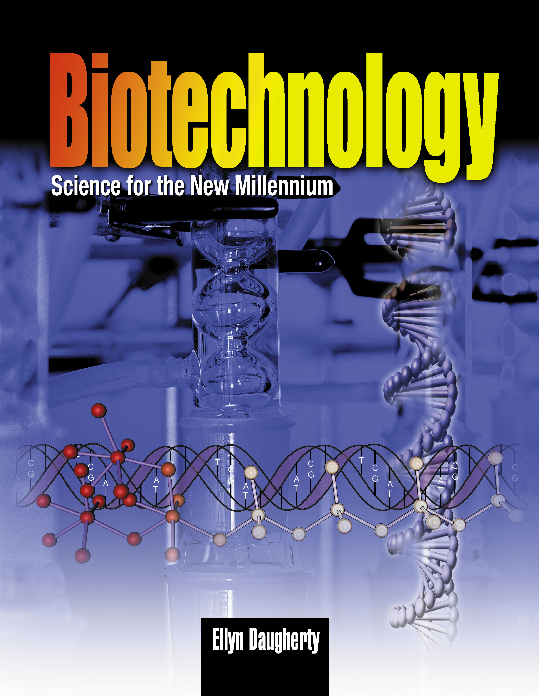
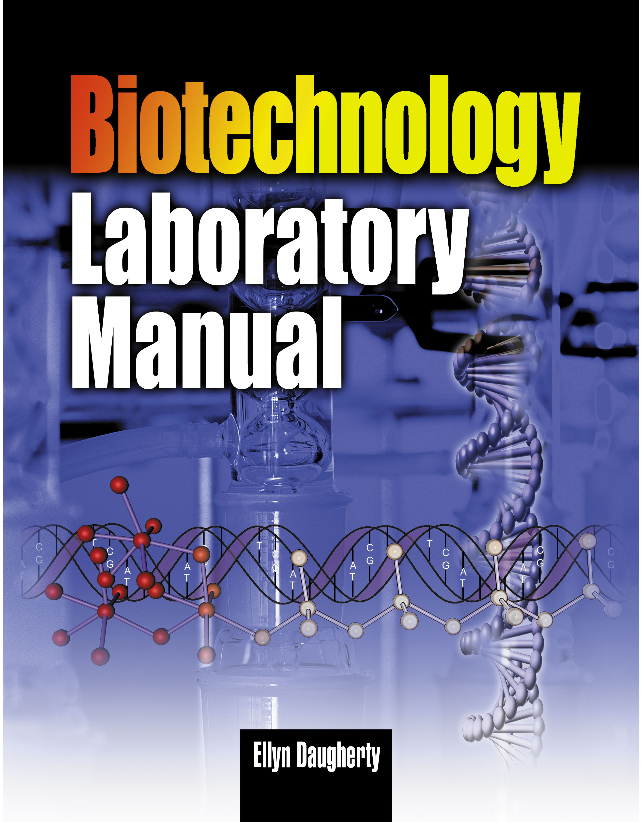
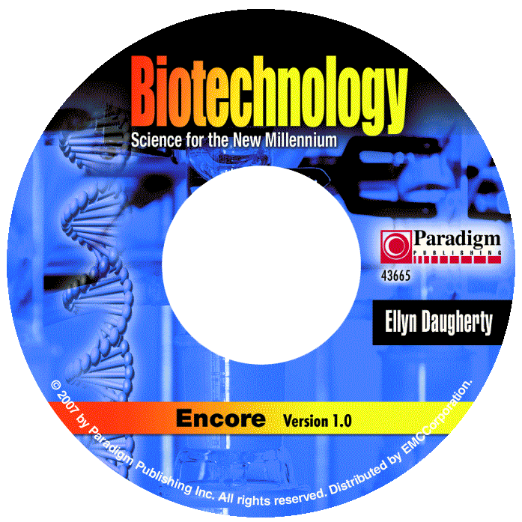
Pipetting Skill Assessment Fun with Volume Measurement
Text - Chapter 3
Lab Manual - Chapter 3
Student CD Tutorials
Course Planner

Slide 2
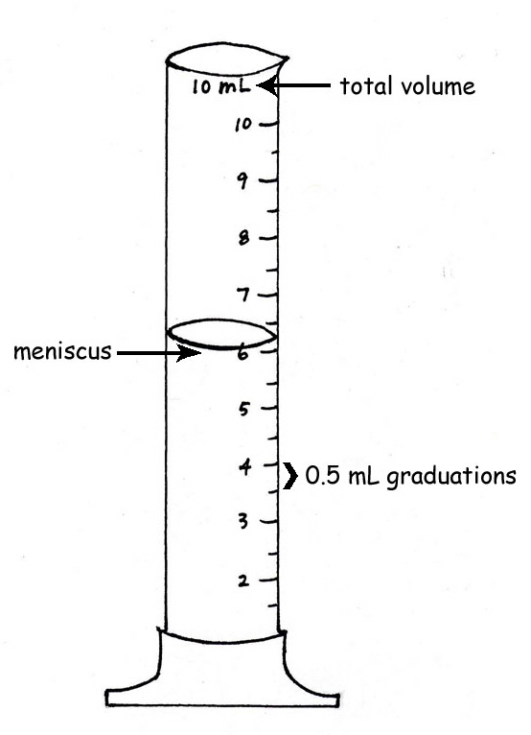
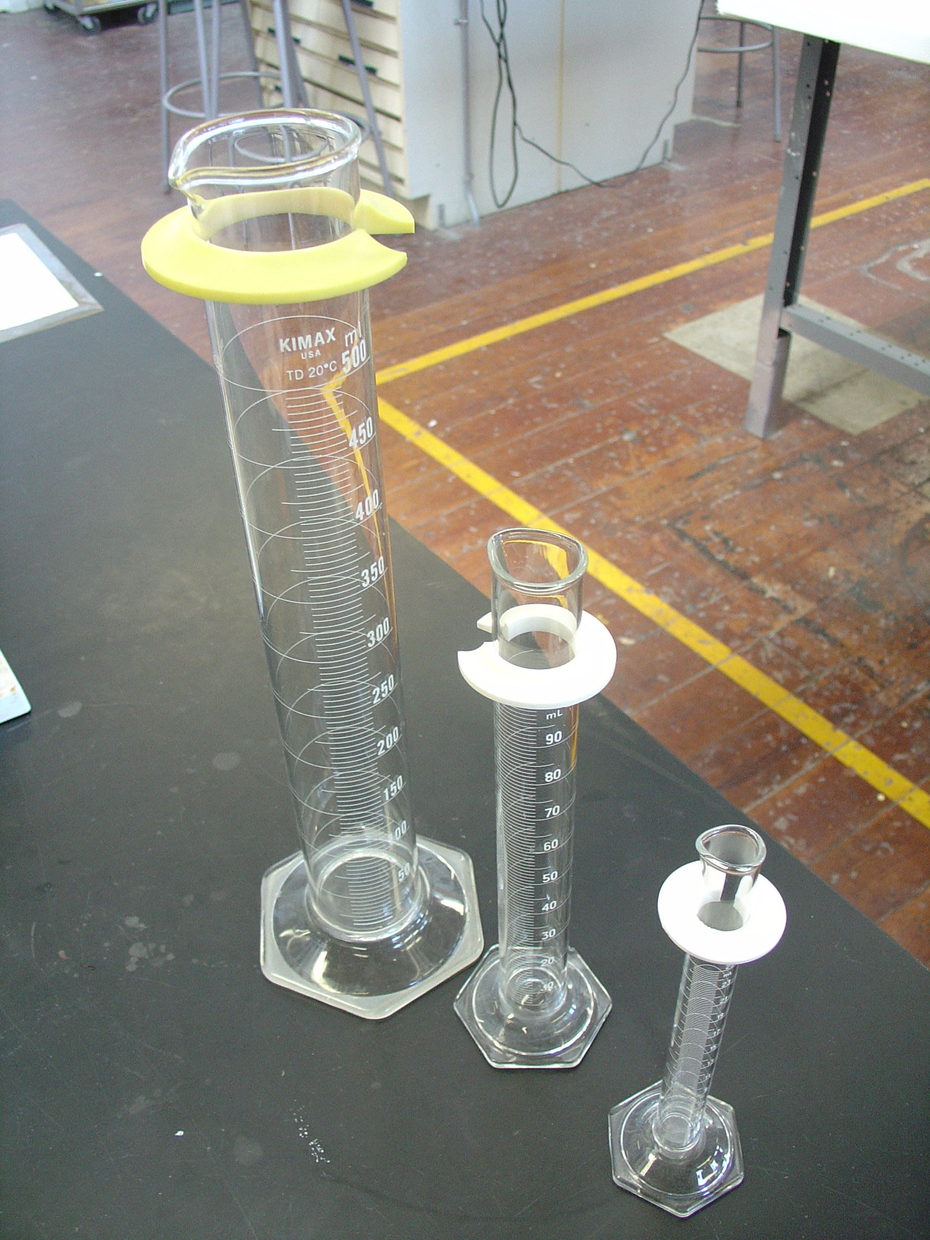
Start with Graduated Cylinders
On all instruments:
What is the total volume that can be measured?
What is the value of each type of graduation?
Use same strategy with pipets and micropipets

Slide 3
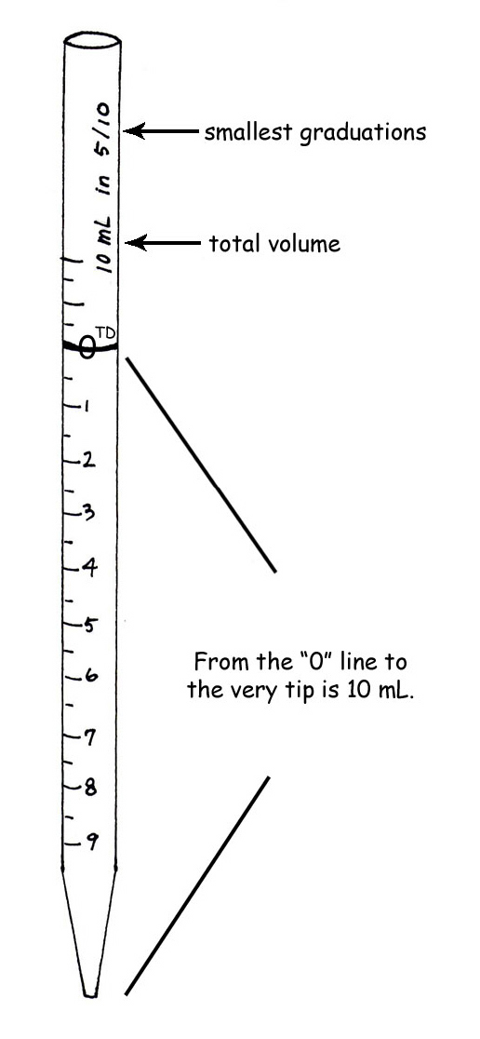
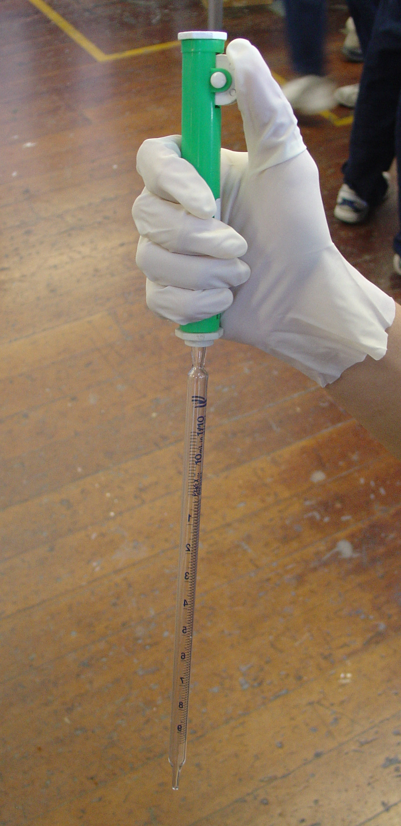
Measuring Small Volumes with Pipets
Start with 10-mL pipets
Show it can be read up or down
Show zero, then to tip
Explain “TD”
Demo green pump and drawing up and dispensing
Into a 13X100mm tube, add 3.60 mL of red solution
Compare tubes with other techs
Label it “10 mL” and set it in the rack until you use the spec (at 400 nm) to compare it to the next tube.

Slide 4
Measuring Small Volumes with Pipets
Repeat with 5-mL pipets
Show it can be read up or down
Show zero, then to tip
Use green pump
Into a 13x100 mm, add 1.80 mL of red solution and 1.80 mL H₂0 to tube #2
Compare the volume in this tube with other techs
Label it “5 mL,” cap it, and invert once to mix, and set it in the rack until you use the spec (at 400 nm) to compare it to the other tubes

Slide 5
Measuring Small Volumes with Pipets
Repeat with 2-mL and 1 mL pipets
Show they can be read up or down. Show zero, then to tip
Use blue pump
Into a 13x100 mm tube, use a 1 mL pipet to add 0.90 mL of H₂0 and then 0.90 mL of red solution.
Now use a 2 mL pipet to add another 1.80 mL of H₂0 to the tube.
Compare the volume in this tube with all the other tubes. Are they all the same?
Label it “1-2 mL,” cap it, and invert once to mix, and set it in the rack until you use the spec (at 400 nm) to compare it to the other tubes

Slide 6
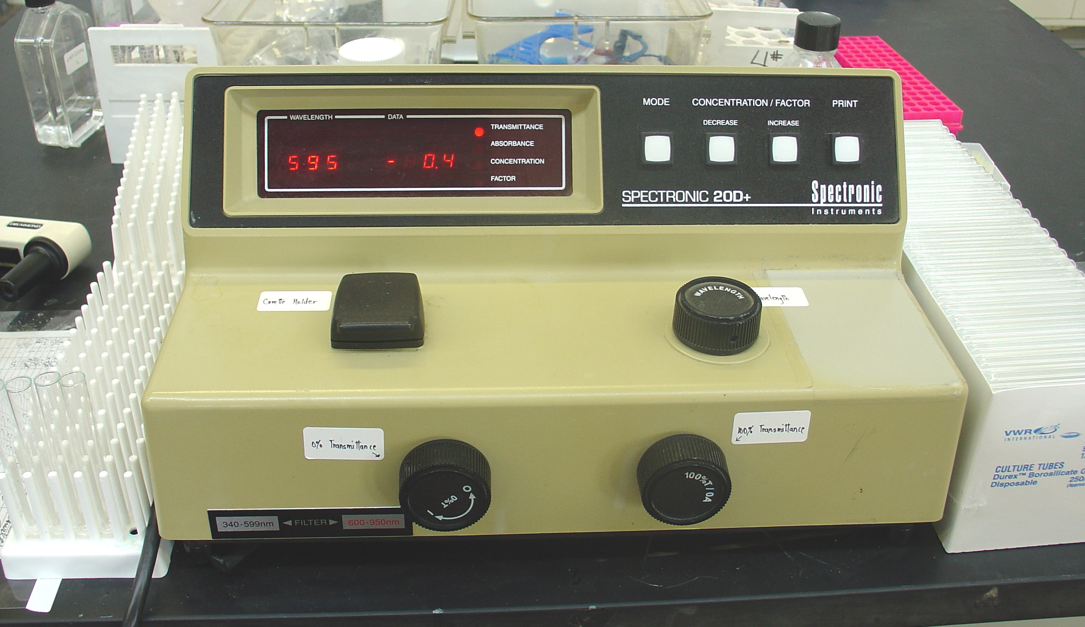
Now use the Spec 20D to read the absorbance of all the red sample tubes at 400 nm.
Spec Use (Lab 7b)
1. Turn on and warm 15 mins.
2. Set wavelength to 400 nm. (Why?)
3. Zero the transmittance with left knob.
4. 100% the transmittance with water blank and right knob.
5. Change to absorbance and red all samples. How do they compare?
Other methods of checking solution prep?

Slide 7
Review: Metric Measurements and Conversions
1000
1000
L mL µL
92 ml = _________ µL 357 µL = _________ mL
0.5 L = _________ mL 0.557 mL = _________ µL

Slide 8
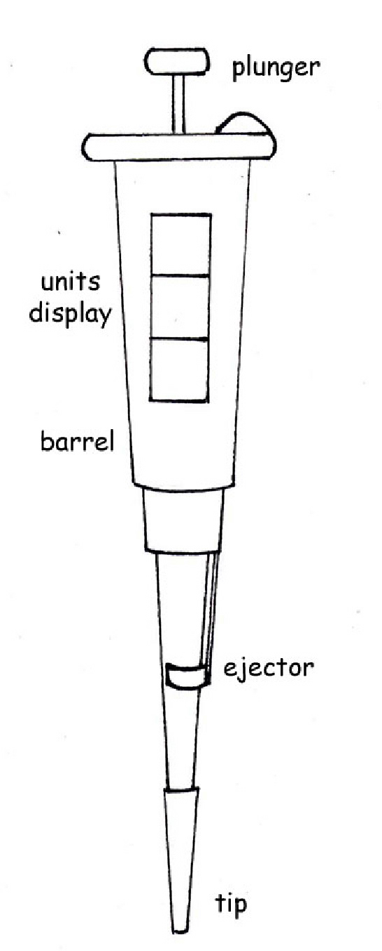
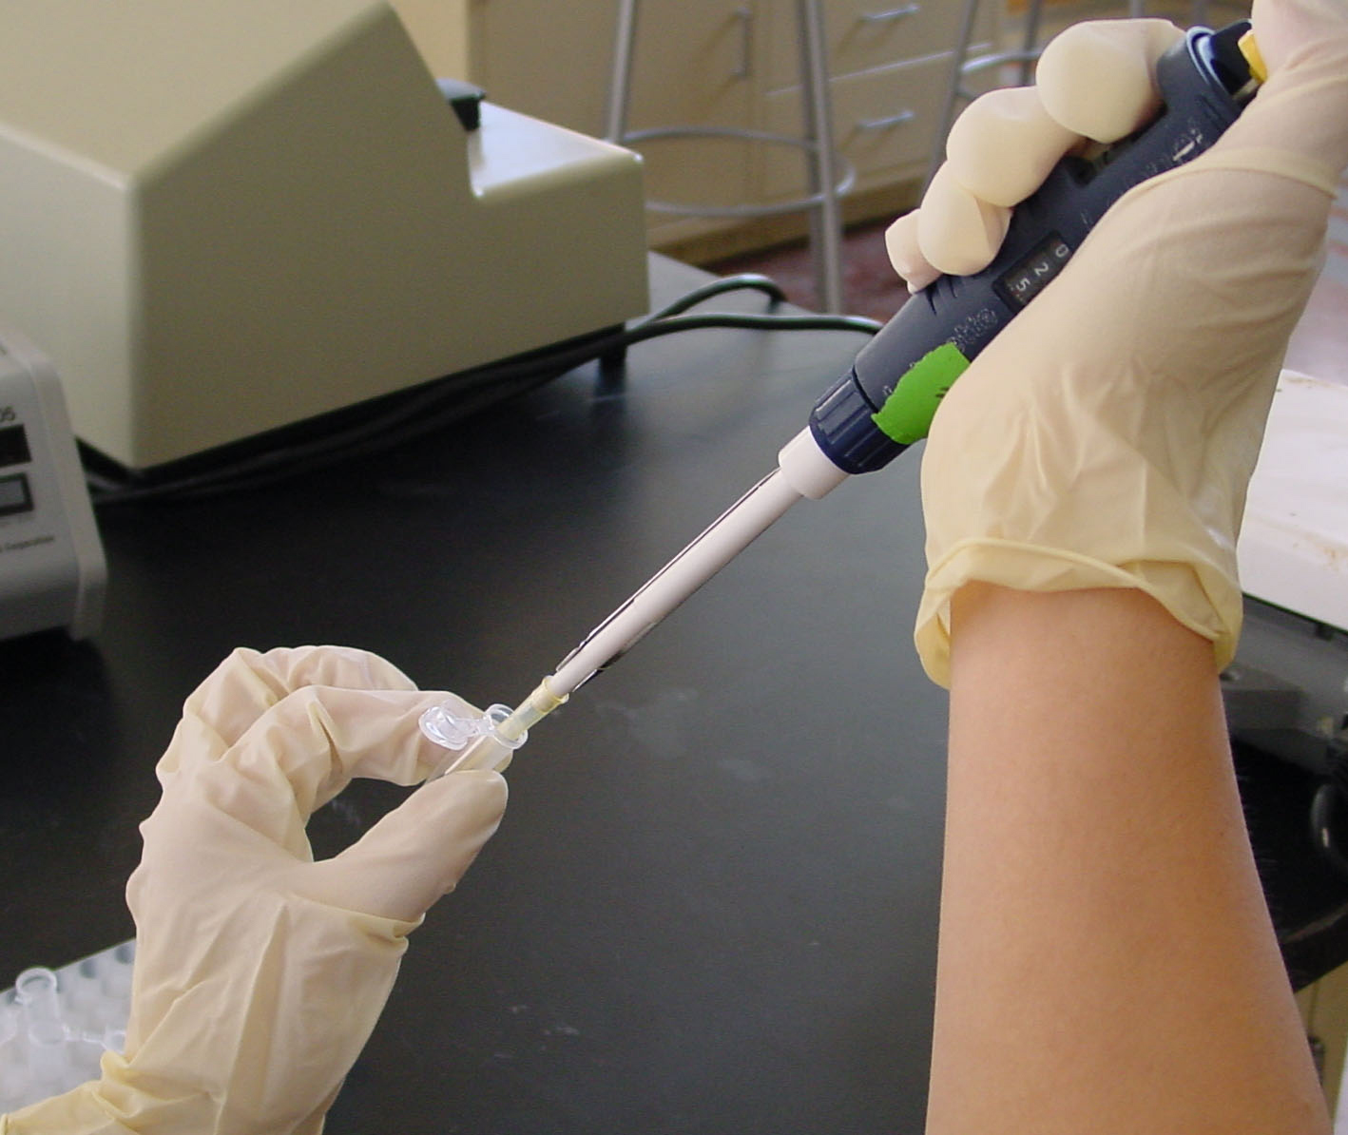
Measuring Very Small Volumes with Micropipets
Start with any of the micropipets
Show how to determine its size and range
Show how to hold it so display can be read.
Demonstrate how to read it
Demonstrate first and second stop
Demonstrate how to put a tip on and eject the tip.
Demonstrate how to take up and dispense a sample.

Slide 9
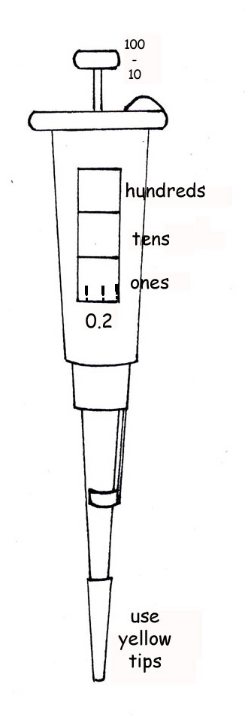
Measuring Very Small Volumes with Micropipets
Using the P-100 and yellow tips
Each partner measures 75.2 µL of one dye into their own 1.7 mL tube.
Demonstrate how to compare tube
Demonstrate to check it by sucking it up

Slide 10
Measuring Very Small Volumes with Micropipets
Using the P-10 and white tips
Each partner measures 9.85 µL of one dye into their own 1.7 mL tube.
Demonstrate how to compare tube
Demonstrate to check it by sucking it up

Slide 11
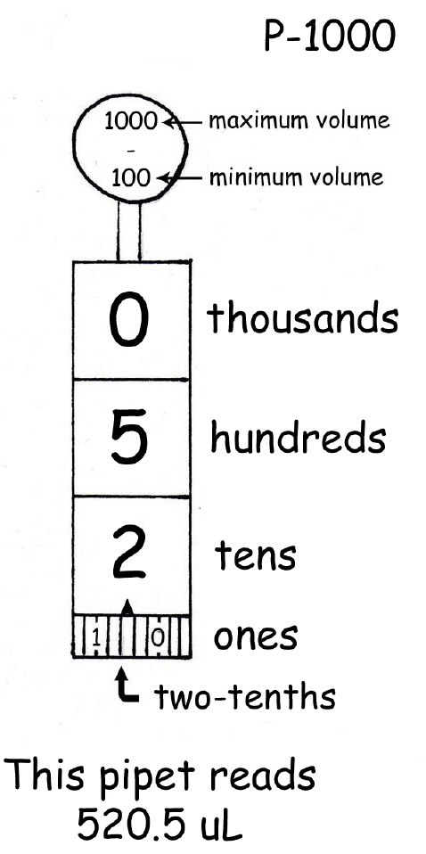
Measuring Very Small Volumes with Micropipets
Using the P-1000 and blue tips
Each partner measures 333 µL of one dye into their own 1.7 mL tube.
Demonstrate how to compare tube
Demonstrate to check it by sucking it up

Slide 12
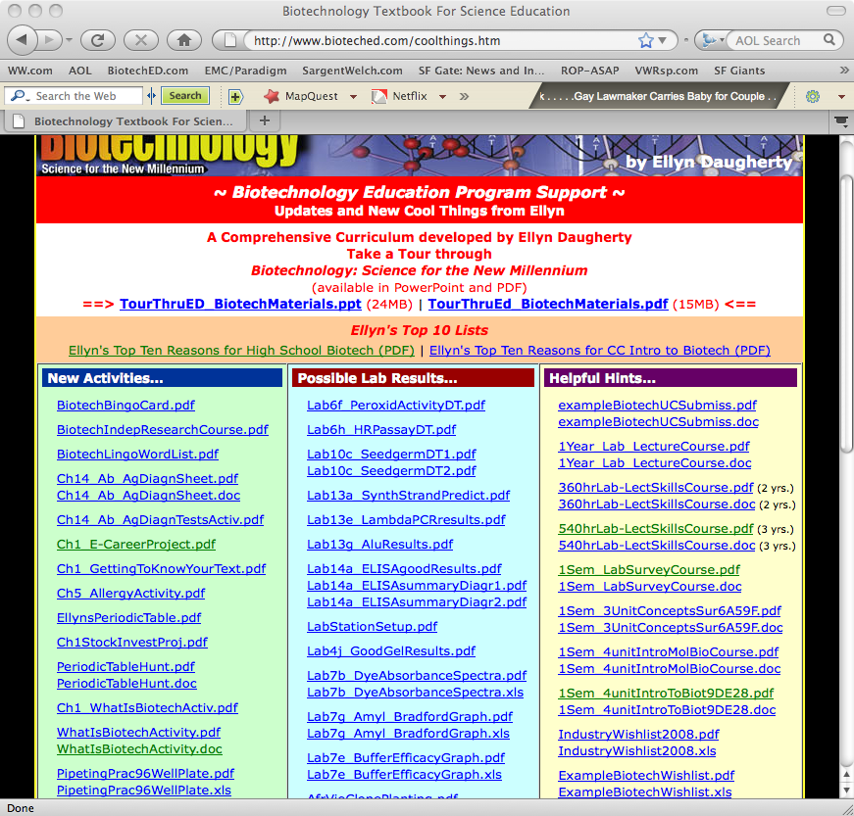
Now test your skill…. Micropipeting Secret Code

Slide 13
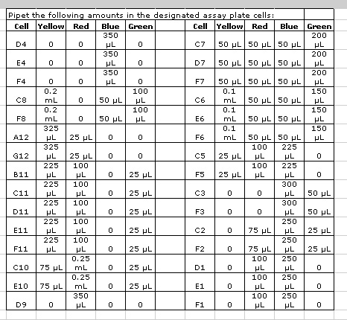
Micropipeting Secret Code

Slide 14
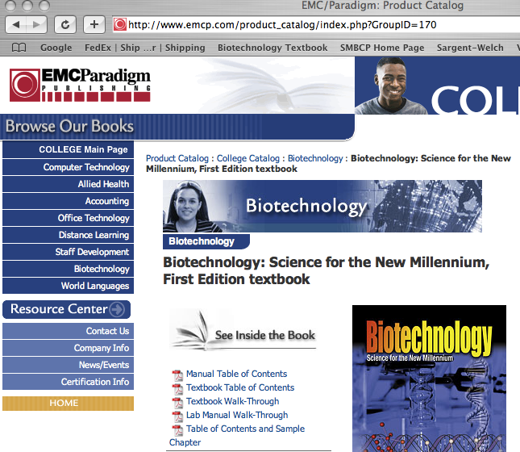
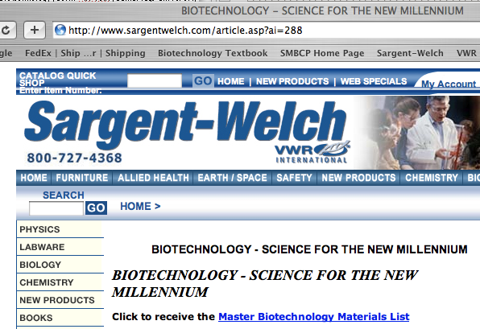
Get help starting or improving a biotech program !
Amy Naum, Biotech Category Manager
for materials/equipment support
VWR/Sargent Welch
www.sargentwelch.com/biotech
Amy_Naum@vwreducation.com 585-321-9422
Amber Fitzpatrick, Sales Account Representative
Amber_Fitzpatrick@vwreducation.com
702-33-.0855
Ellyn Daugherty
SM Biotech Career Pathway
www.SMBiotech.com
www.BiotechEd.com
www.emcp.com/biotech
ellyn@BiotechEd.com
650-400-9424

